Slide 1
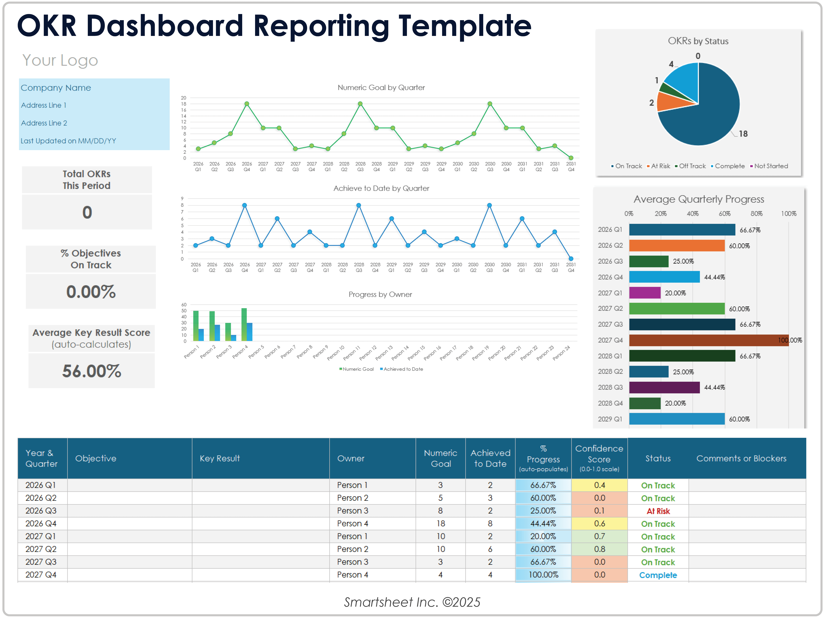
OKR Dashboard Reporting Template
How to Use This Template:
Use the OKR Dashboard Reporting Template in Excel to enter data that will populate the charts and graphs for your dashboard. Place screenshots of each element on the following slides to build out your OKR Dashboard Reporting Presentation.
Company Name
Address Line 1
Address Line 2
Last Updated on MM/DD/YY
Your Logo

Slide 2
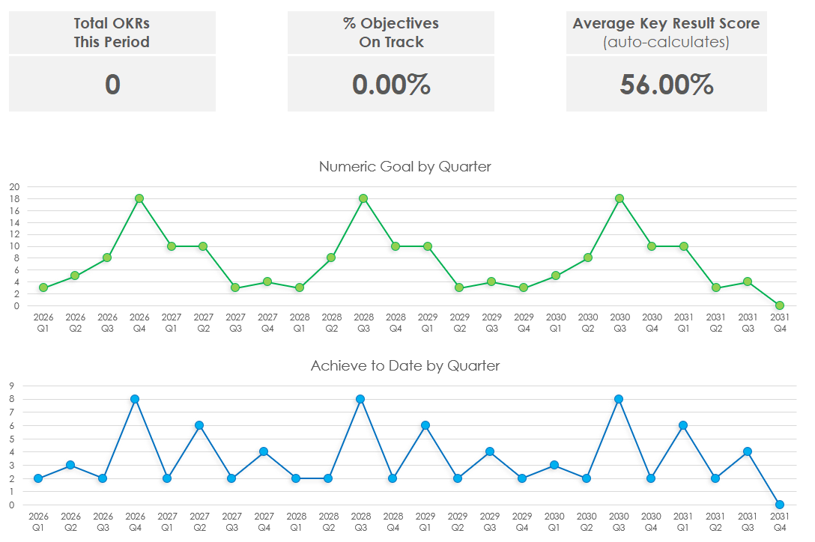
Example

Slide 3
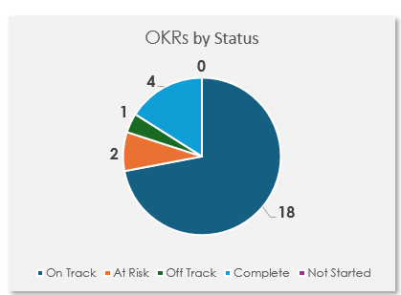
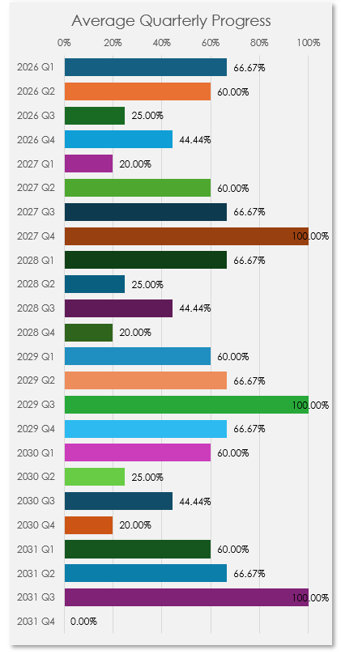
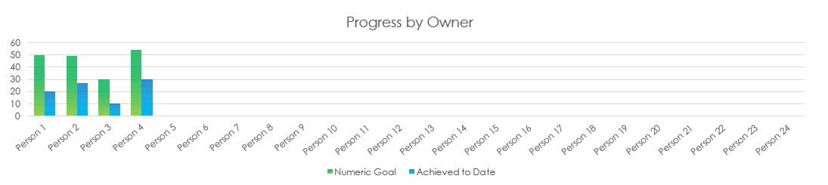
Example
Provided by Smartsheet, Inc.

Slide 4
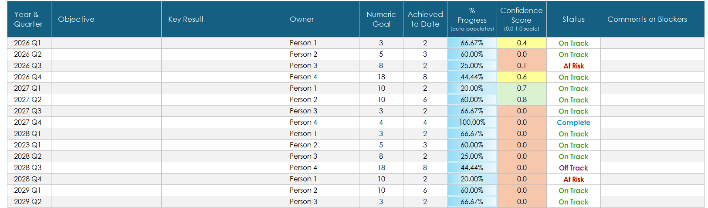
Example
Provided by Smartsheet, Inc.

Slide 5
DISCLAIMER Any articles, templates, or information provided by Smartsheet on the website are for reference only. While we strive to keep the information up to date and correct, we make no representations or warranties of any kind, express or implied, about the completeness, accuracy, reliability, suitability, or availability with respect to the website or the information, articles, templates, or related graphics contained on the website. Any reliance you place on such information is therefore strictly at your own risk.

