Slide 1
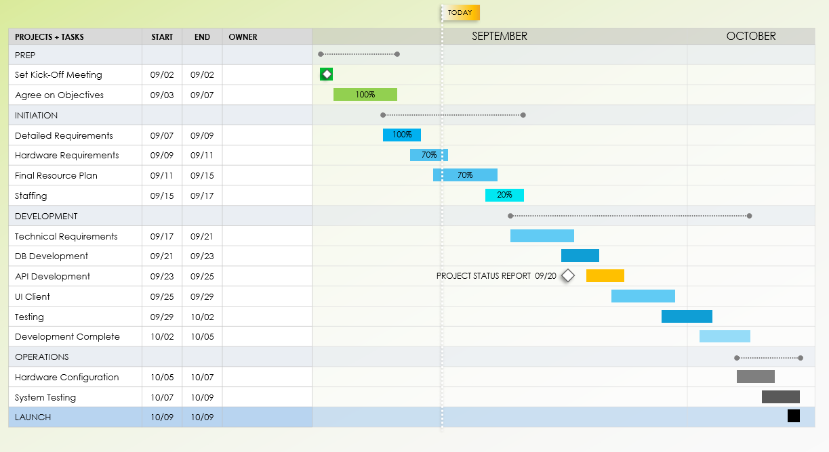
Software Development Gantt Chart Template
Notes for Using This Template
Enter Tasks, Start and End Dates, and Task Owners in the chart area.
Adjust bars for each task to represent the length of time over the span of the project. Add Percent of Task Complete and Additional Task Information within each bar or in the graph area.

Slide 2
Example
TODAY
PROJECTS + TASKS | START | END | OWNER | SEPTEMBER | OCTOBER
PREP
Set Kick-Off Meeting | 09/02 | 09/02
Agree on Objectives | 09/03 | 09/07
INITIATION
Detailed Requirements | 09/07 | 09/09
Hardware Requirements | 09/09 | 09/11
Final Resource Plan | 09/11 | 09/15
Staffing | 09/15 | 09/17
DEVELOPMENT
Technical Requirements | 09/17 | 09/21
DB Development | 09/21 | 09/23
API Development | 09/23 | 09/25
UI Client | 09/25 | 09/29
Testing | 09/29 | 10/02
Development Complete | 10/02 | 10/05
OPERATIONS
Hardware Configuration | 10/05 | 10/07
System Testing | 10/07 | 10/09
LAUNCH | 10/09 | 10/09
100%
100%
70%
70%
20%
PROJECT STATUS REPORT 09/20

Slide 3
TODAY
PROJECTS + TASKS | START | END | OWNER | MONTH 1 | MONTH 2 | MONTH 3
PREP
Set Kick-Off Meeting
Agree on Objectives
INITIATION
Detailed Requirements
Hardware Requirements
Final Resource Plan
Staffing
DEVELOPMENT
Technical Requirements
DB Development
API Development
UI Client
Testing
Development Complete
OPERATIONS
Hardware Configuration
System Testing
LAUNCH
TASK NOTES / MILESTONE 00/00
TASK NOTES / MILESTONE 00/00
TASK NOTES / MILESTONE 00/00
TASK NOTES / MILESTONE 00/00
Provided by Smartsheet, Inc.

Slide 4
DISCLAIMER Any articles, templates, or information provided by Smartsheet on the website are for reference only. While we strive to keep the information up to date and correct, we make no representations or warranties of any kind, express or implied, about the completeness, accuracy, reliability, suitability, or availability with respect to the website or the information, articles, templates, or related graphics contained on the website. Any reliance you place on such information is therefore strictly at your own risk.

