Slide 1
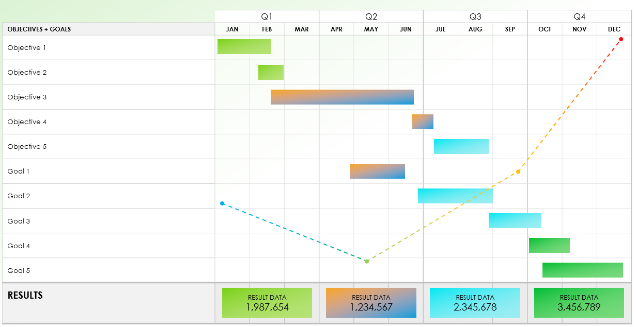
Quarterly Goals Gantt Chart Template
Notes for Using This Template
Enter Objectives and Goals in the chart area.
Adjust bars for each task to represent the length of time. Add Milestone Dates and additional information within each bar or in the graph area. Summarize Results in the bottom row.

Slide 2
Example
 | Q1 |  |  | Q2 |  |  | Q3 |  |  | Q4
OBJECTIVES + GOALS | JAN | FEB | MAR | APR | MAY | JUN | JUL | AUG | SEP | OCT | NOV | DEC
Objective 1
Objective 2
Objective 3
Objective 4
Objective 5
Goal 1
Goal 2
Goal 3
Goal 4
Goal 5
RESULTS
RESULT DATA
1,987,654
RESULT DATA
1,234,567
RESULT DATA
2,345,678
RESULT DATA
3,456,789

Slide 3
 | Q1 |  |  | Q2 |  |  | Q3 |  |  | Q4
OBJECTIVES + GOALS | JAN | FEB | MAR | APR | MAY | JUN | JUL | AUG | SEP | OCT | NOV | DEC
Objective 1
Objective 2
Objective 3
Objective 4
Objective 5
Goal 1
Goal 2
Goal 3
Goal 4
Goal 5
RESULTS
Notes
Notes
Notes
Notes
Notes
Notes
Notes
Notes
Notes
Notes
RESULT DATA
RESULT DATA
RESULT DATA
RESULT DATA
Provided by Smartsheet, Inc.

Slide 4
DISCLAIMER Any articles, templates, or information provided by Smartsheet on the website are for reference only. While we strive to keep the information up to date and correct, we make no representations or warranties of any kind, express or implied, about the completeness, accuracy, reliability, suitability, or availability with respect to the website or the information, articles, templates, or related graphics contained on the website. Any reliance you place on such information is therefore strictly at your own risk.

