Slide 1
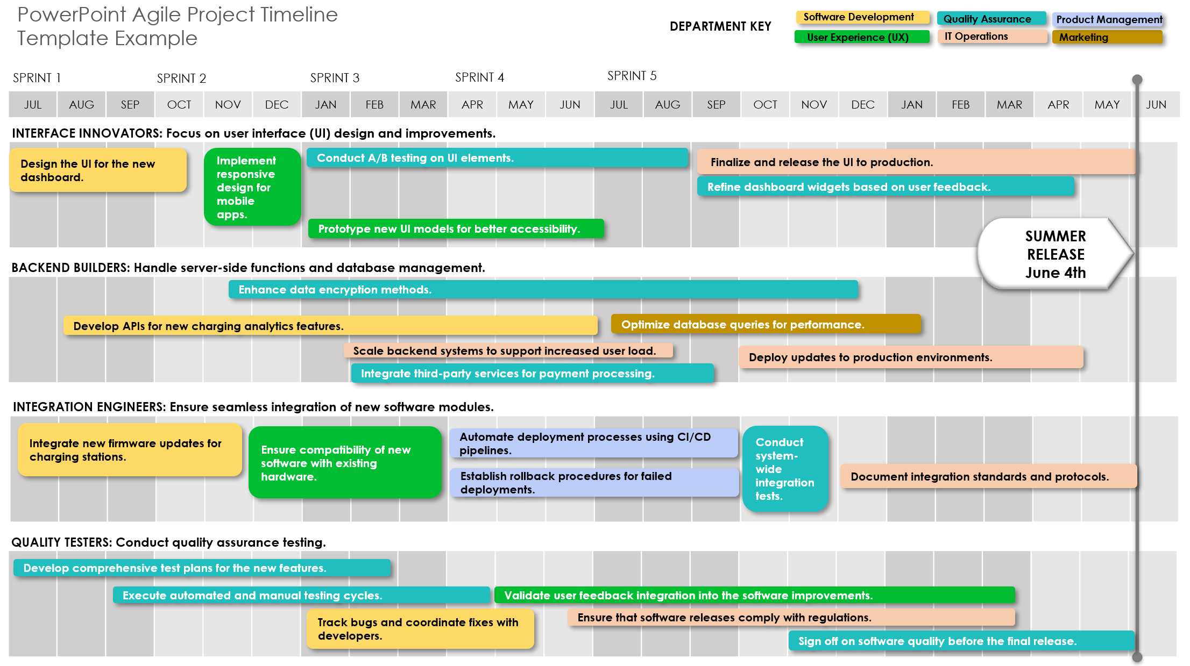
PowerPoint Agile Project Timeline Template
Notes for Using This Template
Enter departments in the Department Key area.
Adjust bars for each department to represent the task duration.
Add milestone dates and additional information within each bar or in the graph area as needed.

Slide 2
PowerPoint Agile Project Timeline
Department
Department
Department
DEPARTMENT KEY
Department
Department
Department
SPRINT 1
SPRINT 2
SPRINT 3
SPRINT 4
SPRINT 5
MILESTONE
MM/DD/YY
JUL | AUG | SEP | OCT | NOV | DEC | JAN | FEB | MAR | APR | MAY | JUN | JUL | AUG | SEP | OCT | NOV | DEC | JAN | FEB | MAR | APR | MAY | JUN
TEAM A
TEXT
TEXT
TEXT
TEAM B
TEXT
TEXT
TEXT
TEAM C
TEAM D

Slide 3
PowerPoint Agile Project Timeline
Template Example
Software Development
Quality Assurance
Product Management
DEPARTMENT KEY
User Experience (UX)
IT Operations
Marketing
SPRINT 1
SPRINT 2
SPRINT 3
SPRINT 4
SPRINT 5
JUL | AUG | SEP | OCT | NOV | DEC | JAN | FEB | MAR | APR | MAY | JUN | JUL | AUG | SEP | OCT | NOV | DEC | JAN | FEB | MAR | APR | MAY | JUN
INTERFACE INNOVATORS: Focus on user interface (UI) design and improvements.
Design the UI for the new dashboard.
Implement responsive design for mobile apps.
Conduct A/B testing on UI elements.
Finalize and release the UI to production.
Refine dashboard widgets based on user feedback.
Prototype new UI models for better accessibility.
SUMMER RELEASE
June 4th
BACKEND BUILDERS: Handle server-side functions and database management.
Enhance data encryption methods.
Develop APIs for new charging analytics features.
Optimize database queries for performance.
Scale backend systems to support increased user load.
Deploy updates to production environments.
Integrate third-party services for payment processing.
INTEGRATION ENGINEERS: Ensure seamless integration of new software modules.
Integrate new firmware updates for charging stations.
Ensure compatibility of new software with existing hardware.
Automate deployment processes using CI/CD pipelines.
Conduct system-wide integration tests.
Establish rollback procedures for failed deployments.
Document integration standards and protocols.
QUALITY TESTERS: Conduct quality assurance testing.
Develop comprehensive test plans for the new features.
Execute automated and manual testing cycles.
Validate user feedback integration into the software improvements.
Track bugs and coordinate fixes with developers.
Ensure that software releases comply with regulations.
Sign off on software quality before the final release.
Provided by Smartsheet, Inc.

Slide 4
DISCLAIMER Any articles, templates, or information provided by Smartsheet on the website are for reference only. While we strive to keep the information up to date and correct, we make no representations or warranties of any kind, express or implied, about the completeness, accuracy, reliability, suitability, or availability with respect to the website or the information, articles, templates, or related graphics contained on the website. Any reliance you place on such information is therefore strictly at your own risk.

