Slide 1
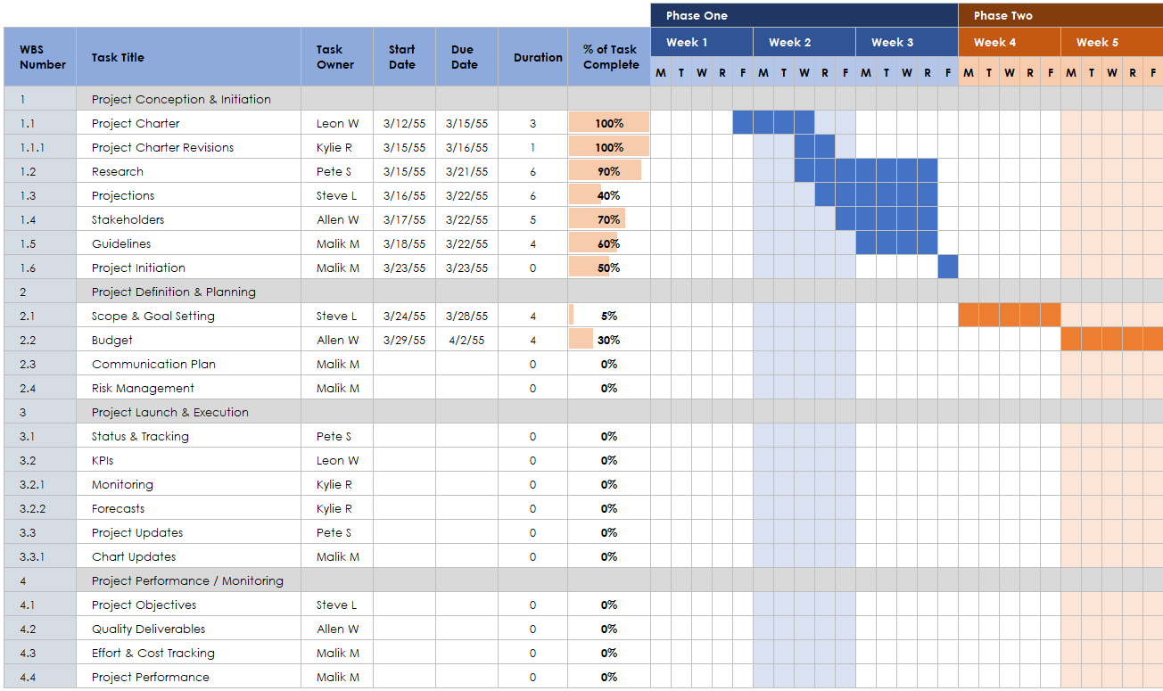
WBS Gantt Chart Presentation Template

Slide 2
 |  |  |  |  |  |  | Phase One |  |  |  |  |  |  |  |  |  |  |  |  |  |  | Phase Two
WBS Number | Task Title | Task Owner | Start Date | Due Date | Duration | % of Task Complete | Week 1 |  |  |  |  | Week 2 |  |  |  |  | Week 3 |  |  |  |  | Week 4 |  |  |  |  | Week 5 |  |  |  |  | Week 6
 |  |  |  |  |  |  | M | T | W | R | F | M | T | W | R | F | M | T | W | R | F | M | T | W | R | F | M | T | W | R | F | M | T | W | R | F
1 | Project Conception & Initiation
1.1 | Project Charter | Leon W | 3/12/55 | 3/15/55 | 3 | 100%
1.1.1 | Project Charter Revisions | Kylie R | 3/15/55 | 3/16/55 | 1 | 100%
1.2 | Research | Pete S | 3/15/55 | 3/21/55 | 6 | 90%
1.3 | Projections | Steve L | 3/16/55 | 3/22/55 | 6 | 40%
1.4 | Stakeholders | Allen W | 3/17/55 | 3/22/55 | 5 | 70%
1.5 | Guidelines | Malik M | 3/18/55 | 3/22/55 | 4 | 60%
1.6 | Project Initiation | Malik M | 3/23/55 | 3/23/55 | 0 | 50%
2 | Project Definition & Planning
2.1 | Scope & Goal Setting | Steve L | 3/24/55 | 3/28/55 | 4 | 5%
2.2 | Budget | Allen W | 3/29/55 | 4/2/55 | 4 | 30%
2.3 | Communication Plan | Malik M |  |  | 0 | 0%
2.4 | Risk Management | Malik M |  |  | 0 | 0%
3 | Project Launch & Execution
3.1 | Status & Tracking | Pete S |  |  | 0 | 0%
3.2 | KPIs | Leon W |  |  | 0 | 0%
3.2.1 | Monitoring | Kylie R |  |  | 0 | 0%
3.2.2 | Forecasts | Kylie R |  |  | 0 | 0%
3.3 | Project Updates | Pete S |  |  | 0 | 0%
3.3.1 | Chart Updates | Malik M |  |  | 0 | 0%
4 | Project Performance / Monitoring
4.1 | Project Objectives | Steve L |  |  | 0 | 0%
4.2 | Quality Deliverables | Allen W |  |  | 0 | 0%
4.3 | Effort & Cost Tracking | Malik M |  |  | 0 | 0%
4.4 | Project Performance | Malik M |  |  | 0 | 0%

Slide 3
 |  |  |  |  |  |  | Phase Three |  |  |  |  |  |  |  |  |  |  |  |  |  |  | Phase Four
WBS Number | Task Title | Task Owner | Start Date | Due Date | Duration | % of Task Complete | Week 7 |  |  |  |  | Week 8 |  |  |  |  | Week 9 |  |  |  |  | Week 10 |  |  |  |  | Week 11 |  |  |  |  | Week 12
 |  |  |  |  |  |  | M | T | W | R | F | M | T | W | R | F | M | T | W | R | F | M | T | W | R | F | M | T | W | R | F | M | T | W | R | F
1 | Project Conception & Initiation
1.1 | Project Charter | Leon W | 3/12/55 | 3/15/55 | 3 | 100%
1.1.1 | Project Charter Revisions | Kylie R | 3/15/55 | 3/16/55 | 1 | 100%
1.2 | Research | Pete S | 3/15/55 | 3/21/55 | 6 | 90%
1.3 | Projections | Steve L | 3/16/55 | 3/22/55 | 6 | 40%
1.4 | Stakeholders | Allen W | 3/17/55 | 3/22/55 | 5 | 70%
1.5 | Guidelines | Malik M | 3/18/55 | 3/22/55 | 4 | 60%
1.6 | Project Initiation | Malik M | 3/23/55 | 3/23/55 | 0 | 50%
2 | Project Definition & Planning
2.1 | Scope & Goal Setting | Steve L | 3/24/55 | 3/28/55 | 4 | 5%
2.2 | Budget | Allen W | 3/29/55 | 4/2/55 | 4 | 30%
2.3 | Communication Plan | Malik M |  |  | 0 | 0%
2.4 | Risk Management | Malik M |  |  | 0 | 0%
3 | Project Launch & Execution
3.1 | Status & Tracking | Pete S |  |  | 0 | 0%
3.2 | KPIs | Leon W |  |  | 0 | 0%
3.2.1 | Monitoring | Kylie R |  |  | 0 | 0%
3.2.2 | Forecasts | Kylie R |  |  | 0 | 0%
3.3 | Project Updates | Pete S |  |  | 0 | 0%
3.3.1 | Chart Updates | Malik M |  |  | 0 | 0%
4 | Project Performance / Monitoring
4.1 | Project Objectives | Steve L |  |  | 0 | 0%
4.2 | Quality Deliverables | Allen W |  |  | 0 | 0%
4.3 | Effort & Cost Tracking | Malik M |  |  | 0 | 0%
4.4 | Project Performance | Malik M |  |  | 0 | 0%

Slide 4
 |  |  |  |  |  |  | Phase One |  |  |  |  |  |  |  |  |  |  |  |  |  |  | Phase Two
WBS Number | Task Title | Task Owner | Start Date | Due Date | Duration | % of Task Complete | Week 1 |  |  |  |  | Week 2 |  |  |  |  | Week 3 |  |  |  |  | Week 4 |  |  |  |  | Week 5 |  |  |  |  | Week 6
 |  |  |  |  |  |  | M | T | W | R | F | M | T | W | R | F | M | T | W | R | F | M | T | W | R | F | M | T | W | R | F | M | T | W | R | F
1
1.1
1.1.1
1.2
1.3
1.4
1.5
1.6
2
2.1
2.2
2.3
2.4
3
3.1
3.2
3.2.1
3.2.2
3.3
3.3.1
4
4.1
4.2
4.3
4.4

Slide 5
 |  |  |  |  |  |  | Phase Three |  |  |  |  |  |  |  |  |  |  |  |  |  |  | Phase Four
WBS Number | Task Title | Task Owner | Start Date | Due Date | Duration | % of Task Complete | Week 7 |  |  |  |  | Week 8 |  |  |  |  | Week 9 |  |  |  |  | Week 10 |  |  |  |  | Week 11 |  |  |  |  | Week 12
 |  |  |  |  |  |  | M | T | W | R | F | M | T | W | R | F | M | T | W | R | F | M | T | W | R | F | M | T | W | R | F | M | T | W | R | F
1
1.1
1.1.1
1.2
1.3
1.4
1.5
1.6
2
2.1
2.2
2.3
2.4
3
3.1
3.2
3.2.1
3.2.2
3.3
3.3.1
4
4.1
4.2
4.3
4.4
Provided by Smartsheet, Inc.

Slide 6
DISCLAIMER Any articles, templates, or information provided by Smartsheet on the website are for reference only. While we strive to keep the information up to date and correct, we make no representations or warranties of any kind, express or implied, about the completeness, accuracy, reliability, suitability, or availability with respect to the website or the information, articles, templates, or related graphics contained on the website. Any reliance you place on such information is therefore strictly at your own risk.

