Slide 1
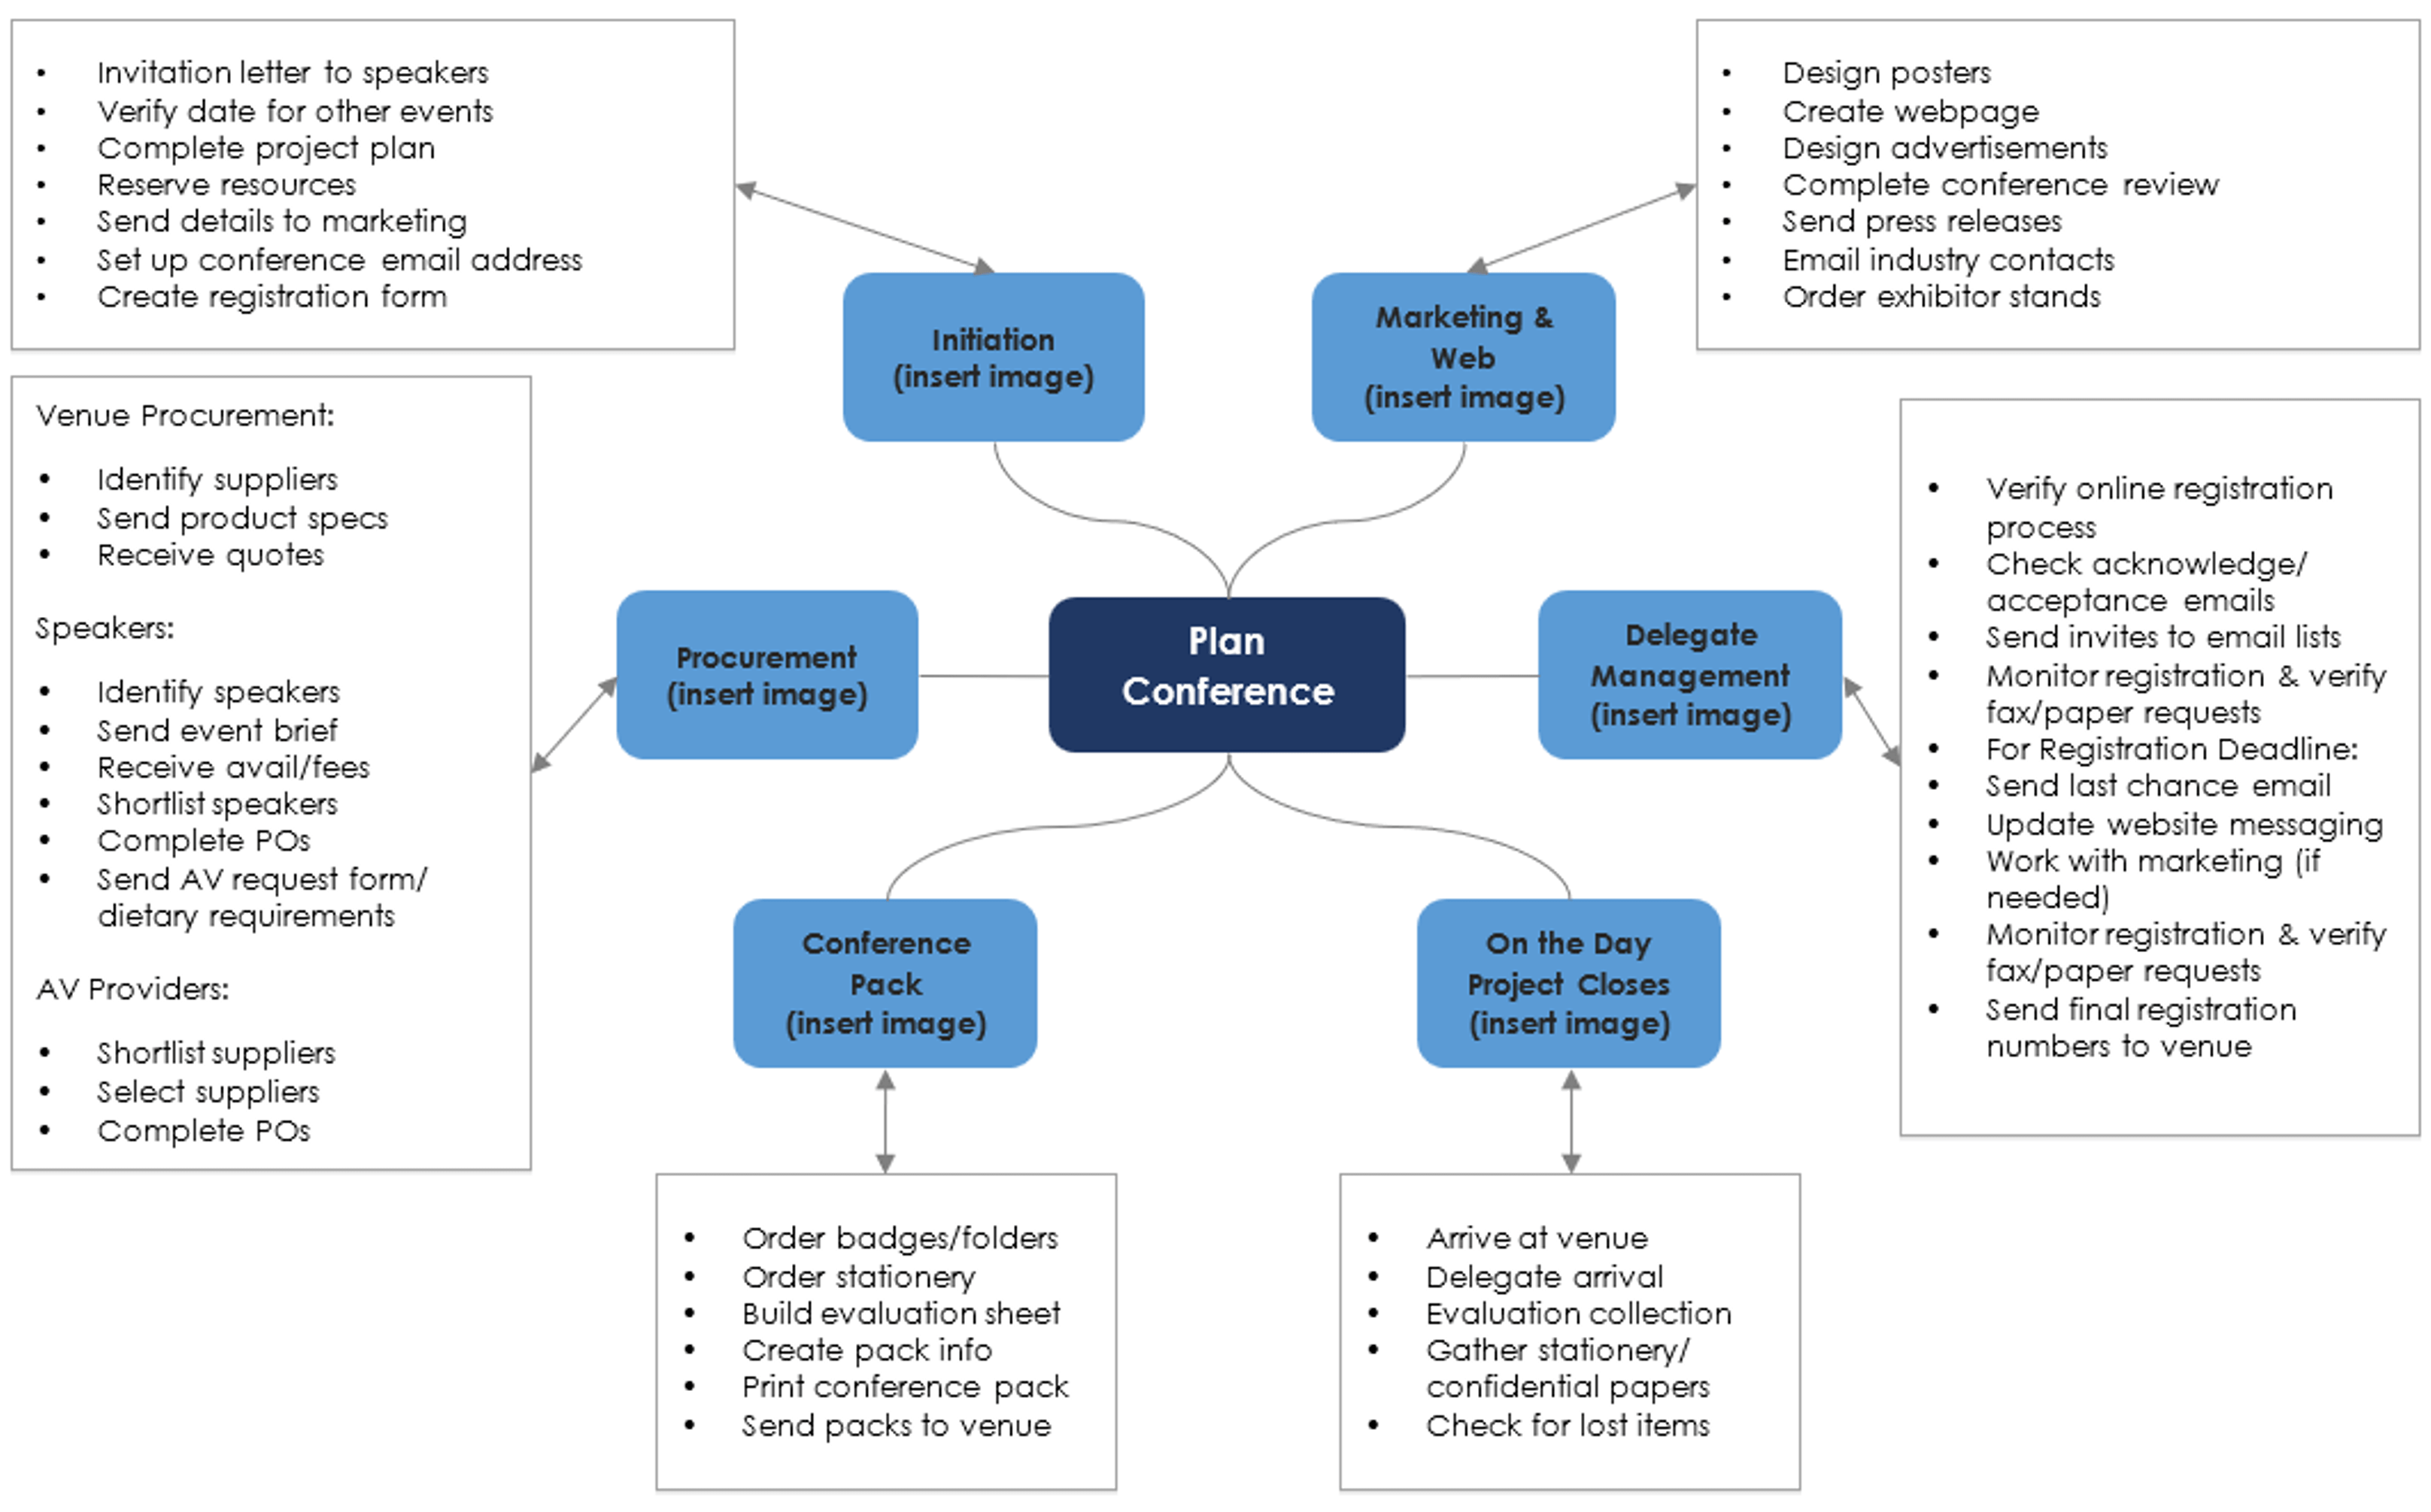
Conference Planning Mindmap Template

Slide 2
Invitation letter to speakers
Verify date for other events
Complete project plan
Reserve resources
Send details to marketing
Set up conference email address
Create registration form
Design posters
Create webpage
Design advertisements
Complete conference review
Send press releases
Email industry contacts
Order exhibitor stands
Initiation
(insert image)
Marketing & Web
(insert image)
Venue Procurement:
Identify suppliers
Send product specs
Receive quotes
Speakers:
Identify speakers
Send event brief
Receive avail/fees
Shortlist speakers
Complete POs
Send AV request form/ dietary requirements
AV Providers:
Shortlist suppliers
Select suppliers
Complete POs
Verify online registration process
Check acknowledge/acceptance emails
Send invites to email lists
Monitor registration & verify fax/paper requests
For Registration Deadline:
Send last chance email
Update website messaging
Work with marketing (if needed)
Monitor registration & verify fax/paper requests
Send final registration numbers to venue
Procurement
(insert image)
Delegate Management
(insert image)
Plan Conference
Conference Pack
(insert image)
On the Day Project Closes
(insert image)
Order badges/folders
Order stationery
Build evaluation sheet
Create pack info
Print conference pack
Send packs to venue
Arrive at venue
Delegate arrival
Evaluation collection
Gather stationery/confidential papers
Check for lost items
Provided by Smartsheet, Inc.

Slide 3
DISCLAIMER Any articles, templates, or information provided by Smartsheet on the website are for reference only. While we strive to keep the information up to date and correct, we make no representations or warranties of any kind, express or implied, about the completeness, accuracy, reliability, suitability, or availability with respect to the website or the information, articles, templates, or related graphics contained on the website. Any reliance you place on such information is therefore strictly at your own risk.

