Slide 1
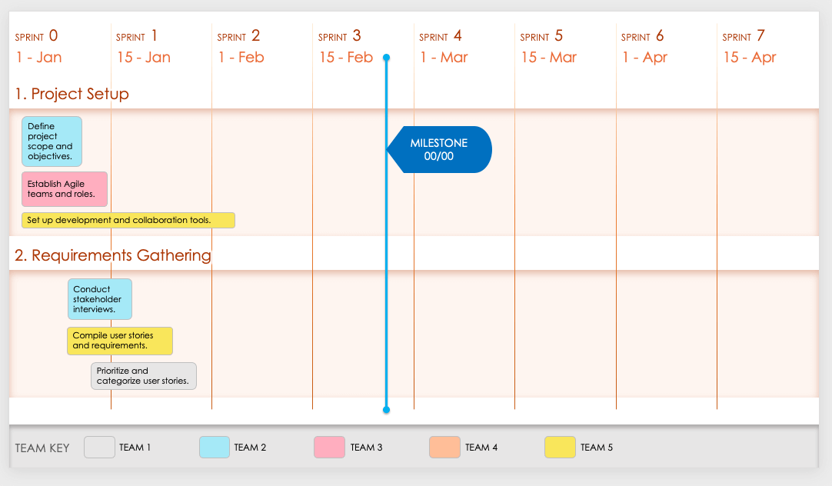
Agile Product Sprint Roadmap Template
This sprint-by-sprint roadmap template allows you to specify project- or product-development deliverables within a certain timebox to hit feature- or project-related milestones. You can specify team-by-team user story and task details, sprint requirements, and their relation to product development’s monthly or quarterly goals. This sprint-specific, Agile-ready template is the perfect way to plan sprints within your product roadmap and to account for each team’s efforts. This template is perfect for when you’re planning the activities for upcoming sprints and need to ensure all team members are aligned on short-term goals.
TO USE THIS TEMPLATE:
Adjust number of Sprints to meet your plan.
Enter Sprint Start Dates.
Apply Teams or Team Members to the Team Key.
Duplicate the initial slide with Dates and Teams to represent each Phase / Category.
Enter Tasks and Milestones.

Slide 2
SPRINT 0
SPRINT 1
SPRINT 2
SPRINT 3
SPRINT 4
SPRINT 5
SPRINT 6
SPRINT 7
00/00
00/00
00/00
00/00
00/00
00/00
00/00
00/00
1. Category / Phase One
MILESTONE
00/00
2. Category / Phase Two
TEAM KEY
TEAM 1
TEAM 2
TEAM 3
TEAM 4
TEAM 5
Provided by Smartsheet, Inc.

Slide 3
DISCLAIMER Any articles, templates, or information provided by Smartsheet on the website are for reference only. While we strive to keep the information up to date and correct, we make no representations or warranties of any kind, express or implied, about the completeness, accuracy, reliability, suitability, or availability with respect to the website or the information, articles, templates, or related graphics contained on the website. Any reliance you place on such information is therefore strictly at your own risk.

