Slide 1
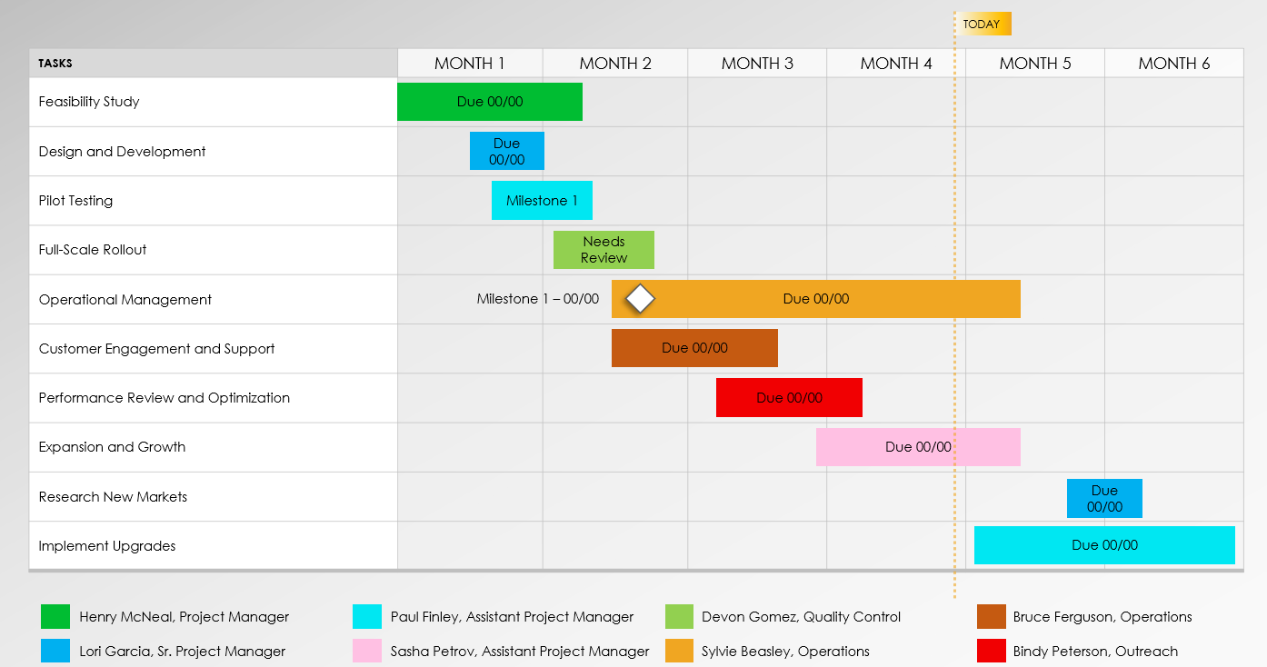
Basic Implementation Plan Presentation Template Example
Notes for Using This Template
Phasing Slide: Enter the phasing data and details that represent your plan and process. Adjust phasing fields on the next slide to suit your plan.
Implementation Slide: Enter Project Tasks in the chart area. Enter Label Owners in the key below the chart. Adjust bars to represent the length of time per task. Add Start and End Dates, Due Dates, Milestone Dates, or additional Task Information within each bar or in the chart area.

Slide 2
Phase 1
Phase 2
Phase 3
Phase 4
Design and Development
Pilot Testing
Feasibility Study
Full-Scale Rollout
Survey potential locations for charging stations.
Finalize designs for charging stations and accompanying infrastructure.
Launch marketing campaigns targeting potential users.
Identify a limited region for pilot installation.
Conduct a market analysis to identify target customer segment.
Develop software solutions for payment, station monitoring, and user interface.
Collect user feedback on station performance and usability.
Begin phased installation of charging stations across targeted regions.
Estimate initial investment and potential ROI.
Secure required permits and approvals for installation.
Address any technical glitches or challenges identified during the pilot.
Train personnel on station maintenance and customer support.
Additional details …
Additional details …
Additional details …
Additional details …
Example

Slide 3
TODAY
Tasks | Month 1 | Month 2 | Month 3 | Month 4 | Month 5 | Month 6
Feasibility Study
Design and Development
Pilot Testing
Full-Scale Rollout
Operational Management
Customer Engagement and Support
Performance Review and Optimization
Expansion and Growth
Research New Markets
Implement Upgrades
Due 00/00
Due 00/00
Milestone 1
Needs Review
Milestone 1 – 00/00
Due 00/00
Due 00/00
Due 00/00
Due 00/00
Due 00/00
Due 00/00
Henry McNeal, Project Manager
Paul Finley, Assistant Project Manager
Devon Gomez, Quality Control
Bruce Ferguson, Operations
Lori Garcia, Sr. Project Manager
Sasha Petrov, Assistant Project Manager
Sylvie Beasley, Operations
Bindy Peterson, Outreach
Example

Slide 4
Phase 1
Phase 2
Phase 3
Phase 4
Phase Title
Phase Title
Phase Title
Phase Title
Description
Description
Description
Description
Description
Description
Description
Description
Description
Description
Description
Description
Description
Description
Description
Description

Slide 5
TODAY
Tasks | Month 1 | Month 2 | Month 3 | Month 4 | Month 5 | Month 6
Task 1
Task 2
Due 00/00
Due 00/00
Milestone 1
Needs Review
Milestone 1 – 00/00
Due 00/00
Due 00/00
Due 00/00
Due 00/00
Due 00/00
Due 00/00
Name, Title
Name, Title
Name, Title
Name, Title
Name, Title
Name, Title
Name, Title
Name, Title
Provided by Smartsheet, Inc.

Slide 6
DISCLAIMER Any articles, templates, or information provided by Smartsheet on the website are for reference only. While we strive to keep the information up to date and correct, we make no representations or warranties of any kind, express or implied, about the completeness, accuracy, reliability, suitability, or availability with respect to the website or the information, articles, templates, or related graphics contained on the website. Any reliance you place on such information is therefore strictly at your own risk.

