Slide 1
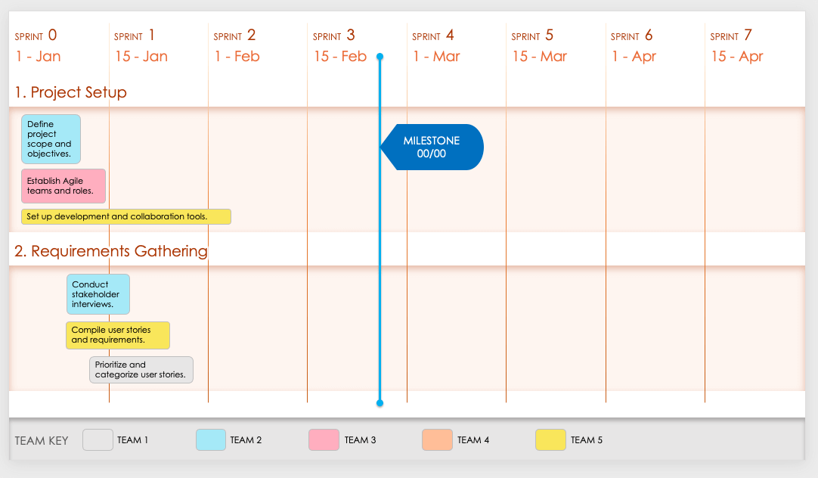
Agile Product Sprint Roadmap Template Example
This sprint-by-sprint roadmap template allows you to specify project- or product-development deliverables within a certain timebox to hit feature- or project-related milestones. You can specify team-by-team user story and task details, sprint requirements, and their relation to product development’s monthly or quarterly goals. This sprint-specific, Agile-ready template is the perfect way to plan sprints within your product roadmap and to account for each team’s efforts. This template is perfect for when you’re planning the activities for upcoming sprints and need to ensure all team members are aligned on short-term goals.

Slide 2
SPRINT 0
SPRINT 1
SPRINT 2
SPRINT 3
SPRINT 4
SPRINT 5
SPRINT 6
SPRINT 7
1 - Jan
15 - Jan
1 - Feb
15 - Feb
1 - Mar
15 - Mar
1 - Apr
15 - Apr
1. Project Setup
Define project scope and objectives.
MILESTONE
00/00
Establish Agile teams and roles.
Set up development and collaboration tools.
2. Requirements Gathering
Conduct stakeholder interviews.
Compile user stories and requirements.
Prioritize and categorize user stories.
TEAM KEY
TEAM 1
TEAM 2
TEAM 3
TEAM 4
TEAM 5

Slide 3
SPRINT 0
SPRINT 1
SPRINT 2
SPRINT 3
SPRINT 4
SPRINT 5
SPRINT 6
SPRINT 7
1 - Jan
15 - Jan
1 - Feb
15 - Feb
1 - Mar
15 - Mar
1 - Apr
15 - Apr
3. Design and Prototyping
Create initial design mockups.
MILESTONE
00/00
Develop interactive prototypes.
Conduct user testing and gather feedback.
4. Software Development - Phase 1
Develop core functionalities.
Implement user interface components.
Integrate back-end and front-end systems.
TEAM KEY
TEAM 1
TEAM 2
TEAM 3
TEAM 4
TEAM 5

Slide 4
SPRINT 0
SPRINT 1
SPRINT 2
SPRINT 3
SPRINT 4
SPRINT 5
SPRINT 6
SPRINT 7
1 - Jan
15 - Jan
1 - Feb
15 - Feb
1 - Mar
15 - Mar
1 - Apr
15 - Apr
5. Testing and Quality Assurance
Perform unit testing.
Conduct integration testing.
Execute system and acceptance testing.
MILESTONE
00/00
6. Software Development - Phase 2
Develop advanced features.
Enhance user experience based on feedback.
Optimize performance and scalability.
TEAM KEY
TEAM 1
TEAM 2
TEAM 3
TEAM 4
TEAM 5

Slide 5
SPRINT 0
SPRINT 1
SPRINT 2
SPRINT 3
SPRINT 4
SPRINT 5
SPRINT 6
SPRINT 7
1 - Jan
15 - Jan
1 - Feb
15 - Feb
1 - Mar
15 - Mar
1 - Apr
15 - Apr
7. Deployment and Delivery
Prepare deployment environment.
Deploy beta version for real-world testing.
Finalize and release product.
MILESTONE
00/00
8. Post-Launch Support and Maintenance
Monitor and address immediate post-launch issues.
Gather user feedback for future updates.
Plan and prioritize ongoing maintenance tasks.
TEAM KEY
TEAM 1
TEAM 2
TEAM 3
TEAM 4
TEAM 5
Provided by Smartsheet, Inc.

Slide 6
DISCLAIMER Any articles, templates, or information provided by Smartsheet on the website are for reference only. While we strive to keep the information up to date and correct, we make no representations or warranties of any kind, express or implied, about the completeness, accuracy, reliability, suitability, or availability with respect to the website or the information, articles, templates, or related graphics contained on the website. Any reliance you place on such information is therefore strictly at your own risk.

