Slide 1
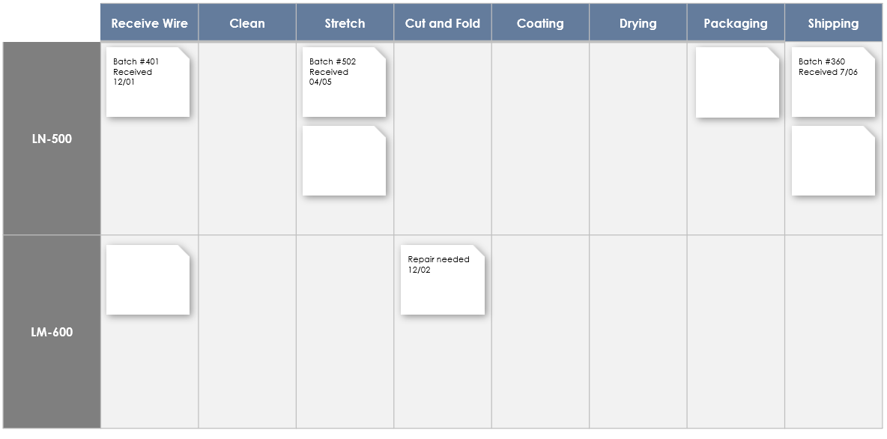
Manufacturing Kanban Board
Provided by Smartsheet, Inc.

Slide 2
Example
Title of Kanban: Hangar Emporium
 | Receive Wire | Clean | Stretch | Cut and Fold | Coating | Drying | Packaging | Shipping
LN-500
LM-600
Batch #401 Received 12/01
Batch #502 Received 04/05
Batch #360 Received 7/06
Repair needed 12/02

Slide 3
Title of Kanban: Name
 | Category | Category | Category | Category | Category | Category | Category | Category
Name
Name
Task
Task
Task
Task
Task
Task
Task
Task
Task
Task
Task
Task
Task
Task
Task
Task
Task
Task
Task
Task
Task
Task
Task
Task
Task
Task
Task
Task
Task
Task
Task
Task

Slide 4
DISCLAIMER Any articles, templates, or information provided by Smartsheet on the website are for reference only. While we strive to keep the information up to date and correct, we make no representations or warranties of any kind, express or implied, about the completeness, accuracy, reliability, suitability, or availability with respect to the website or the information, articles, templates, or related graphics contained on the website. Any reliance you place on such information is therefore strictly at your own risk.

