Slide 1

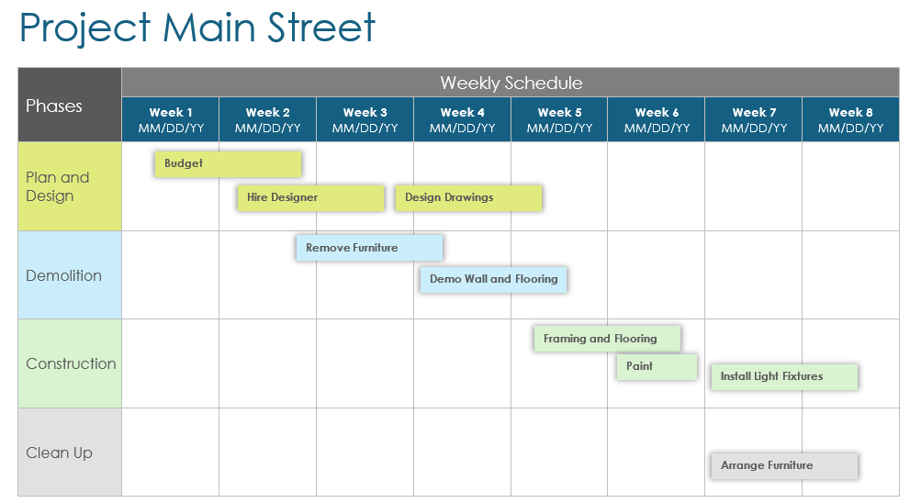
Weekly Construction Schedule Template Example

Slide 2

Example
Project Main Street
Phases | Weekly Schedule
 | Week 1 MM/DD/YY | Week 2 MM/DD/YY | Week 3 MM/DD/YY | Week 4 MM/DD/YY | Week 5 MM/DD/YY | Week 6 MM/DD/YY | Week 7 MM/DD/YY | Week 8 MM/DD/YY
Plan and Design
Demolition
Construction
Clean Up
Budget
Hire Designer
Design Drawings
Remove Furniture
Demo Wall and Flooring
Framing and Flooring
Paint
Install Light Fixtures
Arrange Furniture
Task Name
Task Name
Task Name
Task Name
Task Name
Task Name
Task Name
Task Name

Slide 3
Project Name
Phases | Weekly Schedule
 | Week 1 MM/DD/YY | Week 2 MM/DD/YY | Week 3 MM/DD/YY | Week 4 MM/DD/YY | Week 5 MM/DD/YY | Week 6 MM/DD/YY | Week 7 MM/DD/YY | Week 8 MM/DD/YY
Phase 1
Phase 2
Phase 3
Phase 4
Task Name
Task Name
Task Name
Task Name
Task Name
Task Name
Task Name
Task Name

Slide 4
DISCLAIMER Any articles, templates, or information provided by Smartsheet on the website are for reference only. While we strive to keep the information up to date and correct, we make no representations or warranties of any kind, express or implied, about the completeness, accuracy, reliability, suitability, or availability with respect to the website or the information, articles, templates, or related graphics contained on the website. Any reliance you place on such information is therefore strictly at your own risk.

