Slide 1


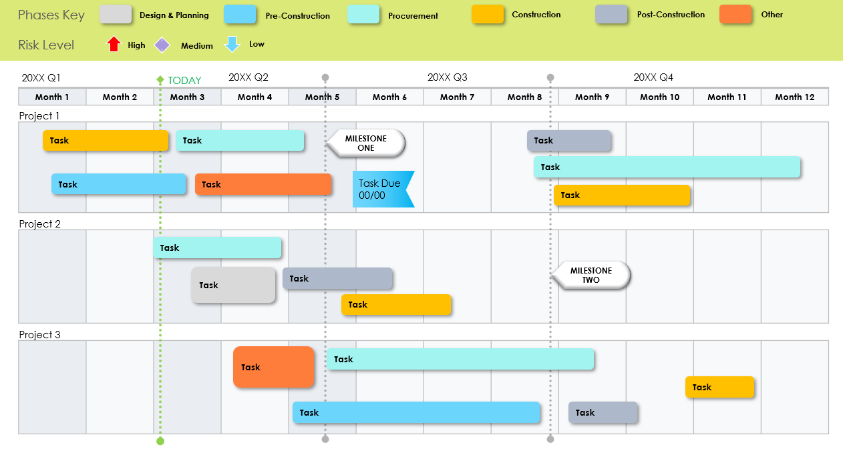
Multiple Construction Project Timeline Template
Notes for Using This Template
Enter the months and activities represented in your plan.
Adjust bars to represent the length of time per task.
Add start and end dates, milestone dates, and additional information within each bar or in the chart area.

Slide 2
Phases Key
Design & Planning
Pre-Construction
Procurement
Construction
Post-Construction
Other
Risk Level
High
Medium
Low
20XX Q1
TODAY
20XX Q2
20XX Q3
20XX Q4
Month 1 | Month 2 | Month 3 | Month 4 | Month 5 | Month 6 | Month 7 | Month 8 | Month 9 | Month 10 | Month 11 | Month 12
Project 1
Project 2
Project 3
Task
Task
MILESTONE ONE
Task
Task
Task
Task
Task Due
00/00
Task
Task
Task
Task
MILESTONE TWO
Task
Task
Task
Task
Task
Task
Multiple Construction Project Timeline Example

Slide 3
Phases Key
Phase
Phase
Phase
Phase
Phase
Phase
Risk Level
High
Medium
Low
20XX Q1
TODAY
20XX Q2
20XX Q3
20XX Q4
Month 1 | Month 2 | Month 3 | Month 4 | Month 5 | Month 6 | Month 7 | Month 8 | Month 9 | Month 10 | Month 11 | Month 12
Project 1
Project 2
Project 3
Task
Task
MILESTONE ONE
Task
Task
Task
Task
MILESTONE TWO
Task
Task Due
00/00
Multiple Construction Project Timeline

Slide 4
DISCLAIMER Any articles, templates, or information provided by Smartsheet on the website are for reference only. While we strive to keep the information up to date and correct, we make no representations or warranties of any kind, express or implied, about the completeness, accuracy, reliability, suitability, or availability with respect to the website or the information, articles, templates, or related graphics contained on the website. Any reliance you place on such information is therefore strictly at your own risk.

