Slide 1
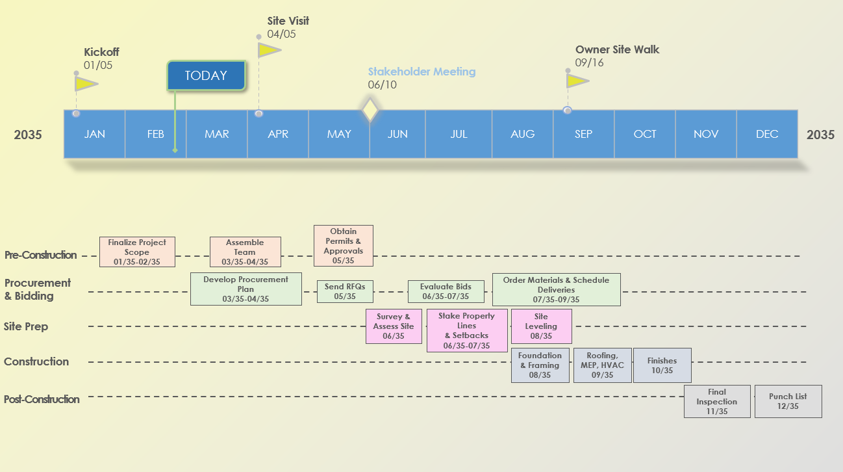
Monthly Construction Timeline Template Example
Template Features: This template features a yearly Gantt chart for easy task and milestone adjustments.

Slide 2
Example
Site Visit
04/05
Kickoff
01/05
Owner Site Walk
09/16
TODAY
Stakeholder Meeting
06/10
JAN | FEB | MAR | APR | MAY | JUN | JUL | AUG | SEP | OCT | NOV | DEC
2035
2035
Obtain Permits & Approvals
05/35
Pre-Construction
Finalize Project Scope
01/35-02/35
Assemble Team
03/35-04/35
Procurement & Bidding
Develop Procurement Plan
03/35-04/35
Send RFQs
05/35
Evaluate Bids
06/35-07/35
Order Materials & Schedule Deliveries
07/35-09/35
Site Prep
Survey & Assess Site
06/35
Stake Property Lines & Setbacks
06/35-07/35
Site Leveling
08/35
Construction
Foundation & Framing
08/35
Roofing, MEP, HVAC
09/35
Finishes
10/35
Post-Construction
Final Inspection
11/35
Punch List
12/35

Slide 3
Milestone 2
MM/DD
Milestone 6
MM/DD
Milestone 1
MM/DD
Milestone 3
MM/DD
Milestone 5
MM/DD
TODAY
EVENT 1
MM/DD
EVENT 2
MM/DD
JAN | FEB | MAR | APR | MAY | JUN | JUL | AUG | SEP | OCT | NOV | DEC
20XX
20XX
Phase 1
Task Description
MM/DD
Task Description
MM/DD
Task Description
MM/DD
Phase 2
Task Description
MM/DD
Task Description
MM/DD
Phase 3
Task Description
MM/DD
Task Description
MM/DD
Task Description
MM/DD
Phase 4
Task Description
Task Description
MM/DD
Phase 5
Task Description
MM/DD
Task Description
MM/DD
Phase 6
Task Description
MM/DD
Task Description
MM/DD

Slide 4
DISCLAIMER Any articles, templates, or information provided by Smartsheet on the website are for reference only. While we strive to keep the information up to date and correct, we make no representations or warranties of any kind, express or implied, about the completeness, accuracy, reliability, suitability, or availability with respect to the website or the information, articles, templates, or related graphics contained on the website. Any reliance you place on such information is therefore strictly at your own risk.

