Slide 1


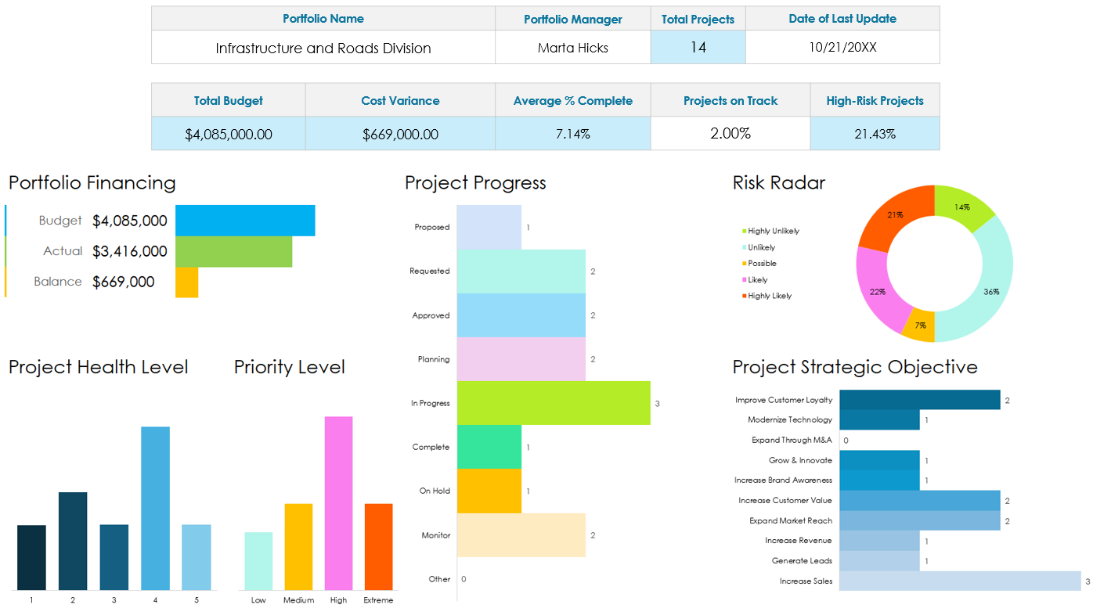
Construction Project Portfolio Management Dashboard Presentation Template
Use the Construction Project Portfolio Management Dashboard Template in Excel to enter data that will populate the charts and graphs for your dashboard. Place screenshots of each element on the following slides to build out your Construction Project Portfolio Management Dashboard Presentation.

Slide 2
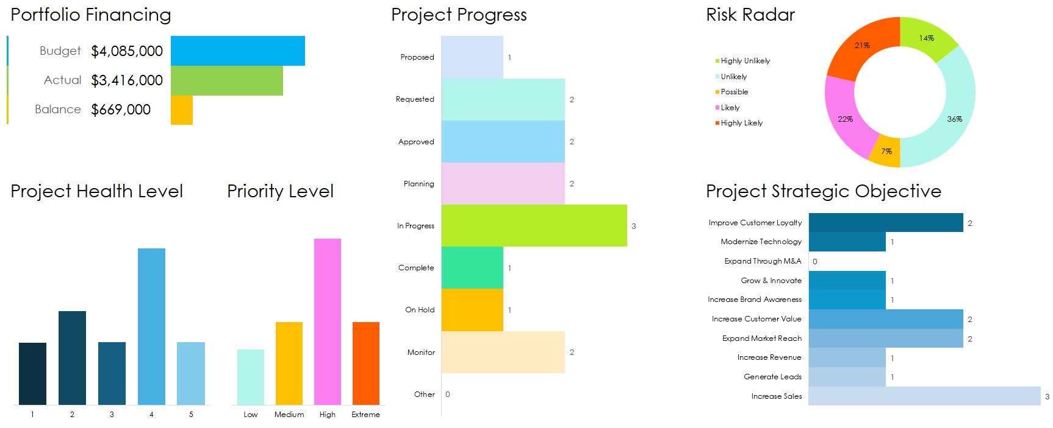
Portfolio Name |  |  |  |  | Portfolio Manager | Total Projects | Date of Last Update
Infrastructure and Roads Division |  |  |  |  | Marta Hicks | 14 | 10/21/20XX
Total Budget |  |  | Cost Variance |  | Average % Complete | Projects on Track |  | High-Risk Projects
$4,085,000.00 |  |  | $669,000.00 |  | 7.14% | 2.00% |  | 21.43%
EXAMPLE

Slide 3
DISCLAIMER Any articles, templates, or information provided by Smartsheet on the website are for reference only. While we strive to keep the information up to date and correct, we make no representations or warranties of any kind, express or implied, about the completeness, accuracy, reliability, suitability, or availability with respect to the website or the information, articles, templates, or related graphics contained on the website. Any reliance you place on such information is therefore strictly at your own risk.

