Slide 1


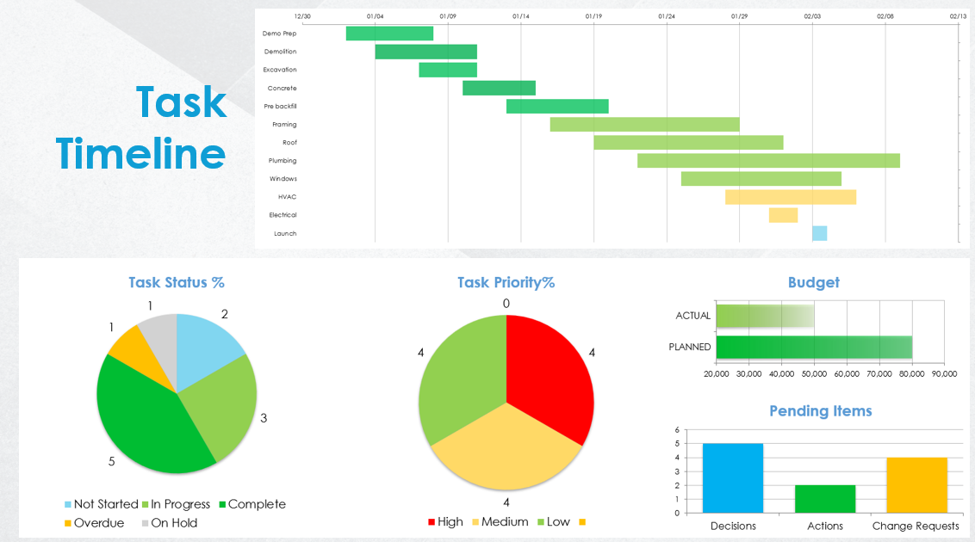
Construction Project Dashboard Template
Use the Construction Project Dashboard Template in Google Sheets to enter data that will populate the charts and graphs for your dashboard. Place screenshots of each element on the following slides to build out your Construction Project Dashboard Presentation.
Project Name | Date | Project Status | % Complete
Name | MM/DD/YY | In Progress | 0%

Slide 2
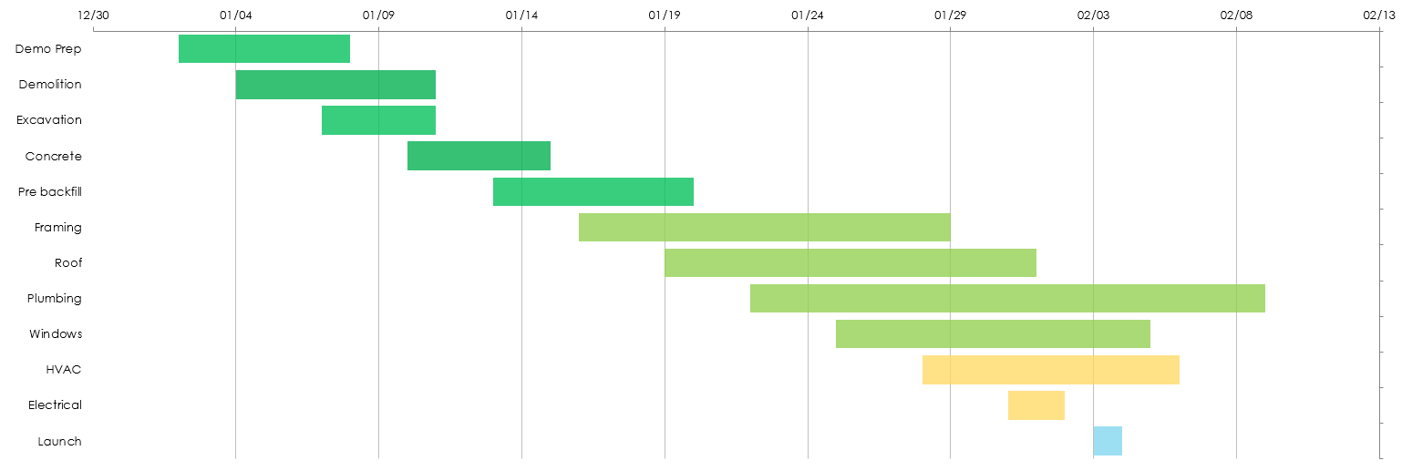
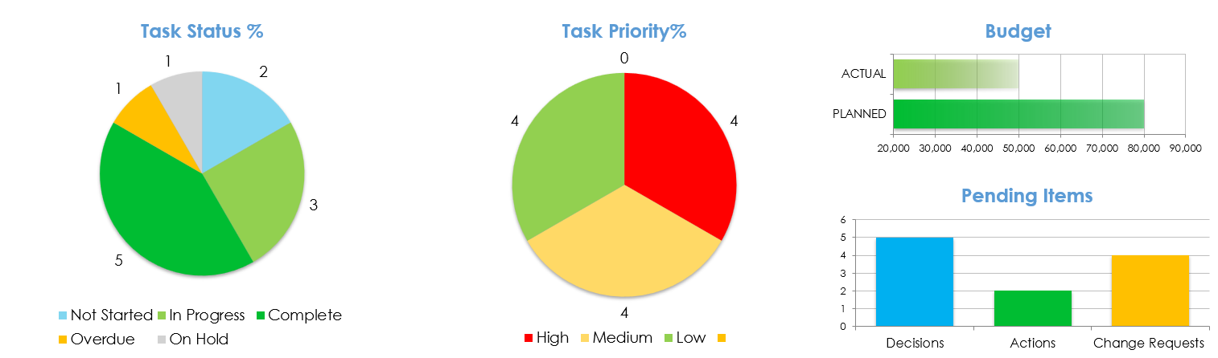
Task Timeline

Slide 3
DISCLAIMER Any articles, templates, or information provided by Smartsheet on the website are for reference only. While we strive to keep the information up to date and correct, we make no representations or warranties of any kind, express or implied, about the completeness, accuracy, reliability, suitability, or availability with respect to the website or the information, articles, templates, or related graphics contained on the website. Any reliance you place on such information is therefore strictly at your own risk.

