Slide 1


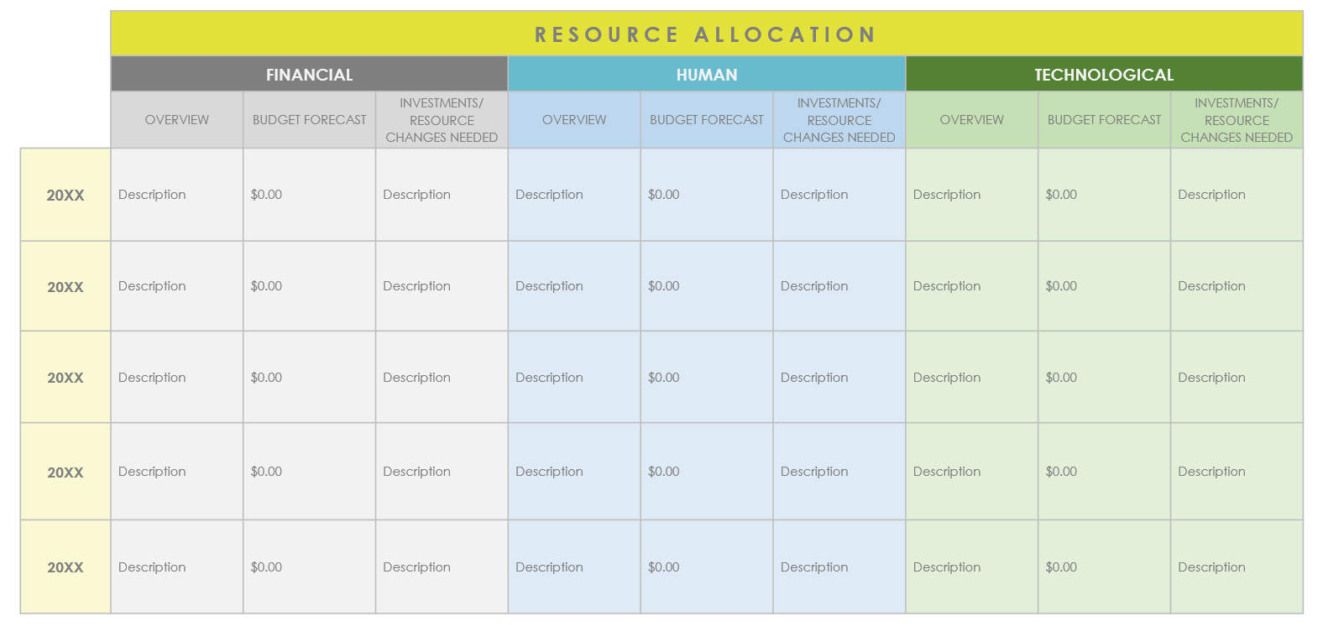
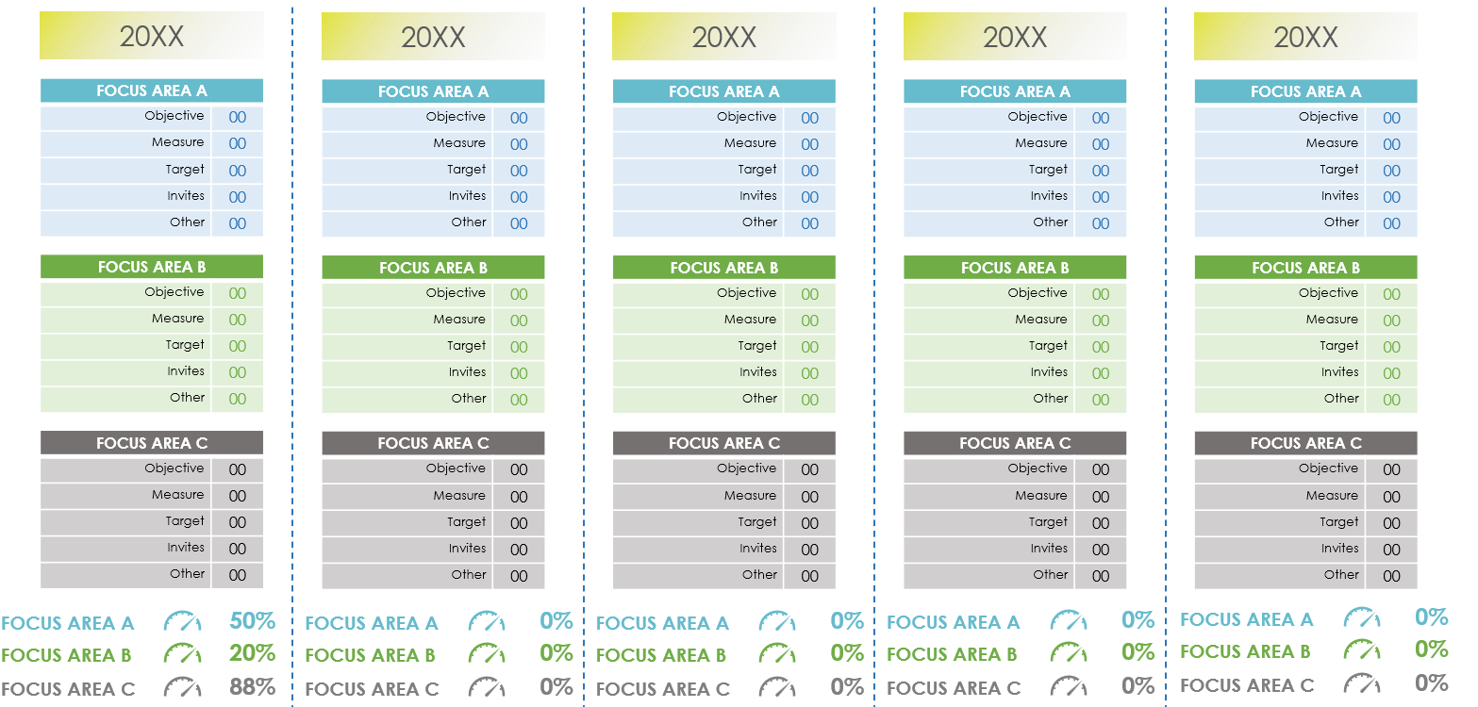
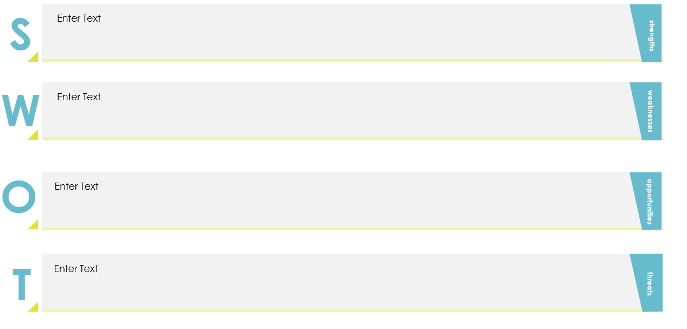
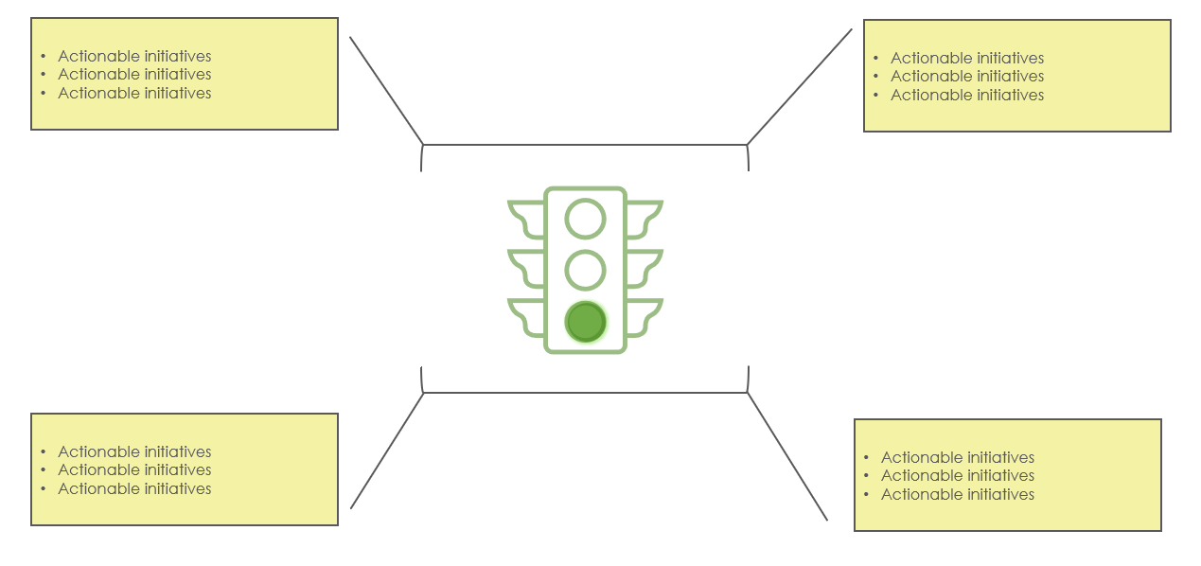
5-Year Strategic Business Plan Presentation Template
This template will help guide you through the process of creating a comprehensive five-year strategic business plan. Each slide is crafted to help your team cover all critical aspects of strategic planning.

Slide 2

CONTENTS
1
INTRODUCTION
6
STRATEGIC OBJECTIVES AND KEY INITIATIVES
2
VISION AND MISSION STATEMENT
7
PERFORMANCE METRICS AND KPIs
8
RESOURCE ALLOCATION AND BUDGET PLANNING
3
MARKET ANALYSIS
AND TRENDS
4
COMPREHENSIVE SWOT ANALYSIS
9
RISK MANAGEMENT AND MITIGATION STRATEGIES
5
YEAR-OVER-YEAR STRATEGIC FOCUS
10
CONCLUSION AND ACTION STEPS
11
APPENDICES

Slide 3
1. INTRODUCTION
Start with a concise overview of your company's goals and strategic objectives over the next five years. Highlight your company's vision and how this plan aligns with it.

Slide 4
2. VISION AND MISSION STATEMENTS
VISION
MISSION
Detail your company's vision statement and explain its relevance to your strategic goals. Discuss how this vision will guide decision-making over the next five years.
Detail your company’s mission statement and explain how it aligns with your strategic goals. Discuss how this mission will guide decision-making over the next five years.

Slide 5
3. MARKET ANALYSIS AND TRENDS
Analyze current market conditions, highlighting trends, challenges, and opportunities that could impact your strategy. Use visual aids like graphs or charts to communicate your findings in an engaging way.
MARKET CONDITIONS
Description | Description | Description
Description | Description | Description
TRENDS
Description | Description | Description
CHALLENGES
OPPORTUNITIES
Description | Description | Description

Slide 6
4. COMPREHENSIVE SWOT ANALYSIS
Present a thorough SWOT analysis to assess internal strengths and weaknesses, alongside external opportunities and threats. This will help in shaping your strategic focus.
S
Enter Text
strengths
W
Enter Text
weaknesses
O
Enter Text
opportunities
T
Enter Text
threats

Slide 7
5. YEAR-OVER-YEAR STRATEGIC FOCUS
Use this slide to outline the key focus areas for each year within the 5-year plan. Use a table or timeline to present annual goals, ensuring they are specific, measurable, achievable, relevant, and time-bound (SMART).
 | GOALS YEAR 1 – 20XX | GOALS YEAR 2 – 20XX | GOALS YEAR 3 – 20XX | GOALS YEAR 4 – 20XX | GOALS YEAR 5 – 20XX
Focus Area | Focus on establishing a strong foundation, setting the stage for growth. | Begin scaling operations, expanding market reach. | Diversify offerings, exploring new market segments. | Strengthen operational efficiencies, optimizing costs. | Consolidate gains, preparing for sustainable growth.
Focus Area | Description | Description | Description | Description | Description
Focus Area | Description | Description | Description | Description | Description
Focus Area | Description | Description | Description | Description | Description

Slide 8

6. STRATEGIC OBJECTIVES AND KEY INITIATIVES
Break down the strategic objectives into actionable initiatives. Highlight how these initiatives align with your yearly focus points, ensuring a coherent strategy that evolves over time.
Actionable initiatives
Actionable initiatives
Actionable initiatives
Actionable initiatives
Actionable initiatives
Actionable initiatives
Actionable initiatives
Actionable initiatives
Actionable initiatives
Actionable initiatives
Actionable initiatives
Actionable initiatives

Slide 9



7. PERFORMANCE METRICS AND KPIs
Define specific KPIs and performance metrics for tracking progress. Use a graphical representation to make target comparisons over five years clear, facilitating easier monitoring and adjustments.
20XX
20XX
20XX
20XX
20XX
FOCUS AREA A
Objective | 00
Measure | 00
Target | 00
Invites | 00
Other | 00
FOCUS AREA A
Objective | 00
Measure | 00
Target | 00
Invites | 00
Other | 00
FOCUS AREA A
Objective | 00
Measure | 00
Target | 00
Invites | 00
Other | 00
FOCUS AREA A
Objective | 00
Measure | 00
Target | 00
Invites | 00
Other | 00
FOCUS AREA A
Objective | 00
Measure | 00
Target | 00
Invites | 00
Other | 00
FOCUS AREA B
Objective | 00
Measure | 00
Target | 00
Invites | 00
Other | 00
FOCUS AREA B
Objective | 00
Measure | 00
Target | 00
Invites | 00
Other | 00
FOCUS AREA B
Objective | 00
Measure | 00
Target | 00
Invites | 00
Other | 00
FOCUS AREA B
Objective | 00
Measure | 00
Target | 00
Invites | 00
Other | 00
FOCUS AREA B
Objective | 00
Measure | 00
Target | 00
Invites | 00
Other | 00
FOCUS AREA C
Objective | 00
Measure | 00
Target | 00
Invites | 00
Other | 00
FOCUS AREA C
Objective | 00
Measure | 00
Target | 00
Invites | 00
Other | 00
FOCUS AREA C
Objective | 00
Measure | 00
Target | 00
Invites | 00
Other | 00
FOCUS AREA C
Objective | 00
Measure | 00
Target | 00
Invites | 00
Other | 00
FOCUS AREA C
Objective | 00
Measure | 00
Target | 00
Invites | 00
Other | 00
FOCUS AREA A
50%
FOCUS AREA A
0%
FOCUS AREA A
0%
FOCUS AREA A
0%
FOCUS AREA A
0%
FOCUS AREA B
20%
FOCUS AREA B
0%
FOCUS AREA B
0%
FOCUS AREA B
0%
FOCUS AREA B
0%
FOCUS AREA C
88%
FOCUS AREA C
0%
FOCUS AREA C
0%
FOCUS AREA C
0%
FOCUS AREA C
0%

Slide 10
8. RESOURCE ALLOCATION AND BUDGET PLANNING
Provide an overview of the resources required (financial, human, technological) across the five-year span. Include budget forecasts and highlight any significant investments or resource changes needed.
 | RESOURCE ALLOCATION
 | FINANCIAL |  |  | HUMAN |  |  | TECHNOLOGICAL
 | OVERVIEW | BUDGET FORECAST | INVESTMENTS/ RESOURCE CHANGES NEEDED | OVERVIEW | BUDGET FORECAST | INVESTMENTS/ RESOURCE CHANGES NEEDED | OVERVIEW | BUDGET FORECAST | INVESTMENTS/ RESOURCE CHANGES NEEDED
20XX | Description | $0.00 | Description | Description | $0.00 | Description | Description | $0.00 | Description
20XX | Description | $0.00 | Description | Description | $0.00 | Description | Description | $0.00 | Description
20XX | Description | $0.00 | Description | Description | $0.00 | Description | Description | $0.00 | Description
20XX | Description | $0.00 | Description | Description | $0.00 | Description | Description | $0.00 | Description
20XX | Description | $0.00 | Description | Description | $0.00 | Description | Description | $0.00 | Description

Slide 11
9. RISK MANAGEMENT AND MITIGATION STRATEGIES
Identify potential risks and outline strategies for mitigation. This proactive approach ensures preparedness for challenges, emphasizing adaptability in your strategic planning.
RISK IDENTIFICATION
IDENTIFIED RISK | CURRENT STATUS | RISK MITIGATION STRATEGIES
Risk description | Complete / Overdue / In Progress / On Hold | Mitigation strategy description

Slide 12
10. CONCLUSION AND ACTION STEPS
Summarize the strategic plan's key points and outline the immediate next steps. Motivate your team with a call to action that emphasizes the importance of collaboration, accountability, and agility in achieving the five-year objectives.

Slide 13
11. APPENDICES
Provide additional resources and documentation that offer detailed insights, financial models, and timelines essential for successfully implementing the strategic business plan. These documents help provide clarity and context.
DOCUMENT TYPE | DESCRIPTION | PURPOSE

Slide 14

TIPS for using this template
1.
Visual Consistency
Ensure all slides have a cohesive look for brand consistency.
2.
Engaging Visuals
Use charts, icons, and infographics to make data more digestible.
3.
Interactive Elements
Consider adding hyperlinks to detailed reports or external documents for those who wish to dive deeper into specific areas.

Slide 15
DISCLAIMER Any articles, templates, or information provided by Smartsheet on the website are for reference only. While we strive to keep the information up to date and correct, we make no representations or warranties of any kind, express or implied, about the completeness, accuracy, reliability, suitability, or availability with respect to the website or the information, articles, templates, or related graphics contained on the website. Any reliance you place on such information is therefore strictly at your own risk.

