Slide 1


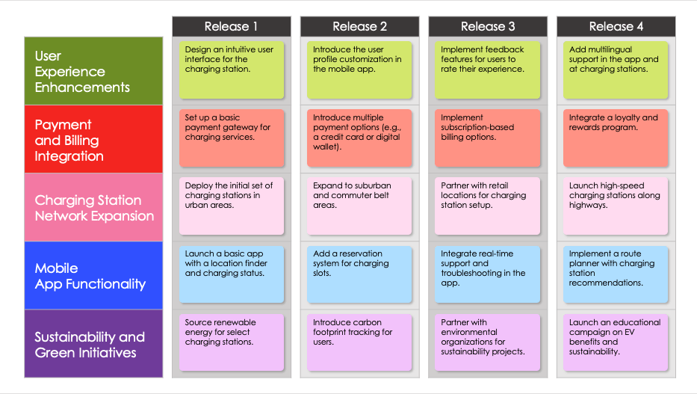
FEATURE-BASED AGILE PRODUCT ROADMAP TEMPLATE
Use this all-inclusive roadmap to keep tabs on every planned product feature simultaneously. This template offers instant insight into each product-specific feature (e.g., business growth, scalability, decreased customer churn, consumer growth, etc.) and duration details (e.g., quarter, month) for each. You can customize the roadmap to timebox sprint periods (typically two weeks or a month) for Agile development. This template is perfect for tracking the broad strokes of feature development for program increment (PI) planning and ensuring you account for and prioritize all key features on your product roadmap.

Slide 2
 |  | Release 1 |  | Release 2 |  | Release 3 |  | Release 4
Category 1
Category 2
Category 3
Category 4
Category 5
Release Task
Release Task
Release Task
Release Task
Release Task
Release Task
Release Task
Release Task
Release Task
Release Task
Release Task
Release Task
Release Task
Release Task
Release Task
Release Task
Release Task
Release Task
Release Task
Release Task

Slide 3
 | Release 1 | Release 2 | Release 3 | Release 4 | Release 5 | Release 6
Category 1
Category 2
Category 3
Category 4
Category 5
Release Task
Release Task
Release Task
Release Task
Release Task
Release Task
Release Task
Release Task
Release Task
Release Task
Release Task
Release Task
Release Task
Release Task
Release Task
Release Task
Release Task
Release Task
Release Task
Release Task
Release Task
Release Task
Release Task
Release Task
Release Task
Release Task
Release Task
Release Task
Release Task
Release Task

Slide 4
 | Release 1 | Release 2 | Release 3 | Release 4 | Release 5 | Release 6
Category 1
Category 2
Category 3
Category 4
Category 5
Category 6
Release Task
Release Task
Release Task
Release Task
Release Task
Release Task
Release Task
Release Task
Release Task
Release Task
Release Task
Release Task
Release Task
Release Task
Release Task
Release Task
Release Task
Release Task
Release Task
Release Task
Release Task
Release Task
Release Task
Release Task
Release Task
Release Task
Release Task
Release Task
Release Task
Release Task
Release Task
Release Task
Release Task
Release Task
Release Task
Release Task

Slide 5
EXAMPLE
 |  | Release 1 |  | Release 2 |  | Release 3 |  | Release 4
User Experience Enhancements
Payment and Billing Integration
Charging Station Network Expansion
Mobile App Functionality
Sustainability and Green Initiatives
Design an intuitive user interface for the charging station.
Introduce the user profile customization in the mobile app.
Implement feedback features for users to rate their experience.
Add multilingual support in the app and at charging stations.
Set up a basic payment gateway for charging services.
Introduce multiple payment options (e.g., a credit card or digital wallet).
Implement subscription-based billing options.
Integrate a loyalty and rewards program.
Deploy the initial set of charging stations in urban areas.
Expand to suburban and commuter belt areas.
Partner with retail locations for charging station setup.
Launch high-speed charging stations along highways.
Launch a basic app with a location finder and charging status.
Add a reservation system for charging slots.
Integrate real-time support and troubleshooting in the app.
Implement a route planner with charging station recommendations.
Source renewable energy for select charging stations.
Introduce carbon footprint tracking for users.
Partner with environmental organizations for sustainability projects.
Launch an educational campaign on EV benefits and sustainability.

Slide 6
DISCLAIMER Any articles, templates, or information provided by Smartsheet on the website are for reference only. While we strive to keep the information up to date and correct, we make no representations or warranties of any kind, express or implied, about the completeness, accuracy, reliability, suitability, or availability with respect to the website or the information, articles, templates, or related graphics contained on the website. Any reliance you place on such information is therefore strictly at your own risk.

