Slide 1


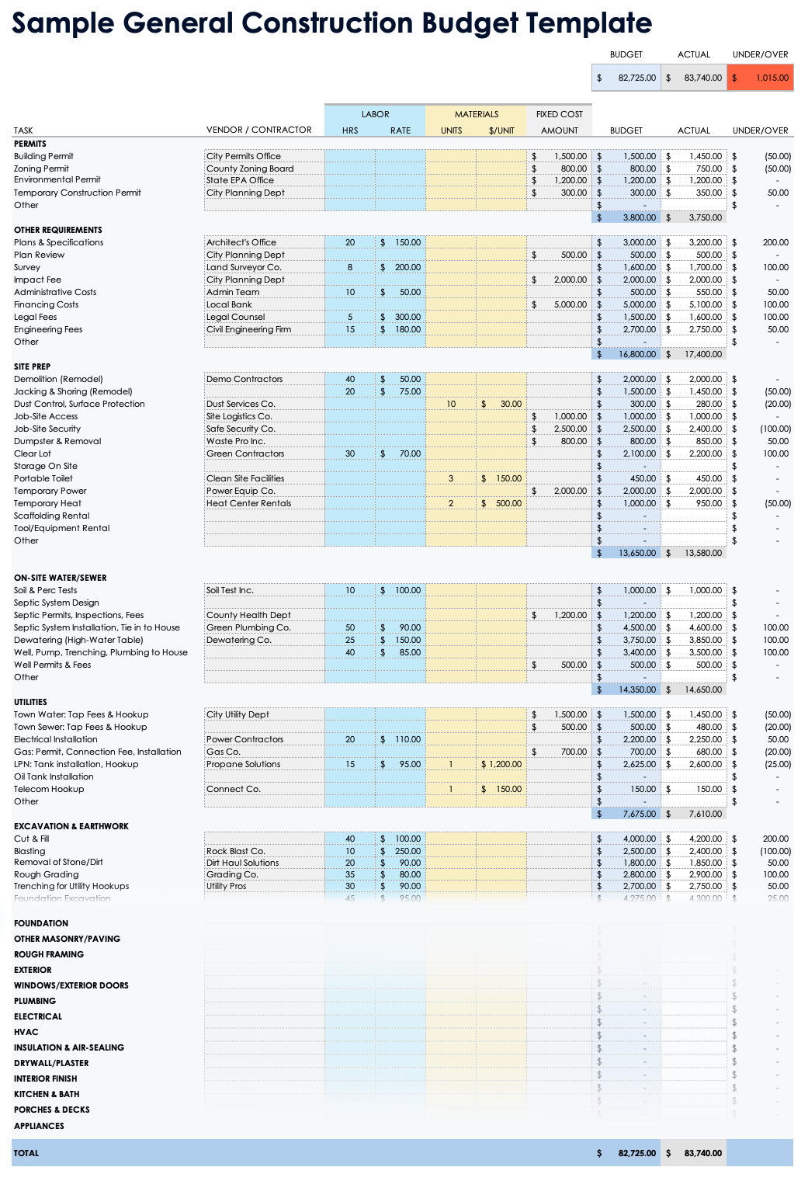
PowerPoint Construction Budget Template
Use the Sample General Construction Budget Template in Excel to track budget details and calculate totals for slide infographics.

Slide 2
Construction Budget
Project Title
123 Avenue A
City, State 10001
000-000-0000
web address
Contractor
Date
Contractor Name
00/00/0000

Slide 3
Project Title
Project Status
In Progress
% Complete
75%
Projected Start Date
Projected End Date
00/00/0000
00/00/0000
Version
Project Manager
0.0.0
PM Name

Slide 4




Budget | $369,725
Actual | $339,425
Project Cost
Amount Paid
Amount Owed
Estimated Profit
$400,000
$310,000
$90,000
$285,000
Description | Budget | Actual
Permits | $3,800 | $3,750
Other Requirements | $16,800 | $17,400
Site Prep | $13,650 | $13,580
On-Site Water / Sewer | $14,350 | $14,650
Utilities | $7,675 | $7,610
Excavation & Earthwork | $26,450 | $26,750
Foundation | $18,500 | $16,500
Other Masonry / Paving | $19,500 | $22,000
Rough Framing | $22,000 | $18,000
Exterior | $32,000 | $35,000
Windows / Exterior Doors | $18,000 | $14,300
Plumbing | $16,000 | $12,000
Electrical | $28,000 | $25,000
HVAC | $11,000 | $9,500
Insulation & Air-Sealing | $4,500 | $4,000
Drywall / Plaster | $18,000 | $14,800
Interior Finish | $18,500 | $16,000
Kitchen & Bath | $58,000 | $62,000
Porches & Decks | $8,500 | $5,300
Appliances | $14,500 | $1,285

Slide 5
Comments
Comments Text

Slide 6
DISCLAIMER Any articles, templates, or information provided by Smartsheet on the website are for reference only. While we strive to keep the information up to date and correct, we make no representations or warranties of any kind, express or implied, about the completeness, accuracy, reliability, suitability, or availability with respect to the website or the information, articles, templates, or related graphics contained on the website. Any reliance you place on such information is therefore strictly at your own risk.

