Slide 1


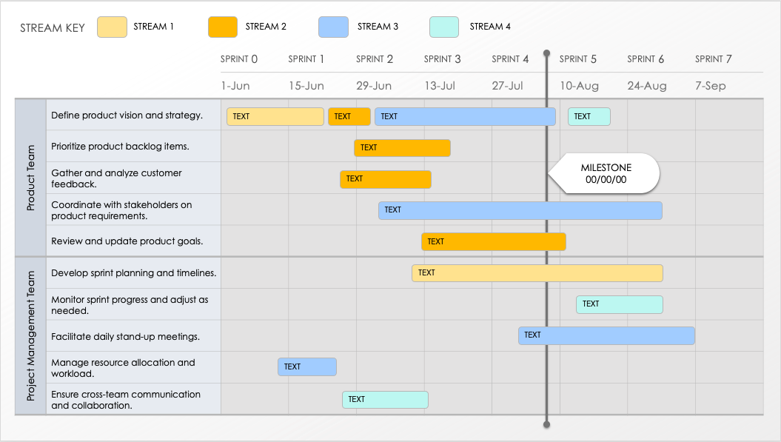
AGILE SCRUM PRODUCT ROADMAP TEMPLATE – EXAMPLE
Effectively track your team’s development goals with this scrum product roadmap template. Enter feature and user requirements, prototype, feature design, user acceptance testing, and other sprint-by-sprint product-roadmap tasks to keep tabs on each team’s development goals and accomplishments. Timebox sprint details into two-week or month-long periods with this simple-to-use, customizable template. This template is perfect for Agile teams that follow scrum methodology and need to plan and track progress across sprints.

Slide 2
STREAM KEY
STREAM 1
STREAM 2
STREAM 3
STREAM 4
 |  | SPRINT 0 | SPRINT 1 | SPRINT 2 | SPRINT 3 | SPRINT 4 | SPRINT 5 | SPRINT 6 | SPRINT 7
 |  | 1-Jun | 15-Jun | 29-Jun | 13-Jul | 27-Jul | 10-Aug | 24-Aug | 7-Sep
Product Team | Define product vision and strategy.
 | Prioritize product backlog items.
 | Gather and analyze customer feedback.
 | Coordinate with stakeholders on product requirements.
 | Review and update product goals.
Project Management Team | Develop sprint planning and timelines.
 | Monitor sprint progress and adjust as needed.
 | Facilitate daily stand-up meetings.
 | Manage resource allocation and workload.
 | Ensure cross-team communication and collaboration.
TEXT
TEXT
TEXT
TEXT
TEXT
MILESTONE
00/00/00
TEXT
TEXT
TEXT
TEXT
TEXT
TEXT
TEXT
TEXT

Slide 3
STREAM KEY
STREAM 1
STREAM 2
STREAM 3
STREAM 4
 |  | SPRINT 0 | SPRINT 1 | SPRINT 2 | SPRINT 3 | SPRINT 4 | SPRINT 5 | SPRINT 6 | SPRINT 7
 |  | 1-Jun | 15-Jun | 29-Jun | 13-Jul | 27-Jul | 10-Aug | 24-Aug | 7-Sep
Development Team | Implement new features from backlog.
 | Conduct code reviews and refactoring.
 | Develop and integrate APIs.
 | Address technical debt and optimize performance.
 | Collaborate with UX and QA teams for feature integration.
User Experience (UX) Team | Design user interface and experience prototypes.
 | Conduct user research and usability testing.
 | Create and update design system components.
 | Collaborate with developers on UI implementation.
 | Iterate designs based on feedback and testing results.
TEXT
TEXT
MILESTONE
00/00/00
TEXT
TEXT
TEXT
TEXT
TEXT
TEXT
TEXT
TEXT

Slide 4
STREAM KEY
STREAM 1
STREAM 2
STREAM 3
STREAM 4
 |  | SPRINT 0 | SPRINT 1 | SPRINT 2 | SPRINT 3 | SPRINT 4 | SPRINT 5 | SPRINT 6 | SPRINT 7
 |  | 1-Jun | 15-Jun | 29-Jun | 13-Jul | 27-Jul | 10-Aug | 24-Aug | 7-Sep
Quality Assurance Team | Develop and execute test plans.
 | Perform automated and manual testing.
 | Identify, document, and track bugs.
 | Validate user stories against acceptance criteria.
 | Conduct regression testing after each build.
Cross-Functional Tasks | Participate in sprint retrospectives and reviews.
 | Update documentation and user guides.
 | Plan for upcoming sprints based on team feedback.
 | Coordinate with marketing and sales for product launch.
 | Conduct risk assessment and mitigation planning.
TEXT
TEXT
MILESTONE
00/00/00
TEXT
TEXT
TEXT
TEXT
TEXT
TEXT
TEXT
TEXT

Slide 5
DISCLAIMER Any articles, templates, or information provided by Smartsheet on the website are for reference only. While we strive to keep the information up to date and correct, we make no representations or warranties of any kind, express or implied, about the completeness, accuracy, reliability, suitability, or availability with respect to the website or the information, articles, templates, or related graphics contained on the website. Any reliance you place on such information is therefore strictly at your own risk.

