Slide 1
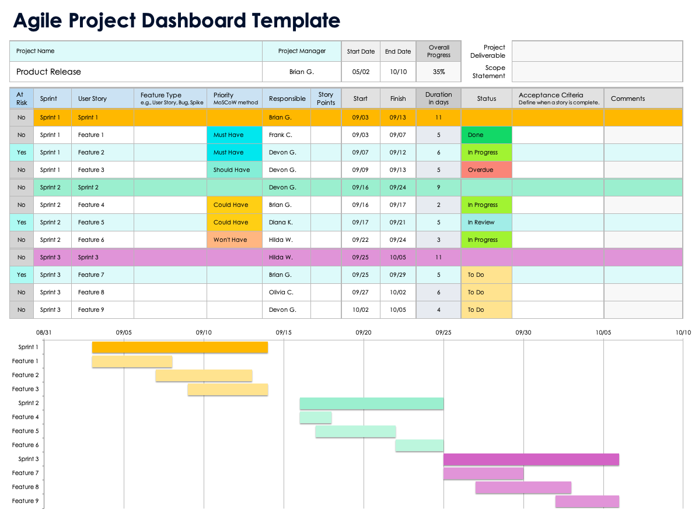
Agile Project Dashboard Template
Use the Agile Project Dashboard Template in Excel to enter data that will populate the charts and graphs for your dashboard. Place screenshots of each element on the following slides to build out your Project Dashboard Presentation.

Slide 2
Agile Project Dashboard
Company Name
123 Avenue A
City, State 10001
000-000-0000
web address
Prepared By
Date
Preparer Name
00/00/0000

Slide 3
Project Title
Project Status
In Progress
% Complete
75%
Start Date
End Date
00/00/0000
00/00/0000
Version
Project Manager
0.0.0
PM Name

Slide 4
Agile Project Dashboard
Project Deliverable
Scope Statement
Sprints and User Stories
Status and Acceptance Criteria
Gantt Chart Timeline
Priority and Status Overview

Slide 5
1. Project Deliverable
Project Deliverable Text

Slide 6
2. Scope Statement
Scope Statement Text

Slide 7
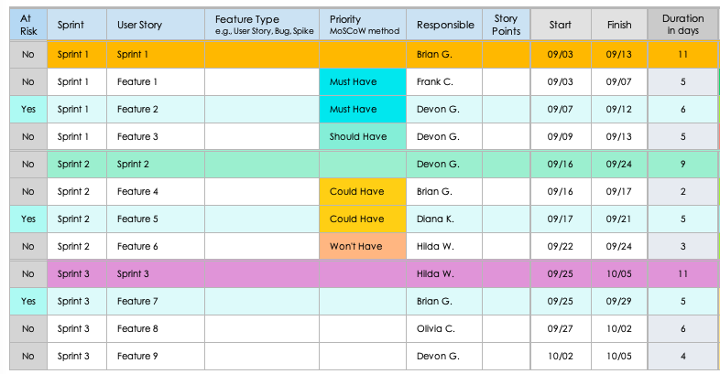
3. Sprints and User Stories

Slide 8
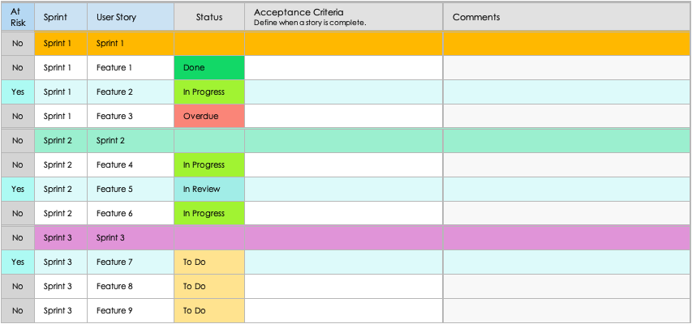
4. Status and Acceptance Criteria

Slide 9
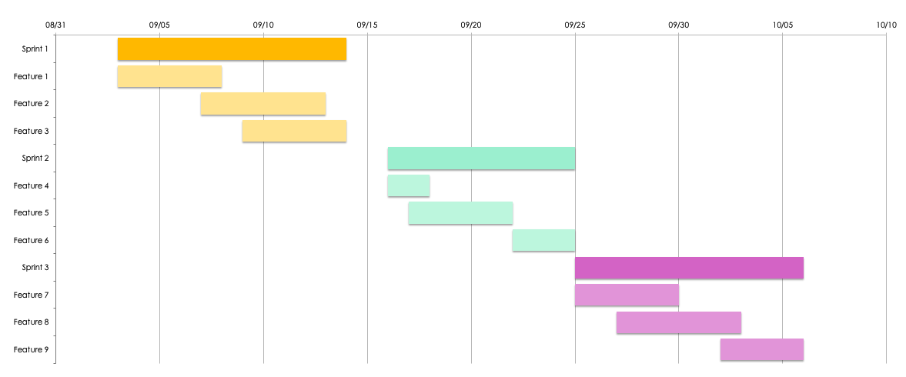
5. Gantt Chart Timeline

Slide 10
6. Priority and Status Overview
Status
To Do | 4
In Progress | 2
Done | 3
In Review | 1
Approved | 2
Overdue | 1
On Hold | 1
Priority MoSCoW method
Must Have | 7
Should Have | 4
Could Have | 2
Won't Have | 1

Slide 11
Comments
Comments Text

Slide 12
DISCLAIMER Any articles, templates, or information provided by Smartsheet on the website are for reference only. While we strive to keep the information up to date and correct, we make no representations or warranties of any kind, express or implied, about the completeness, accuracy, reliability, suitability, or availability with respect to the website or the information, articles, templates, or related graphics contained on the website. Any reliance you place on such information is therefore strictly at your own risk.

