Slide 1
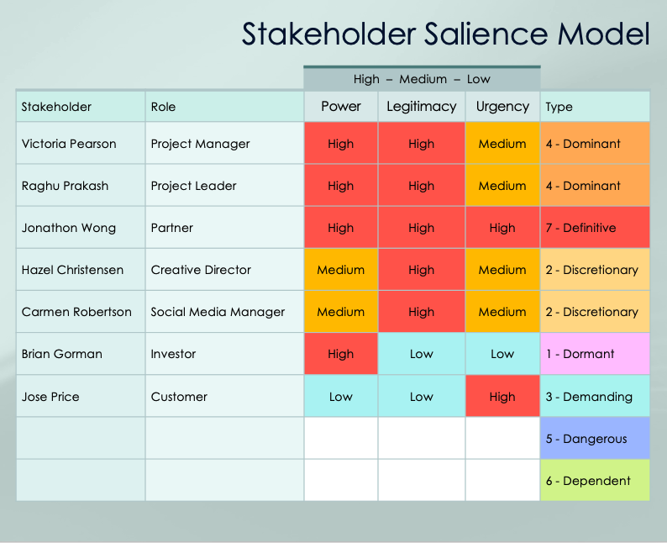
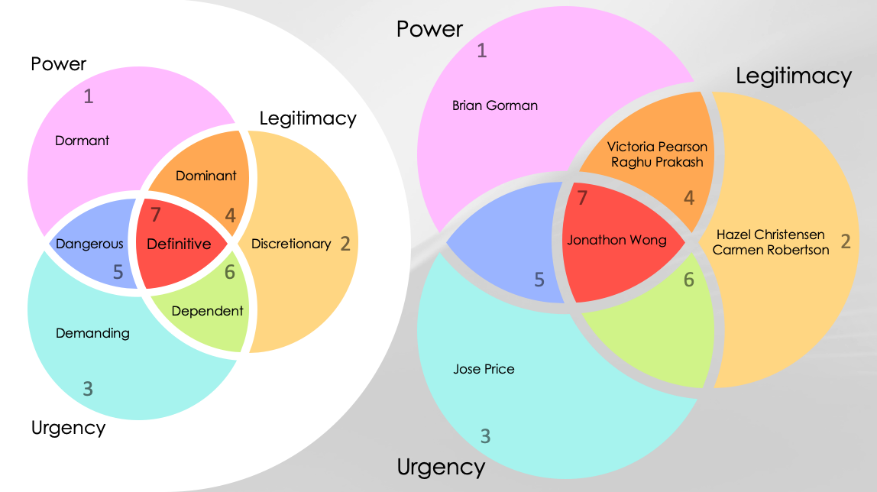
Stakeholder Salience Model Template Example
Opening slides contain sample data.
Blank template begins on slide 6.

Slide 2
Project Name
Cloud-Based PM Software Implementation
Stakeholder Salience Model
Project Manager
Victoria Pearson
Date
02/28/20XX
Version
1.0.1

Slide 3
Stakeholder Type
Power
1
1 - Dormant | Power only
2 - Discretionary | Legitimacy only
3 - Demanding | Urgency only
4 - Dominant | Power and Legitimacy
5 - Dangerous | Power and Urgency
6 - Dependent | Legitimacy and Urgency
7 - Definitive | Power, Legitimacy, and Urgency
Legitimacy
Dormant
Dominant
7
4
Dangerous
Definitive
Discretionary
2
5
6
Dependent
Demanding
Stakeholder Salience Model
3
Urgency

Slide 4
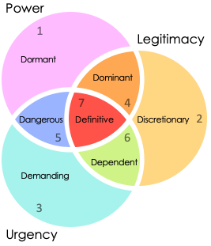
Stakeholder Salience Model
 |  | High – Medium – Low
Stakeholder | Role | Power | Legitimacy | Urgency | Type
Victoria Pearson | Project Manager | High | High | Medium | 4 - Dominant
Raghu Prakash | Project Leader | High | High | Medium | 4 - Dominant
Jonathon Wong | Partner | High | High | High | 7 - Definitive
Hazel Christensen | Creative Director | Medium | High | Medium | 2 - Discretionary
Carmen Robertson | Social Media Manager | Medium | High | Medium | 2 - Discretionary
Brian Gorman | Investor | High | Low | Low | 1 - Dormant
Jose Price | Customer | Low | Low | High | 3 - Demanding
 |  |  |  |  | 5 - Dangerous
 |  |  |  |  | 6 - Dependent
1 - Dormant | Power only
2 - Discretionary | Legitimacy only
3 - Demanding | Urgency only
4 - Dominant | Power and Legitimacy
5 - Dangerous | Power and Urgency
6 - Dependent | Legitimacy and Urgency
7 - Definitive | Power, Legitimacy, and Urgency

Slide 5
Power
1
Power
Legitimacy
1
Legitimacy
Brian Gorman
Dormant
Victoria Pearson
Raghu Prakash
Dominant
7
4
7
4
Dangerous
Definitive
Discretionary
2
Jonathon Wong
Hazel Christensen
Carmen Robertson
2
5
6
5
6
Dependent
Demanding
Jose Price
3
Salience Model
Urgency
3
Urgency

Slide 6
Project Name
Text
Stakeholder Salience Model
Project Manager
Text
Date
00/00/0000
Version
1.0.1

Slide 7
Stakeholder Type
Power
1
1 - Dormant | Power only
2 - Discretionary | Legitimacy only
3 - Demanding | Urgency only
4 - Dominant | Power and Legitimacy
5 - Dangerous | Power and Urgency
6 - Dependent | Legitimacy and Urgency
7 - Definitive | Power, Legitimacy, and Urgency
Legitimacy
Dormant
Dominant
7
4
Dangerous
Definitive
Discretionary
2
5
6
Dependent
Demanding
Stakeholder Salience Model
3
Urgency

Slide 8
Stakeholder Salience Model
 |  | High – Medium – Low
Stakeholder | Role | Power | Legitimacy | Urgency | Type
1 - Dormant | Power only
2 - Discretionary | Legitimacy only
3 - Demanding | Urgency only
4 - Dominant | Power and Legitimacy
5 - Dangerous | Power and Urgency
6 - Dependent | Legitimacy and Urgency
7 - Definitive | Power, Legitimacy, and Urgency

Slide 9
Power
1
Power
Legitimacy
1
Stakeholder
Stakeholder
Stakeholder
Legitimacy
Dormant
Stakeholder
Stakeholder
Stakeholder
Dominant
7
4
7
4
Stakeholder
Stakeholder
Stakeholder
Stakeholder
Stakeholder
Stakeholder
Stakeholder
Stakeholder
Stakeholder
Dangerous
Definitive
Discretionary
2
2
5
6
5
6
Dependent
Stakeholder
Stakeholder
Stakeholder
Demanding
Stakeholder
Stakeholder
Stakeholder
3
Salience Model
Urgency
3
Urgency

Slide 10
Notes
Text
Stakeholder Salience Model

Slide 11
DISCLAIMER Any articles, templates, or information provided by Smartsheet on the website are for reference only. While we strive to keep the information up to date and correct, we make no representations or warranties of any kind, express or implied, about the completeness, accuracy, reliability, suitability, or availability with respect to the website or the information, articles, templates, or related graphics contained on the website. Any reliance you place on such information is therefore strictly at your own risk.

