Slide 1

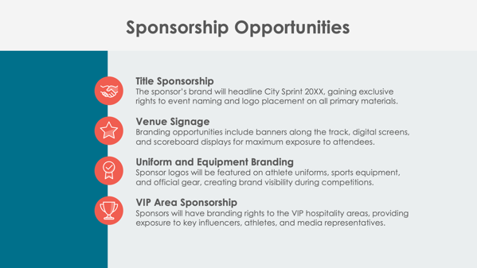
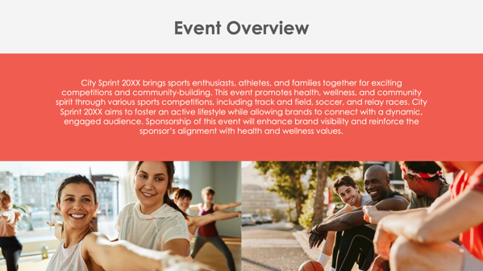
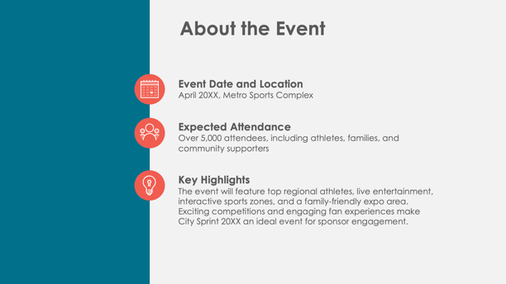
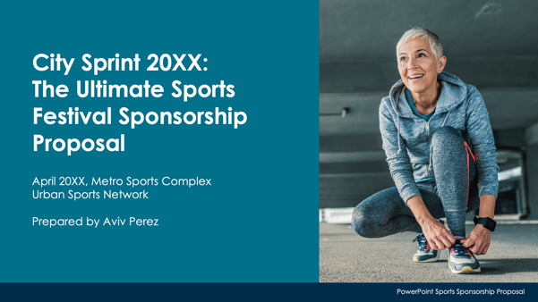
PowerPoint Sports Sponsorship Proposal Template Example

Slide 2

City Sprint 20XX:
The Ultimate Sports
Festival Sponsorship Proposal
April 20XX, Metro Sports Complex
Urban Sports Network
Prepared by Aviv Perez
EXAMPLE: PowerPoint Sports Sponsorship Proposal

Slide 3
Contents
1 | Event Overview
2 | About the Event
3 | Sponsorship Opportunities
4 | Sponsorship Benefits
5 | Sponsorship Packages
6 | Custom Sponsorship Opportunities
7 | Marketing and Promotion Plan
8 | Audience Reach and Media Coverage
9 | Sponsor Activation Opportunities
10 | Previous Successes and Testimonials
11 | Contact Information

Slide 4

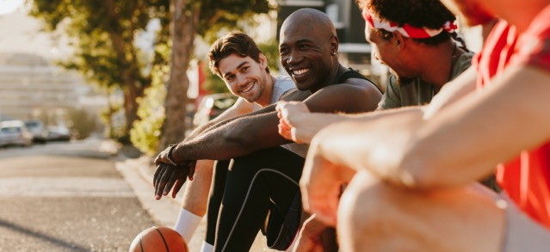
Event Overview
City Sprint 20XX brings sports enthusiasts, athletes, and families together for exciting competitions and community-building. This event promotes health, wellness, and community spirit through various sports competitions, including track and field, soccer, and relay races. City Sprint 20XX aims to foster an active lifestyle while allowing brands to connect with a dynamic, engaged audience. Sponsorship of this event will enhance brand visibility and reinforce the sponsor’s alignment with health and wellness values.

Slide 5



About the Event
Event Date and Location
April 20XX, Metro Sports Complex
Expected Attendance
Over 5,000 attendees, including athletes, families, and community supporters
Key Highlights
The event will feature top regional athletes, live entertainment, interactive sports zones, and a family-friendly expo area. Exciting competitions and engaging fan experiences make City Sprint 20XX an ideal event for sponsor engagement.

Slide 6




Sponsorship Opportunities
Title Sponsorship
The sponsor’s brand will headline City Sprint 20XX, gaining exclusive rights to event naming and logo placement on all primary materials.
Venue Signage
Branding opportunities include banners along the track, digital screens, and scoreboard displays for maximum exposure to attendees.
Uniform and Equipment Branding
Sponsor logos will be featured on athlete uniforms, sports equipment, and official gear, creating brand visibility during competitions.
VIP Area Sponsorship
Sponsors will have branding rights to the VIP hospitality areas, providing exposure to key influencers, athletes, and media representatives.

Slide 7

Sponsorship Benefits
City Sprint 20XX sponsorship offers unique benefits, including on-site and media exposure through high-traffic branding locations. Sponsors will connect directly with fans through branded zones and activities, creating memorable engagement. The event supports community wellness and aligns with brands that value sports, health, and performance.
4

Slide 8
Sponsorship Packages
Platinum Package
The title sponsorship includes top-tier logo placement on all event materials and athlete uniforms; 30 VIP passes; and featured mentions in all media coverage and social media.
Gold Package
This package includes prominent logo placement on venue signage and team gear; 20 VIP tickets; and sponsor mentions in press releases.
Silver Package
This package includes logo placement on selected event signage, 10 general admission tickets, and recognition in event recaps.
Bronze Package
This package includes logo placement in the event program, acknowledgment on social media, and five general admission tickets.
$X,XXX
$X,XXX
$X,XXX
$X,XXX

Slide 9

Custom Sponsorship Opportunities
City Sprint 20XX offers tailored opportunities for brands to enhance their presence, including branded fan zones, exclusive meet-and-greets with athletes, and sponsor-hosted fan competitions. Each opportunity allows sponsors to create engaging and memorable interactions aligned with their brand goals.

Slide 10



Marketing and Promotion Plan
Pre-Event
Sponsors will be featured in digital ads, countdown posts on social media, and email announcements, reaching thousands before event day.
During Event
Real-time updates on social media, branded livestreams, and dynamic on-site branding maximize sponsor exposure.
Post-Event
Sponsor logos will be featured in event recap videos, social media thank-you posts, and follow-up emails to attendees.
7

Slide 11


Audience Reach and Media Coverage
Attendance
5,000+ expected on-site, with a projected livestream audience of 15,000.
Demographics
Attendees are primarily 18–45 years old and interested in fitness, community events, and sports culture.
Media Exposure
The event will be covered by local news outlets and sports media platforms, giving sponsors broad visibility across digital and broadcast channels.

Slide 12

Sponsor Activation Opportunities
Fan Zones
Sponsors can host interactive areas with branded activities, creating memorable experiences for attendees.
Contests and Giveaways
Sponsors will brand competitions where winners receive prizes, encouraging fan participation.
Social Media Engagement
Sponsors receive shout-outs and exclusive content features, increasing online visibility.
VIP Experiences
Sponsors gain branding rights within VIP areas, creating an exclusive environment for top-tier attendees and media.

Slide 13
Previous Successes and Testimonials
Past events organized by Urban Sports Network
Over
5,000
attendees
Garnered
30,000+
media impressions
Feedback from previous sponsors includes:
“City Sprint connects us with a passionate community, offering real engagement opportunities with fans.”
Metrics and feedback illustrate the event’s strong community presence and sponsor satisfaction.

Slide 14
Contact Information
Sponsorship Coordinator
Brooklyn Jansen
Website
Email
Urbansportsnetwork.com
sponsorships@urbansportsnetwork.com
Phone
Web & Social
(555) 678-1234
Follow us on Instagram, Threads, Facebook, and X for updates.

Slide 15
DISCLAIMER Any articles, templates, or information provided by Smartsheet on the website are for reference only. While we strive to keep the information up to date and correct, we make no representations or warranties of any kind, express or implied, about the completeness, accuracy, reliability, suitability, or availability with respect to the website or the information, articles, templates, or related graphics contained on the website. Any reliance you place on such information is therefore strictly at your own risk.

