Slide 1
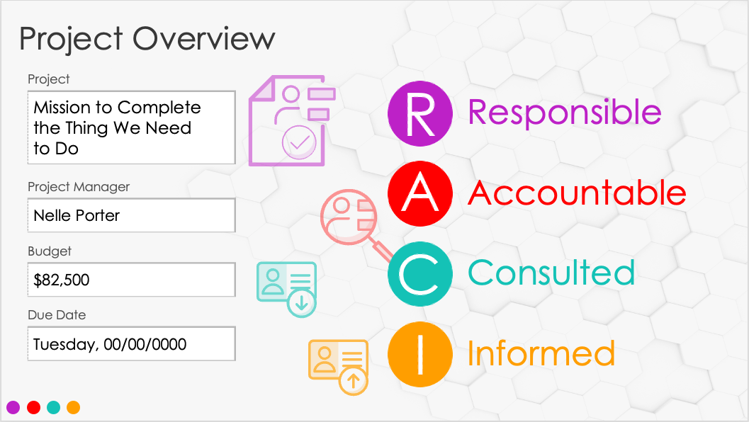
Simple RACI Matrix Template

Slide 2
RACI
Matrix
Responsible
Accountable
Consulted
Informed
00/00/0000

Slide 3
Project Overview
Project
Responsible
Accountable
Project Manager
Budget
Consulted
Due Date
Informed

Slide 4
Phase 1: Initiate
 |  | Project Sponsor | CPO | Director | Role 4 | Role 5 | Project Manager | Operations Engineer | Quality Assurance | Developer | Role 5 | Consultant | Customer Service | Role 3 | Role 4 | Role 5 | Role 1 | Role 2 | Role 3 | Role 4 | Role 5
 |  | Project Leadership |  |  |  |  | Project Team Members |  |  |  |  | Additional Resources |  |  |  |  | Other
Request Review by PMO
Submit Project Request
Research Solution
Develop Business Case
Project
Deliverable
or Activity
RESPONSIBLE
ACCOUNTABLE
CONSULTED
INFORMED

Slide 5
Phase 2: Plan
 |  | Project Sponsor | CPO | Director | Role 4 | Role 5 | Project Manager | Operations Engineer | Quality Assurance | Developer | Role 5 | Consultant | Customer Service | Role 3 | Role 4 | Role 5 | Role 1 | Role 2 | Role 3 | Role 4 | Role 5
 |  | Project Leadership |  |  |  |  | Project Team Members |  |  |  |  | Additional Resources |  |  |  |  | Other
Create Project Charter
Create Schedule
Create Additional Plans as Required
Project
Deliverable
or Activity
RESPONSIBLE
ACCOUNTABLE
CONSULTED
INFORMED

Slide 6
Phase 3: Execute
 |  | Project Sponsor | CPO | Director | Role 4 | Role 5 | Project Manager | Operations Engineer | Quality Assurance | Developer | Role 5 | Consultant | Customer Service | Role 3 | Role 4 | Role 5 | Role 1 | Role 2 | Role 3 | Role 4 | Role 5
 |  | Project Leadership |  |  |  |  | Project Team Members |  |  |  |  | Additional Resources |  |  |  |  | Other
Build Deliverables
Create Status Report
Project
Deliverable
or Activity
RESPONSIBLE
ACCOUNTABLE
CONSULTED
INFORMED

Slide 7
Phase 4: Control
 |  | Project Sponsor | CPO | Director | Role 4 | Role 5 | Project Manager | Operations Engineer | Quality Assurance | Developer | Role 5 | Consultant | Customer Service | Role 3 | Role 4 | Role 5 | Role 1 | Role 2 | Role 3 | Role 4 | Role 5
 |  | Project Leadership |  |  |  |  | Project Team Members |  |  |  |  | Additional Resources |  |  |  |  | Other
Perform Change Management
Project
Deliverable
or Activity
RESPONSIBLE
ACCOUNTABLE
CONSULTED
INFORMED

Slide 8
Phase 5: Close
 |  | Project Sponsor | CPO | Director | Role 4 | Role 5 | Project Manager | Operations Engineer | Quality Assurance | Developer | Role 5 | Consultant | Customer Service | Role 3 | Role 4 | Role 5 | Role 1 | Role 2 | Role 3 | Role 4 | Role 5
 |  | Project Leadership |  |  |  |  | Project Team Members |  |  |  |  | Additional Resources |  |  |  |  | Other
Create Lessons Learned
Create Project Closure Report
Project
Deliverable
or Activity
RESPONSIBLE
ACCOUNTABLE
CONSULTED
INFORMED

Slide 9
Notes
summary information / comments

Slide 10
DISCLAIMER Any articles, templates, or information provided by Smartsheet on the website are for reference only. While we strive to keep the information up to date and correct, we make no representations or warranties of any kind, express or implied, about the completeness, accuracy, reliability, suitability, or availability with respect to the website or the information, articles, templates, or related graphics contained on the website. Any reliance you place on such information is therefore strictly at your own risk.

