Slide 1


Restaurant Business Plan Template Example
Flavors and Vibes Bistro
Date Prepared | 6/11/20XX
Contact | Victoria Pearson, Owner
Phone, Email | (555)-123-7654, vpearson@flavorsandvibes . com
Address | 111 Main Street, Metroville, USA
Website, Links | flavorsandvibes.com, @flavorsandvibes

Slide 2
Contents
1 | Executive Summary
2 | Restaurant Overview
3 | Market Analysis
4 | Menu and Product Line
5 | Marketing Plan and Sales Strategy
6 | Operations Plan
7 | Management Structure
8 | Financial Plan
9 | Implementation Timeline
10 | Supporting Documents

Slide 3
Executive Summary
Flavors and Vibes Bistro is a contemporary dining establishment offering a fusion of global cuisines in a lively, upscale atmosphere. Opening in the heart of downtown Metroville in 20XX, the bistro is designed to serve urban professionals and food enthusiasts seeking quality and innovation. We aim to combine culinary excellence with exceptional service, creating an experience that inspires loyalty and word-of-mouth promotion. Financial goals include achieving profitability within 12 months and expanding to a second location by year three.

Slide 4
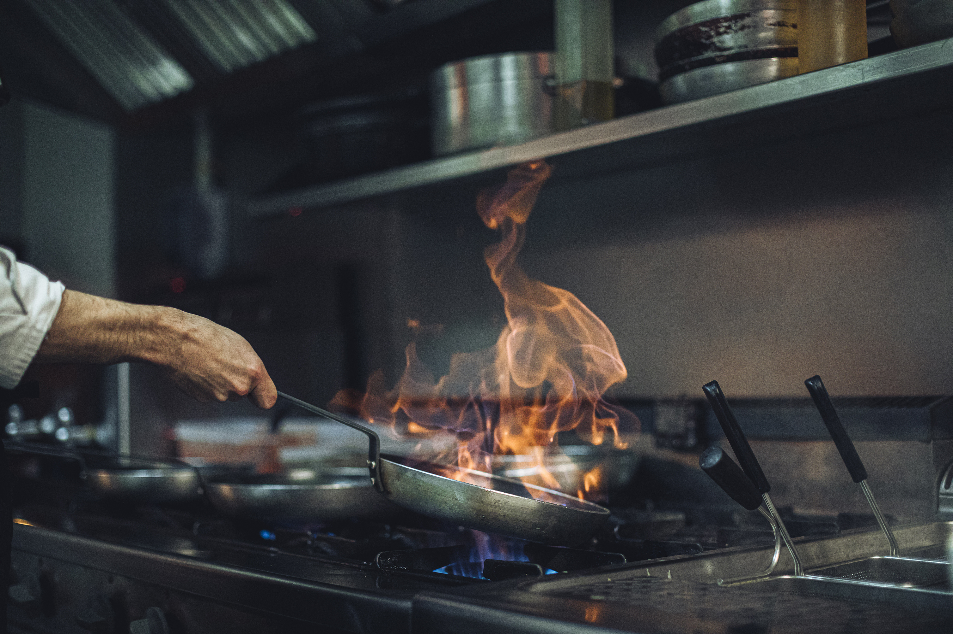

Restaurant Overview
Flavors and Vibes Bistro is a locally-owned restaurant focusing on global fusion cuisine. Featuring a menu that blends Asian, Mediterranean, and Latin American influences, the bistro brings together diverse flavors in a welcoming setting. The bistro will be owned and operated by a culinary-trained entrepreneur with over 15 years of experience in the hospitality industry. The bistro will operate as a sole proprietorship, with plans to evolve into an LLC as the business grows.

Slide 5
Market Analysis
Target Market
Primary customers include professionals aged 25–45 working downtown and families seeking unique weekend dining options. A secondary target includes tourists and event attendees attracted by the vibrant Metroville nightlife.
Location Analysis
Flavors and Vibes Bistro will be located in a prime area of downtown Metroville, known for its high foot traffic, proximity to office complexes, and accessibility via public transit. The area has seen a 15% year-over-year increase in dining expenditures.
Competition Analysis
Key competitors include established casual dining chains and boutique eateries specializing in single cuisines. Flavors and Vibes Bistro has a unique fusion concept, trendy ambiance, and affordable price points.

Slide 6
Menu and Product Line
Offerings and Pricing
Menu highlights include small plates like Korean BBQ sliders, entrees like Mediterranean spiced lamb, and signature cocktails priced between $8 and $15. Average per-person spending projections are $25.
Food and Beverage Options
The menu incorporates locally sourced ingredients with seasonal specials that rotate monthly. Beverage offerings include craft cocktails, mocktails, and a curated selection of international wines.

Slide 7

Marketing Plan and Sales Strategy
The marketing strategy will include a grand opening event with social media influencers, targeted online advertising, and partnerships with local event organizers. Loyalty programs and promotions during weekday lunch hours will help establish a regular customer base.

Slide 8
Operations Plan
Staffing
The bistro will employ 15 staff members, including chefs, servers, and hostesses. Training programs will focus on consistency and exceptional customer service.
Service Policies and Procedures
Operational protocols will emphasize speed, accuracy, and guest satisfaction, supported by a state-of-the-art kitchen workflow system.
Point of Sale and Payroll
POS systems manage orders and track sales, and they integrate with payroll software for seamless staff payment processing.
Suppliers
Partnerships established with local farms and specialty suppliers maintain ingredient quality and support sustainability.

Slide 9
Management Structure
Flavors and Vibes Bistro features a dedicated team with extensive experience in restaurant operations, culinary arts, and customer service. This team oversees all aspects of the business, from daily operations to long-term growth strategies. Together, they blend innovation and professionalism to ensure the bistro's success.
Name | Role | Experience / Qualifications
Victoria Pearson | Owner | 15+ years' experience in hospitality management with a focus on restaurant startups
Romy Bailey | General Manager | 15+ years' experience in restaurant management
Olivia Carter | Executive Chef | Culinary Institute graduate with 10 years' experience in global fusion cuisine
Makara McLean | Marketing Manager | 8 years' experience in food and beverage marketing with expertise in event planning
Staff Name | Title | Description
Staff Name | Title | Description

Slide 10
Financial Plan
Projections and Funding
Startup costs are estimated at $350,000, covering leasehold improvements, kitchen equipment, and initial inventory. Funding occurs through personal savings and a small business loan.
Budget and Revenue Forecast
First-year revenue is projected at $1.2 million, with a 60% gross profit margin.

Slide 11
Implementation Timeline
Phase | Timeframe | Key Activities
Phase 1 | Months 1-3 | Secure funding, finalize location lease, begin renovations
Phase 2 | Months 4-6 | Hire staff, conduct training, launch marketing campaigns
Phase 3 | Month 7 | Soft opening and customer feedback phase
Phase 4 | Month 8 | Official grand opening

Slide 12
Supporting Documents
Document | Purpose
Lease agreement | Proof of secured location and rental terms
Health and safety certification | Local regulations and food safety standards compliance
Sample menu | Overview of main offerings and pricing structure
Vendor contacts | Supplier agreements to ensure consistent inventory
Insurance policies | Coverage for liability, property, and employee protection
Employee training manuals | Operational standards and staff procedures documentation

Slide 13
DISCLAIMER Any articles, templates, or information provided by Smartsheet on the website are for reference only. While we strive to keep the information up to date and correct, we make no representations or warranties of any kind, express or implied, about the completeness, accuracy, reliability, suitability, or availability with respect to the website or the information, articles, templates, or related graphics contained on the website. Any reliance you place on such information is therefore strictly at your own risk.

