Slide 1

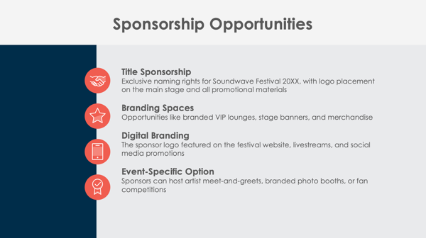
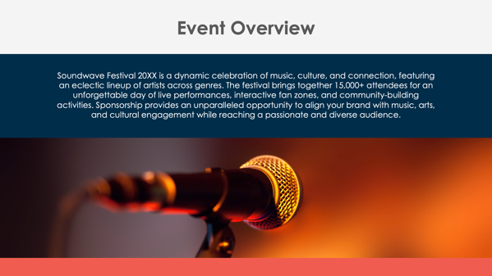
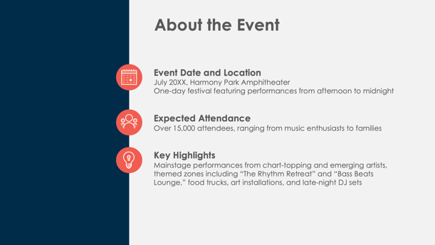
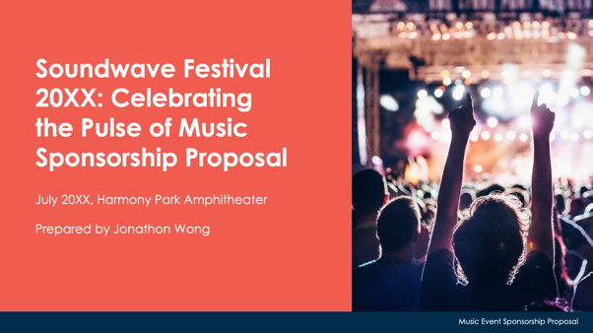
PowerPoint Music Event Sponsorship Proposal Template Example

Slide 2
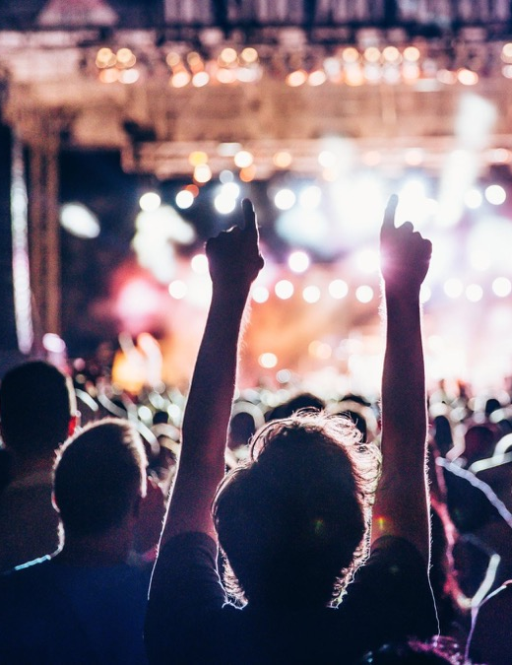
Soundwave Festival 20XX: Celebrating the Pulse of Music
Sponsorship Proposal
July 20XX, Harmony Park Amphitheater
Prepared by Jonathon Wong
EXAMPLE: Music Event Sponsorship Proposal

Slide 3
Contents
1 | Event Overview
2 | About the Event
3 | Sponsorship Opportunities
4 | Sponsorship Benefits
5 | Sponsorship Packages
6 | Custom Sponsorship Opportunities
7 | Marketing and Promotion Plan
8 | Music and Fan Engagement Opportunities
9 | Previous Successes and Testimonials
10 | Contact Information

Slide 4
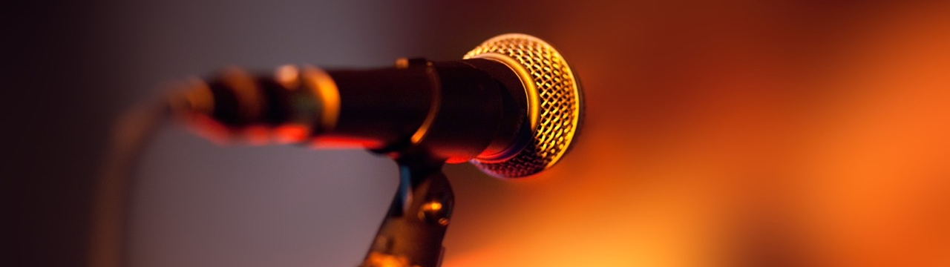
Event Overview
Soundwave Festival 20XX is a dynamic celebration of music, culture, and connection, featuring an eclectic lineup of artists across genres. The festival brings together 15,000+ attendees for an unforgettable day of live performances, interactive fan zones, and community-building activities. Sponsorship provides an unparalleled opportunity to align your brand with music, arts, and cultural engagement while reaching a passionate and diverse audience.

Slide 5



About the Event
Event Date and Location
July 20XX, Harmony Park Amphitheater
One-day festival featuring performances from afternoon to midnight
Expected Attendance
Over 15,000 attendees, ranging from music enthusiasts to families
Key Highlights
Mainstage performances from chart-topping and emerging artists, themed zones including “The Rhythm Retreat” and “Bass Beats Lounge,” food trucks, art installations, and late-night DJ sets

Slide 6




Sponsorship Opportunities
Title Sponsorship
Exclusive naming rights for Soundwave Festival 20XX, with logo placement on the main stage and all promotional materials
Branding Spaces
Opportunities like branded VIP lounges, stage banners, and merchandise
Digital Branding
The sponsor logo featured on the festival website, livestreams, and social media promotions
Event-Specific Option
Sponsors can host artist meet-and-greets, branded photo booths, or fan competitions

Slide 7
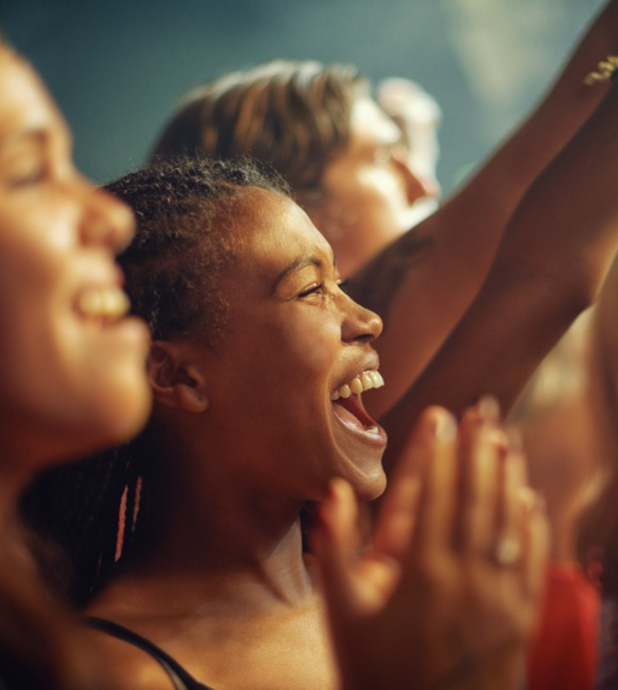
Sponsorship Benefits
Sponsors will receive unparalleled brand visibility through event signage, digital channels, and interactive fan engagement. This partnership creates strong associations with music and culture, aligning your brand with creativity and entertainment. Enhanced brand exposure will continue post-event through recap videos and follow-up marketing materials.
4

Slide 8
Sponsorship Packages
Platinum Package
Title sponsorship of the main stage, premium logo placement on all materials, 30 VIP tickets, and featured in press releases
Gold Package
Branding on merchandise and banners, 20 VIP tickets, and mentions in social media campaigns
Silver Package
Logo on digital materials, 10 general admission tickets, and mention in post-event video highlights
Bronze Package
Logo on event program, five general admission tickets, and social media thank-you posts
$X,XXX
$X,XXX
$X,XXX
$X,XXX

Slide 9
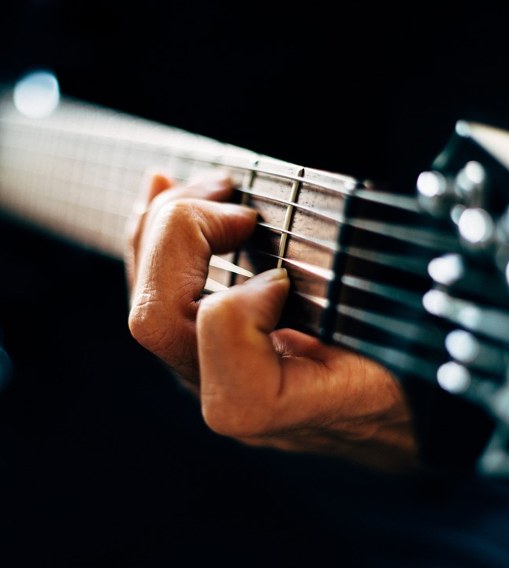
Custom Sponsorship Opportunities
Soundwave Festival 20XX offers tailored sponsorship options, including branded merchandise giveaways, sponsor-hosted afterparties, and custom artist collaborations. These unique opportunities allow brands to connect directly with attendees through creative and meaningful interactions.

Slide 10


Marketing and Promotion Plan
Pre-Event
Sponsors are featured in teaser campaigns, email blasts, and targeted social ads, reaching over 50,000 followers on digital platforms.
During Event
Sponsor branding is integrated into livestreams, on-site interviews, and social media highlights.
Post-Event
Sponsor logos are included in recap videos, thank-you posts, and follow-up emails, ensuring extended visibility.
7

Slide 11
Music and Fan Engagement Opportunities
Fan Zones
Sponsors can brand the interactive or themed spaces like “The Rhythm Retreat,” offering games and music-inspired activities.
Meet-and-Greet Sessions
Sponsors can host exclusive artist meet-and-greet sessions for VIP ticket holders.
VIP Lounges
Sponsors receive branding rights in premium lounge areas, creating an exclusive and immersive experience.
Competitions and Giveaways
Sponsors can engage attendees through branded contests and prize giveaways, fostering memorable interactions.

Slide 12
Previous Successes and Testimonials
In 20XX, the Soundwave Festival…
hosted over
12,000+
attendees
garnered
100,000+
media impressions
Feedback from previous sponsors includes:
“Soundwave exceeded expectations, offering us prime brand exposure and direct engagement with our target audience.”
Testimonials and metrics demonstrate the festival’s impact and professionalism.

Slide 13
Contact Information
Sponsorship Coordinator
Kiran Gupta
Website
Email
amplifyentertainment.com
sponsorships@amplifyentertainment.com
Phone
Web & Social
(555) 789-1234
Follow us on Instagram, Facebook, and X for event updates.

Slide 14
DISCLAIMER Any articles, templates, or information provided by Smartsheet on the website are for reference only. While we strive to keep the information up to date and correct, we make no representations or warranties of any kind, express or implied, about the completeness, accuracy, reliability, suitability, or availability with respect to the website or the information, articles, templates, or related graphics contained on the website. Any reliance you place on such information is therefore strictly at your own risk.

