Slide 1

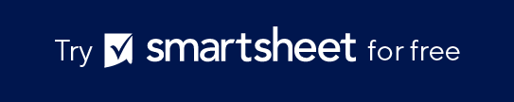
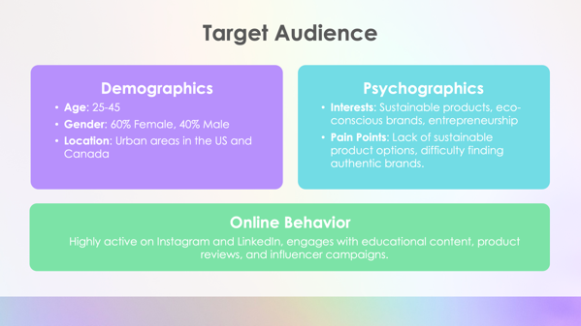
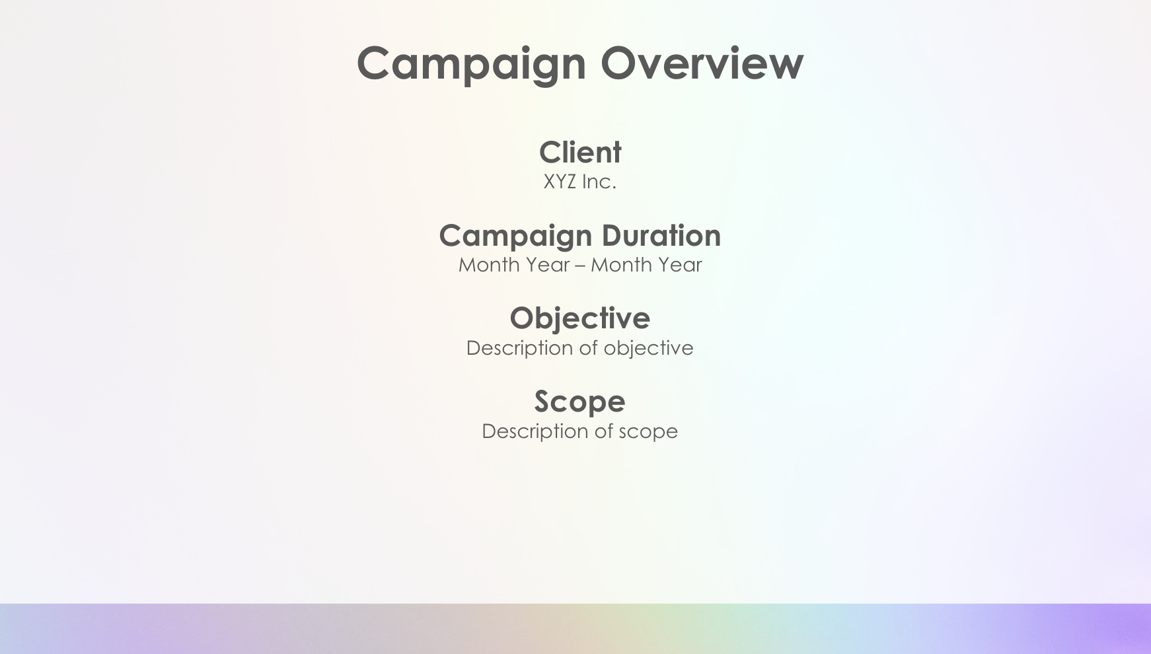
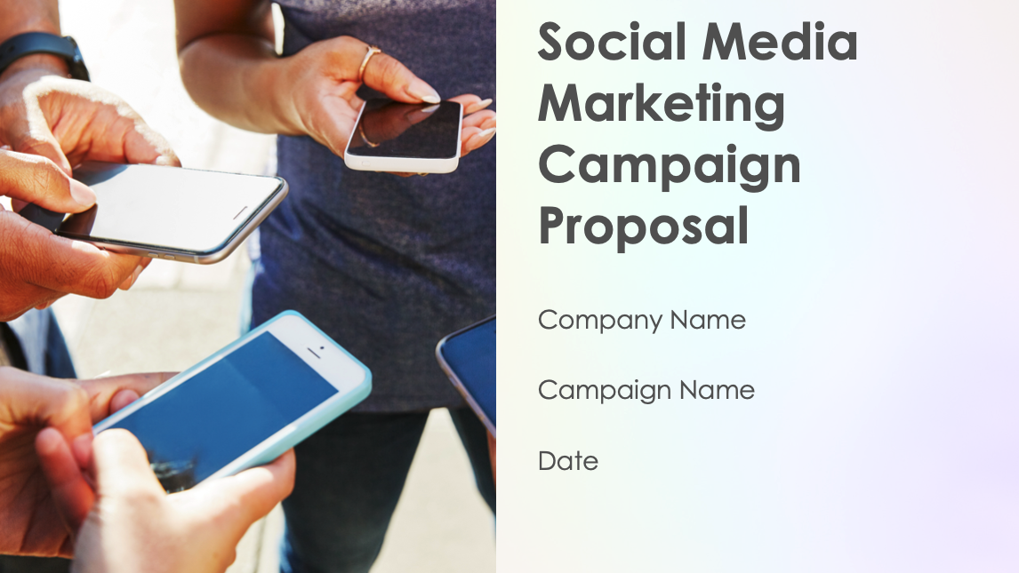
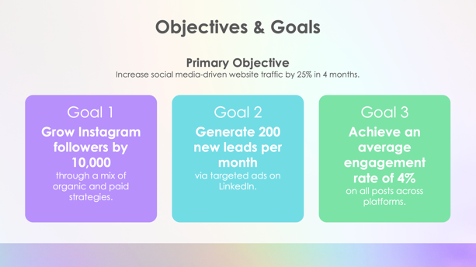
Social Media Marketing Campaign Proposal Template Example

Slide 2
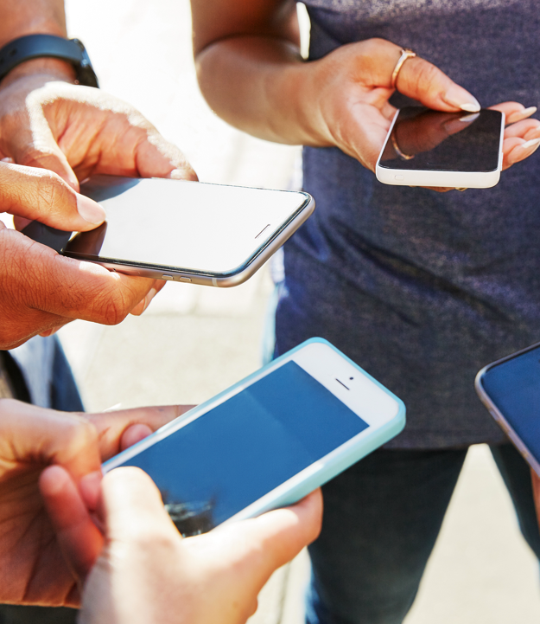
Social Media Marketing Campaign Proposal
Company name
Campaign name
Date

Slide 3

Campaign Overview
Client
XYZ Inc.
Campaign Duration
November 2024 – February 2025
Objective
Drive brand awareness and customer acquisition through a targeted social media strategy.
Scope
Full-service social media management across Facebook, Instagram, and LinkedIn.

Slide 4
Objectives & Goals
Primary Objective
Increase social media-driven website traffic by 25% in 4 months.
Goal 1
Grow Instagram followers by 10,000
through a mix of organic and paid strategies.
Goal 2
Generate 200 new leads per month
via targeted ads on LinkedIn.
Goal 3
Achieve an average engagement rate of 4%
on all posts across platforms.

Slide 5
Target Audience
Demographics
Age: 25–45
Gender: 60% female, 40% male
Location: Urban areas in the US and Canada
Psychographics
Interests: Sustainable products, eco-conscious brands, entrepreneurship
Pain Points: Lack of sustainable product options, difficulty finding authentic brands
Online Behavior
Highly active on Instagram and LinkedIn, engages with educational content, product reviews, and influencer campaigns

Slide 6
Competitive Analysis
Competitors Analyzed
GreenFuture Co., EcoMarket Inc., Sustainify
Key Insights
GreenFuture Co.
has strong Instagram engagement but limited presence on LinkedIn.
EcoMarket Inc.
dominates Facebook ads but lacks consistent organic content.
Sustainify’s
influencer campaigns have increased their visibility but have low conversion rates.
Opportunities
Invest more in LinkedIn content to capture an underserved audience in the B2B space.

Slide 7
Marketing Reach by Channel
Facebook
Reach last year
200,000
Customer acquisitions
300
Top-performing channel for retargeting ads
(5% conversion rate)
Instagram
Reach last year
500,000
Customer acquisitions
800
Best for brand awareness and community engagement
(7% engagement rate)
LinkedIn
Reach last year
100,000
Customer acquisitions
150
High-quality leads and B2B connections

Slide 8




Content Strategy
Content Pillars
Educational
(Sustainability tips, industry trends)
Promotional
(New products, special offers)
User-Generated Content
(Customer stories, testimonials)
Influencer Partnerships
(Micro-influencers in the eco-friendly space)
Formats
Instagram reels, stories, and static posts;
LinkedIn articles and infographics;
Facebook video ads

Slide 9
Channel Strategy
Facebook
Focus on retargeting ads and community engagement through groups.
Instagram
Prioritize Instagram reels for organic reach, with influencer collaboration to increase visibility.
LinkedIn
Use LinkedIn ads and thought leadership content to generate B2B leads.

Slide 10
Campaign Timeline
Campaign kickoff
Content creation
Initial ads launch
Social media ads optimization
Influencer partnerships begin
Increased promotional activity
Mid-campaign review
Final push for customer acquisition
Post-campaign performance analysis
November–December
December–January
January–February
February–March

Slide 11





Cost Breakdown
Total campaign cost
$50,000
Paid ads
$25,000
Content creation
$10,000
Influencer marketing
$5,000
Analytics & reporting
$3,000
Management fees
$7,000
Payment terms
50% upfront,
50% on completion

Slide 12
Metrics & Reporting
KPIs Tracked
Reach, impressions, and engagement (weekly reports)
Conversion rates (monthly)
ROI on ad spend (end of campaign)
Tools Used
Google analytics
Facebook ads manager
Instagram insights
LinkedIn campaign manager

Slide 13
Next Steps
Sign contract
Confirm approval to proceed with campaign execution.
Kickoff meeting
Schedule a meeting within the first week to align on content and ads.
Campaign launch
Set the go-live date for all platforms.

Slide 14
Social Media Marketing Campaign Proposal
Company name
Campaign name
Date

Slide 15
Campaign Overview
Client
XYZ Inc.
Campaign Duration
Month Year – Month Year
Objective
Description of objective
Scope
Description of scope

Slide 16
Objectives & Goals
Primary Objective
Description of primary objective
Goal 1
Grow Instagram followers by XXXXX
through a mix of organic and paid strategies.
Goal 2
Generate XXX new leads per month
via targeted ads on LinkedIn.
Goal 3
Achieve an average engagement rate of X%
on all posts across platforms.

Slide 17
Target Audience
Demographics
Age:
Gender: XX% female, XX% male
Location:
Psychographics
Interests:
Pain Points:
Online Behavior
Description of online behavior

Slide 18
Competitive Analysis
Competitors Analyzed
Company names
Key Insights
Company Name
has strong Instagram engagement but limited presence on LinkedIn.
Company Name
dominates Facebook ads but lacks consistent organic content.
Company Name
influencer campaigns have increased their visibility but have low conversion rates.
Opportunities
Description of opportunities

Slide 19
Marketing Reach by Channel
Facebook
Reach last year
XXX,XXX
Customer acquisitions
XXX
Top-performing channel for retargeting ads
(X% conversion rate)
Instagram
Reach last year
XXX,XXX
Customer acquisitions
XXX
Best for brand awareness and community engagement
(X% engagement rate)
LinkedIn
Reach last year
XXX,XXX
Customer acquisitions
XXX
High-quality leads and B2B connections

Slide 20
Content Strategy
Content Pillars
Educational
(Sustainability tips, industry trends)
Promotional
(New products, special offers)
User-Generated Content
(Customer stories, testimonials)
Influencer Partnerships
(Micro-influencers in the eco-friendly space)
Formats
Instagram reels, stories, and static posts;
LinkedIn articles and infographics;
Facebook video ads

Slide 21
Channel Strategy
Facebook
Description of strategy
Instagram
Description of strategy
LinkedIn
Description of strategy

Slide 22
Campaign Timeline
Description
Description
Description
Description
Description
Description
Description
Description
Description
November–December
December–January
January–February
February–March

Slide 23
Cost Breakdown
Total campaign cost
$XX,XXX
Paid ads
$XX,XXX
Content creation
$XX,XXX
Influencer marketing
$X,XXX
Analytics & reporting
$X,XXX
Management fees
$X,XXX
Payment terms
XX% upfront,
XX% on completion

Slide 24
Metrics & Reporting
KPIs Tracked
List of tracked KPIs
Tools Used
List of tools used

Slide 25
Next Steps
Sign contract
Confirm approval to proceed with campaign execution.
Kickoff meeting
Schedule a meeting within the first week to align on content and ads.
Campaign launch
Set the go-live date for all platforms.

Slide 26
DISCLAIMER Any articles, templates, or information provided by Smartsheet on the website are for reference only. While we strive to keep the information up to date and correct, we make no representations or warranties of any kind, express or implied, about the completeness, accuracy, reliability, suitability, or availability with respect to the website or the information, articles, templates, or related graphics contained on the website. Any reliance you place on such information is therefore strictly at your own risk.

