Slide 1

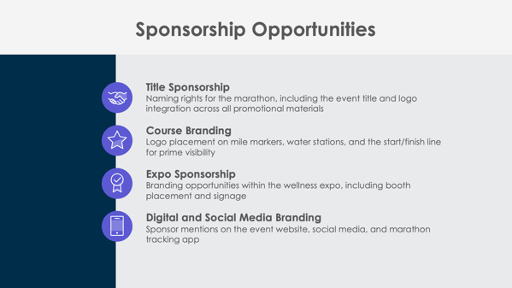

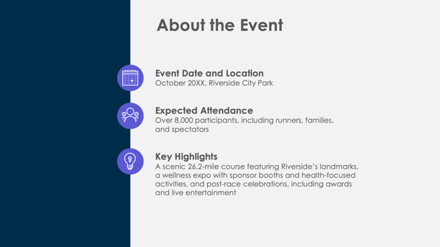

PowerPoint Marathon Sponsorship Proposal Template

Slide 2

Event Name
Sponsorship Proposal
Event Date and Location
Organization’s Name
Prepared by Name
Marathon Sponsorship Proposal

Slide 3
Contents
1 | Event Overview
2 | About the Event
3 | Sponsorship Opportunities
4 | Sponsorship Benefits
5 | Sponsorship Packages
6 | Custom Sponsorship Opportunities
7 | Marketing and Promotion Plan
8 | Audience Reach and Community Impact
9 | Runner and Spectator Opportunities
10 | Previous Successes and Testimonials
11 | Contact Information

Slide 4

Event Overview

Slide 5



About the Event
Event Date and Location
Expected Attendance
Key Highlights

Slide 6




Sponsorship Opportunities
Title Sponsorship
Course Branding
Expo Sponsorship
Digital and Social Media Branding

Slide 7

Sponsorship Benefits
4

Slide 8
Sponsorship Packages
Platinum Package
Gold Package
Silver Package
Bronze Package
$X,XXX
$X,XXX
$X,XXX
$X,XXX

Slide 9

Custom Sponsorship Opportunities

Slide 10


Marketing and Promotion Plan
Pre-Event
During Event
Post-Event
7

Slide 11
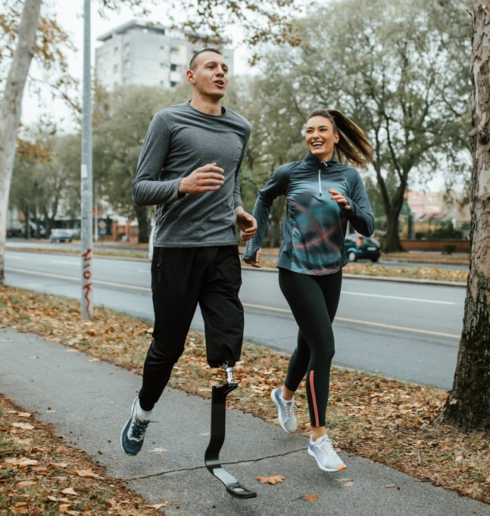

Audience Reach and Community Impact
Attendance
Demographics
Media Exposure

Slide 12

Runner and Spectator Engagement Opportunities

Slide 13
Previous Successes and Testimonials
The Marathon Name has a proven track record, with
over
X,XXX
participants
over
XX,XXX
media impressions
Feedback from previous sponsors includes:
“Quote here.”

Slide 14
Contact Information
Sponsorship Coordinator
Name
Website
Email
company.com
sponsorships@company.com
Phone
Web & Social
(555) 234-5678
Follow us on Instagram, Facebook, Threads, and X for event updates.

Slide 15
DISCLAIMER Any articles, templates, or information provided by Smartsheet on the website are for reference only. While we strive to keep the information up to date and correct, we make no representations or warranties of any kind, express or implied, about the completeness, accuracy, reliability, suitability, or availability with respect to the website or the information, articles, templates, or related graphics contained on the website. Any reliance you place on such information is therefore strictly at your own risk.

