Slide 1

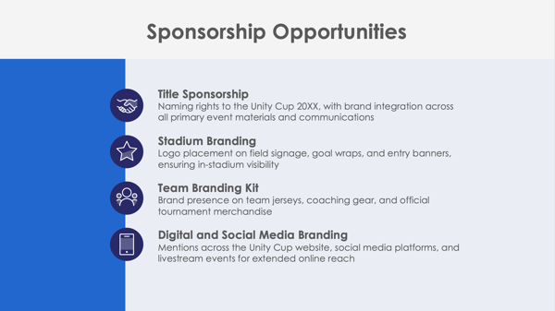
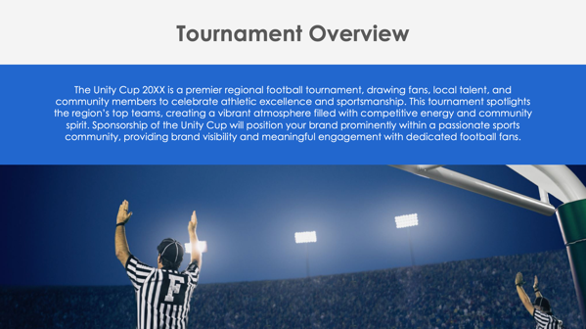
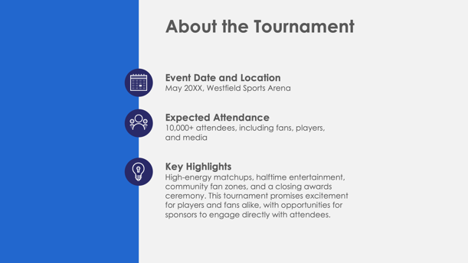

PowerPoint Football Tournament Sponsorship Proposal Template Example

Slide 2
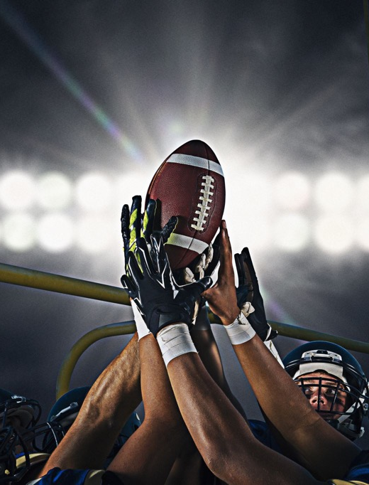
Unity Cup 20XX: Regional Football Championship
Sponsorship Proposal
May 20XX, Westfield Sports Arena
Victory Sports Alliance
Prepared by Hazel Christensen
EXAMPLE: Football Tournament Sponsorship Proposal

Slide 3
Contents
1 | Tournament Overview
2 | About the Tournament
3 | Sponsorship Opportunities
4 | Sponsorship Benefits
5 | Sponsorship Packages
6 | Custom Sponsorship Opportunities
7 | Marketing and Promotion Plan
8 | Audience Reach and Fan Demographics
9 | Fan Engagement and Activation Opportunities
10 | Previous Successes and Testimonials
11 | Contact Information

Slide 4
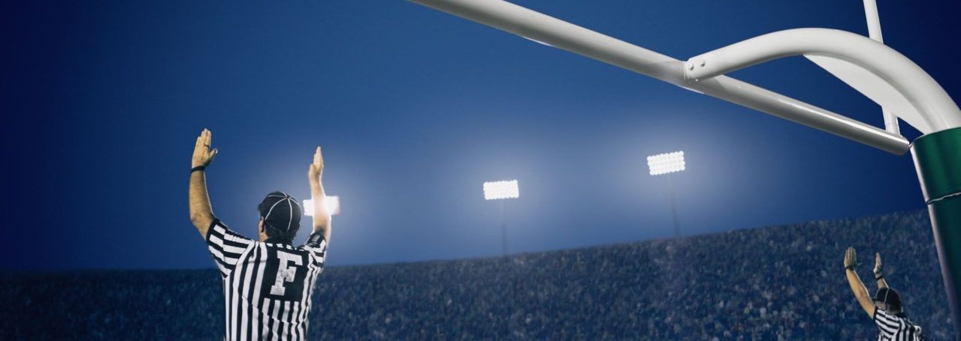
Tournament Overview
The Unity Cup 20XX is a premier regional football tournament, drawing fans, local talent, and community members to celebrate athletic excellence and sportsmanship. This tournament spotlights the region’s top teams, creating a vibrant atmosphere filled with competitive energy and community spirit. Sponsorship of the Unity Cup will position your brand prominently within a passionate sports community, providing brand visibility and meaningful engagement with dedicated football fans.

Slide 5



About the Tournament
Event Date and Location
May 20XX, Westfield Sports Arena
Expected Attendance
10,000+ attendees, including fans, players,
and media
Key Highlights
High-energy matchups, halftime entertainment, community fan zones, and a closing awards ceremony. This tournament promises excitement for players and fans alike, with opportunities for sponsors to engage directly with attendees.

Slide 6



Sponsorship Opportunities
Title Sponsorship
Naming rights to the Unity Cup 20XX, with brand integration across all primary event materials and communications
Stadium Branding
Logo placement on field signage, goal wraps, and entry banners, ensuring in-stadium visibility
Team Branding Kit
Brand presence on team jerseys, coaching gear, and official tournament merchandise
Digital and Social Media Branding
Mentions across the Unity Cup website, social media platforms, and livestream events for extended online reach

Slide 7
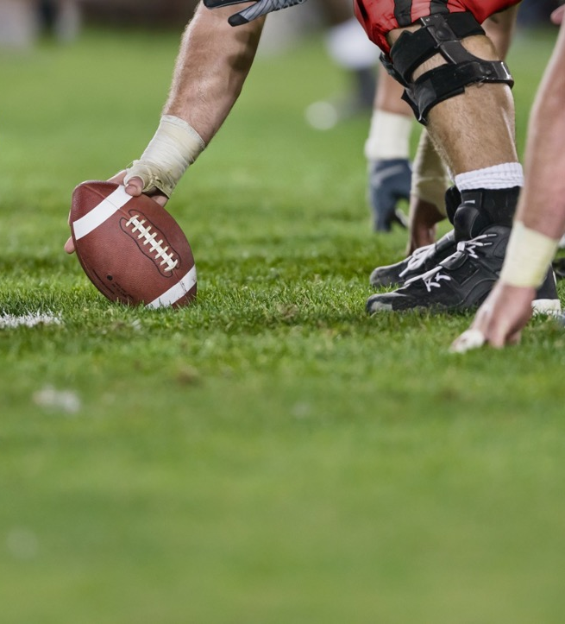
Sponsorship Benefits
Unity Cup 20XX sponsorship provides high-impact brand visibility across in-stadium and online channels, reaching a dedicated sports audience. Sponsors will engage directly with fans through branded zones and interactive experiences, fostering positive brand associations with sportsmanship and community values. Enhanced visibility will continue in post-event recaps and digital media, ensuring a lasting sponsor presence.
4

Slide 8
Sponsorship Packages
Platinum Package
Title sponsorship with top-tier logo placement on all stadium signage, team kits, 40 VIP passes, and exclusive media branding in press and social channels
Gold Package
Prominent logo placement on stadium banners and player benches, 25 VIP tickets, and mentions in tournament social media updates
Silver Package
Logo featured on the tournament website and select signage, 15 general admission tickets, and acknowledgment in post-event highlights
Bronze Package
Logo placement in the event program, social media shout-out, and five general admission tickets
$X,XXX
$X,XXX
$X,XXX
$X,XXX

Slide 9
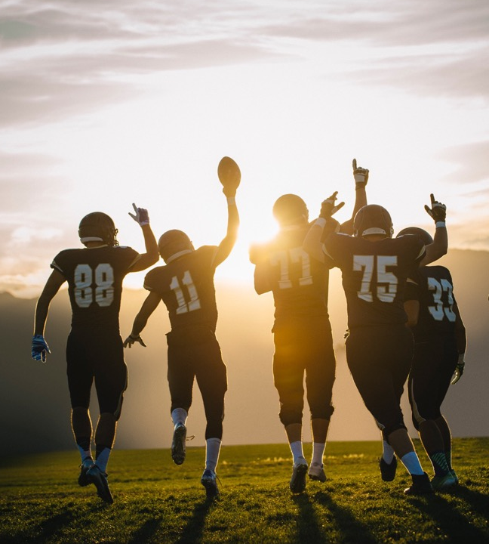
Custom Sponsorship Opportunities
Victory Sports Alliance offers tailored options to maximize brand impact, including branded fan zones, exclusive halftime shows, sponsor-hosted challenges, and branded giveaways. These custom opportunities allow sponsors to connect directly with fans, creating unique brand moments aligned with their marketing goals.

Slide 10


Marketing and Promotion Plan
Pre-Tournament
Social media countdowns, influencer partnerships, and press releases highlighting sponsor involvement
During Tournament
Real-time social media updates, livestream branding, and in-stadium digital screens to maximize exposure
Post-Tournament
Sponsor recognition in event recap videos, thank-you posts, and follow-up newsletters to attendees to extend the brand's reach
7

Slide 11
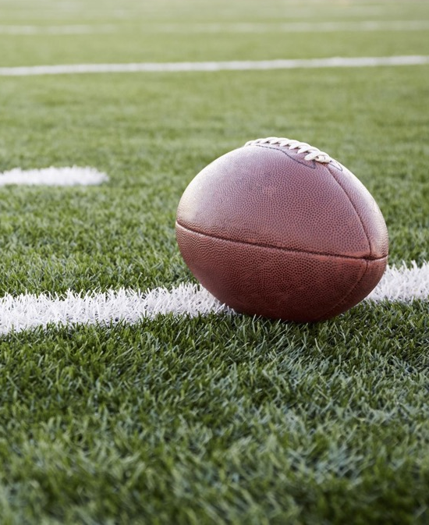

Audience Reach and Fan Demographics
Attendance and Viewership
Over 10,000 on-site fans and an expected 20,000 virtual viewers through livestreams
Audience Demographics
Primarily 18–45 years old, sports enthusiasts, families, and community members interested in team sports
Media Coverage
The event will receive coverage from local sports channels, digital sports platforms, and local newspapers, offering sponsors extensive reach within the sports community

Slide 12
Fan Engagement and Activation Opportunities
Fan Zones
Branded interactive areas where attendees can enjoy games, photo booths, and giveaways
Sponsor Booths
Branded booths within the stadium where sponsors can directly interact with fans
Contests and Giveaways
Sponsor-hosted halftime challenges and branded merchandise prizes to enhance fan engagement
VIP Lounge
Exclusive branded area for sponsor representatives, guests, and media, creating a premium experience aligned with the brand’s image

Slide 13
Previous Successes and Testimonials
The Unity Cup's previous events have…
attracted over
10,000
attendees
garnered
45,000+
media impressions
Feedback from previous sponsors includes:
“The Unity Cup allowed us to connect with fans and significantly boosted our visibility among a passionate sports audience.”
Metrics and positive feedback demonstrate the tournament's impact and value for sponsors.

Slide 14
Contact Information
Sponsorship Coordinator
Jason Desjardins
Website
Email
victorysportsalliance.org
sponsorships@victorysportsalliance.org
Phone
Web & Social
(555) 345-6789
Follow us on Instagram, X, Facebook, and Threads for updates on Unity Cup 20XX.

Slide 15
DISCLAIMER Any articles, templates, or information provided by Smartsheet on the website are for reference only. While we strive to keep the information up to date and correct, we make no representations or warranties of any kind, express or implied, about the completeness, accuracy, reliability, suitability, or availability with respect to the website or the information, articles, templates, or related graphics contained on the website. Any reliance you place on such information is therefore strictly at your own risk.

