Slide 1

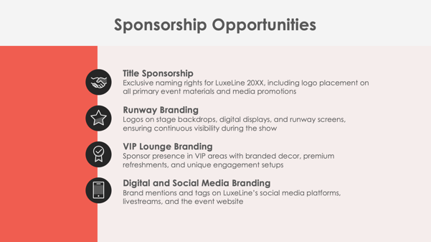
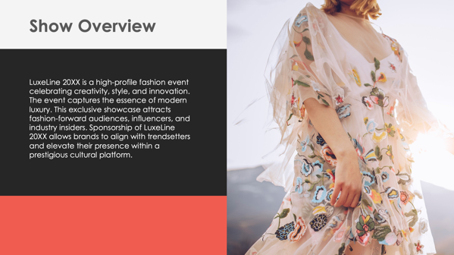
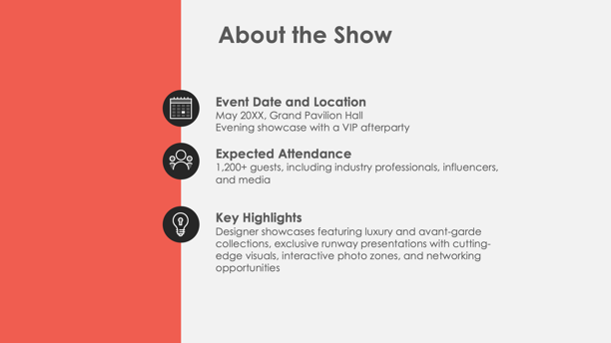
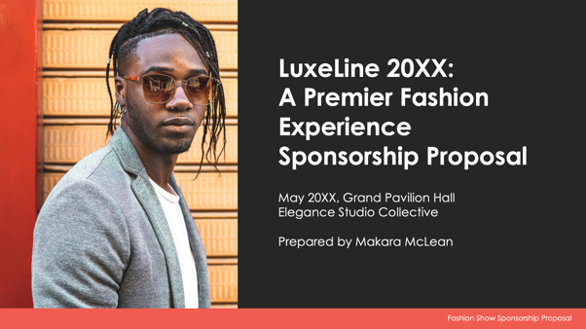
PowerPoint Fashion Show Sponsorship Proposal Template Example

Slide 2
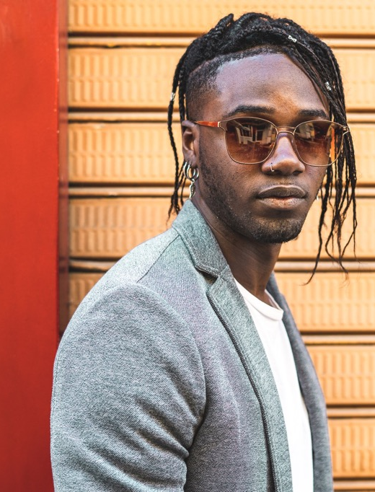
LuxeLine 20XX:
A Premier Fashion Experience
Sponsorship Proposal
May 20XX, Grand Pavilion Hall
Elegance Studio Collective
Prepared by Makara McLean
EXAMPLE: Fashion Show Sponsorship Proposal

Slide 3
Contents
1 | Show Overview
2 | About the Show
3 | Sponsorship Opportunities
4 | Sponsorship Benefits
5 | Sponsorship Packages
6 | Custom Sponsorship Opportunities
7 | Marketing and Promotion Plan
8 | Audience Reach and Influencer Engagement
9 | Fashion Show Attendee Engagement Opportunities
10 | Previous Successes and Testimonials
11 | Contact Information

Slide 4

Show Overview
LuxeLine 20XX is a high-profile fashion event celebrating creativity, style, and innovation. The event captures the essence of modern luxury. This exclusive showcase attracts fashion-forward audiences, influencers, and industry insiders. Sponsorship of LuxeLine 20XX allows brands to align with trendsetters and elevate their presence within a prestigious cultural platform.

Slide 5



About the Show
Event Date and Location
May 20XX, Grand Pavilion Hall
Evening showcase with a VIP afterparty
Expected Attendance
1,200+ guests, including industry professionals, influencers, and media
Key Highlights
Designer showcases featuring luxury and avant-garde collections, exclusive runway presentations with cutting-edge visuals, interactive photo zones, and networking opportunities

Slide 6




Sponsorship Opportunities
Title Sponsorship
Exclusive naming rights for LuxeLine 20XX, including logo placement on all primary event materials and media promotions
Runway Branding
Logos on stage backdrops, digital displays, and runway screens, ensuring continuous visibility during the show
VIP Lounge Branding
Sponsor presence in VIP areas with branded decor, premium refreshments, and unique engagement setups
Digital and Social Media Branding
Brand mentions and tags on LuxeLine’s social media platforms, livestreams, and the event website

Slide 7
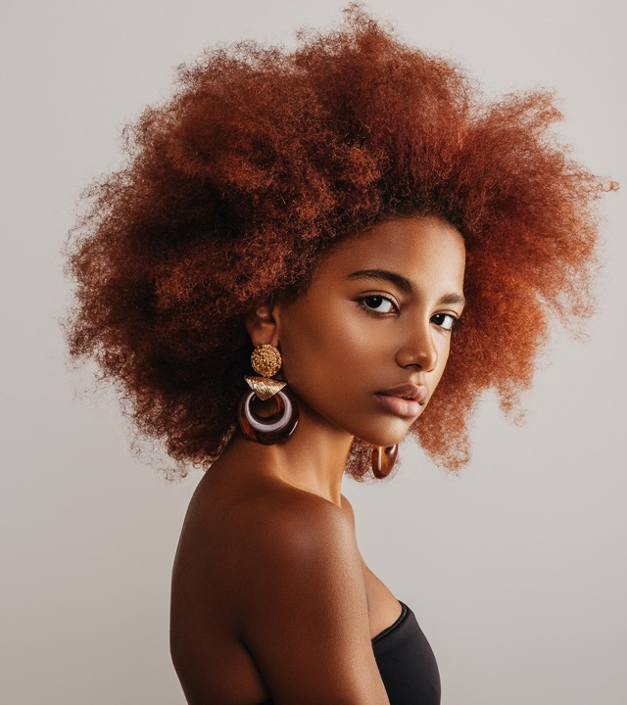
Sponsorship Benefits
Sponsors gain premium exposure to high-net-worth individuals, influencers, and fashion enthusiasts. LuxeLine 20XX positions your brand as a supporter of creativity and style, enhancing its image in the luxury space. Sponsors enjoy lasting connections with an exclusive audience through multi-channel visibility and direct interaction opportunities.
4

Slide 8
Sponsorship Packages
Platinum Package
Title sponsorship with top-tier logo placement on all runway backdrops and event materials, 30 VIP tickets, and featured mentions in media and press releases
Gold Package
Prominent logo placement on venue signage and photo walls, 20 VIP tickets, and mentions in event newsletters and social media campaigns
Silver Package
Logo placement on the event website, 10 general admission tickets, and acknowledgment in post-event highlights
Bronze Package
Logo in the event program, a social media thank-you post, and five general admission tickets
$X,XXX
$X,XXX
$X,XXX
$X,XXX

Slide 9
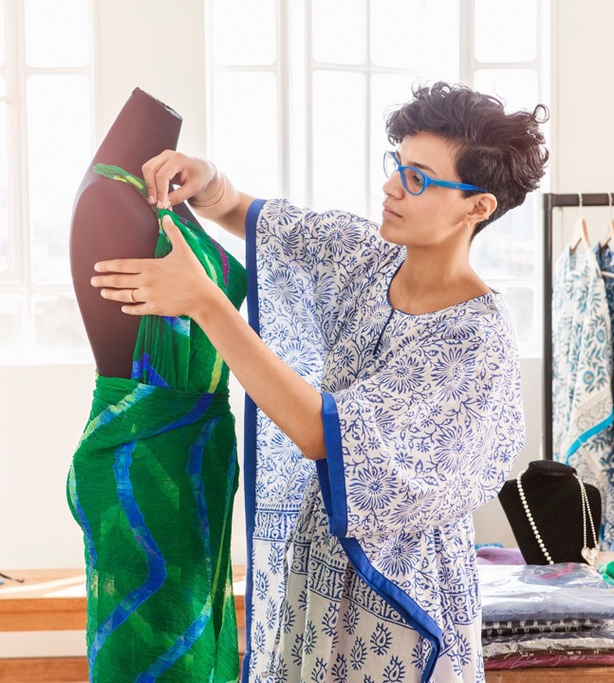
Custom Sponsorship Opportunities
LuxeLine 20XX offers custom sponsorship options, including branded gift bags, sponsor-hosted pre-show receptions, runway walk branding, and exclusive afterparty sponsorships. These tailored opportunities allow brands to create immersive and personalized interactions with attendees, reinforcing brand identity.

Slide 10


Marketing and Promotion Plan
Pre-Event
Social media countdowns, influencer collaborations, and press releases featuring sponsor mentions
During Event
Real-time social media updates, livestream coverage with branded placements, and on-site interviews highlighting sponsors
Post-Event
Recap videos, thank-you posts on social media, and a detailed summary report featuring sponsor contributions
7

Slide 11
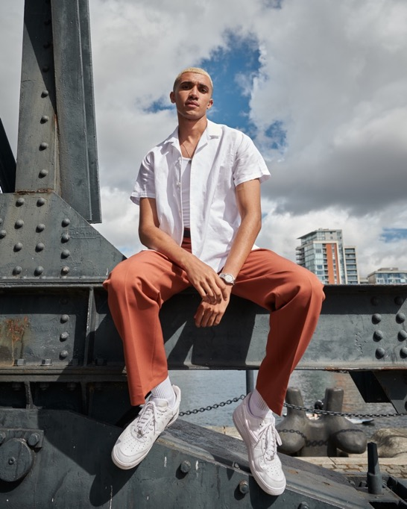

Audience Reach and Influencer Engagement
Projected Reach
1,200+ attendees on-site and thousands of livestream viewers
Demographics
Primarily fashion-forward individuals aged 25–50, including professionals, influencers, and trendsetters
Media Exposure
Prominent lifestyle magazines and fashion bloggers to ensure broad visibility across multiple platforms

Slide 12
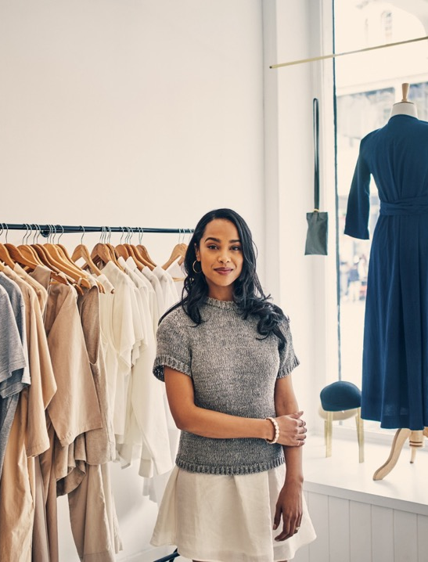
Fashion Show Attendee Engagement Opportunities
Branded Social Zones
Sponsors can host interactive spaces for guests to capture branded social media content.
Competitions and Giveaways
Sponsors can engage attendees with contests, offering branded prizes to enhance their connection.
VIP Lounge Experiences
Exclusive branding within VIP areas creates a premium atmosphere for high-profile attendees.
Live Social Media Challenges
Sponsors can initiate interactive campaigns for attendees and online viewers, amplifying digital engagement.

Slide 13
Previous Successes and Testimonials
In 20XX, LuxeLine…
attracted over
1,000
attendees
garnered over
80,000
media impressions
Feedback from previous sponsors includes:
“LuxeLine provided unparalleled exposure to our target market, positioning our brand alongside the essence of luxury.”
These metrics highlight the event’s success and value for sponsors.

Slide 14
Contact Information
Sponsorship Coordinator
Mateus Tobin
Website
Email
elegancestudiocollective.com
sponsorships@elegancestudiocollective.com
Phone
Web & Social
(555) 987-6543
Follow us on Instagram, X, Facebook, and Threads for updates.

Slide 15
DISCLAIMER Any articles, templates, or information provided by Smartsheet on the website are for reference only. While we strive to keep the information up to date and correct, we make no representations or warranties of any kind, express or implied, about the completeness, accuracy, reliability, suitability, or availability with respect to the website or the information, articles, templates, or related graphics contained on the website. Any reliance you place on such information is therefore strictly at your own risk.

