Slide 1

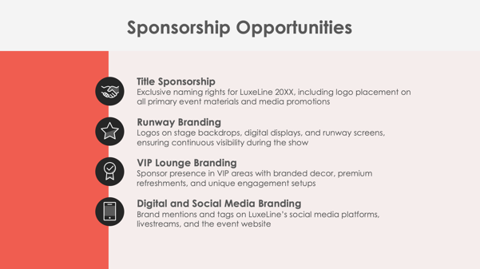
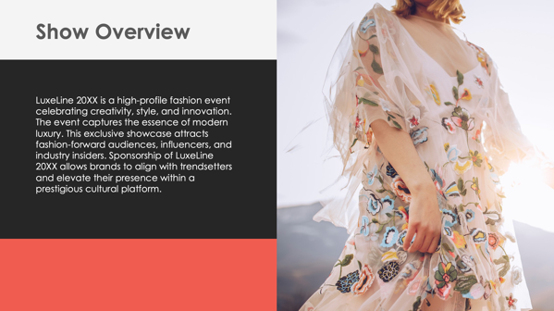
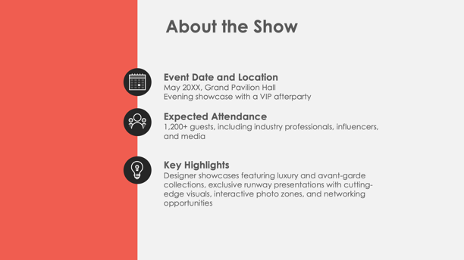
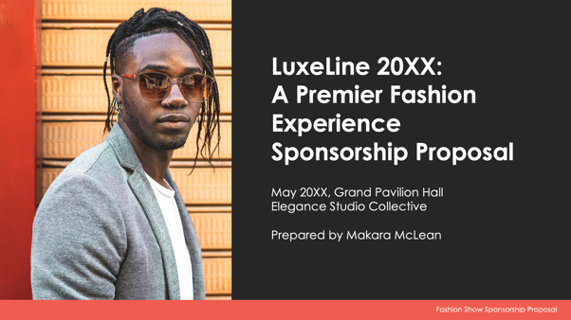
PowerPoint Fashion Show
Sponsorship Proposal Template

Slide 2

Show Name:
Sponsorship Proposal
Event Date and Location
Organization’s Name
Prepared by Name
Fashion Show Sponsorship Proposal

Slide 3
Contents
1 | Show Overview
2 | About the Show
3 | Sponsorship Opportunities
4 | Sponsorship Benefits
5 | Sponsorship Packages
6 | Custom Sponsorship Opportunities
7 | Marketing and Promotion Plan
8 | Audience Reach and Influencer Engagement
9 | Fashion Show Attendee Engagement Opportunities
10 | Previous Successes and Testimonials
11 | Contact Information

Slide 4

Show Overview

Slide 5



About the Show
Event Date and Location
Expected Attendance
Key Highlights

Slide 6




Sponsorship Opportunities
Title Sponsorship
Runway Branding
VIP Lounge Branding
Digital and Social Media Branding

Slide 7
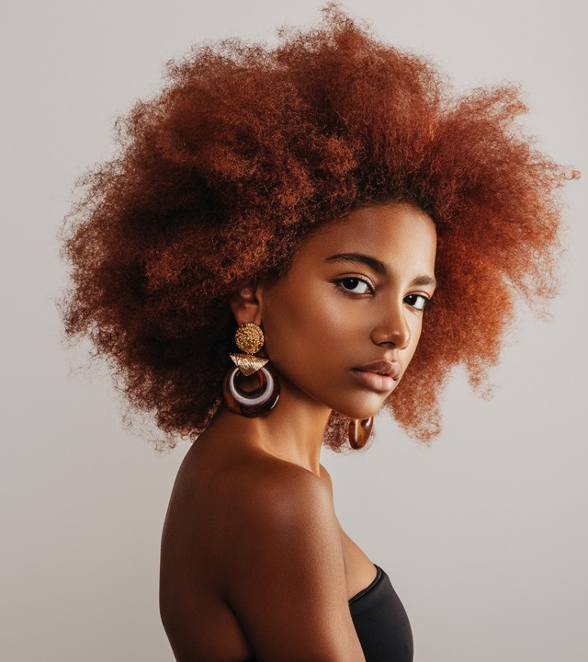
Sponsorship Benefits
4

Slide 8
Sponsorship Packages
Platinum Package
Gold Package
Silver Package
Bronze Package
$X,XXX
$X,XXX
$X,XXX
$X,XXX

Slide 9
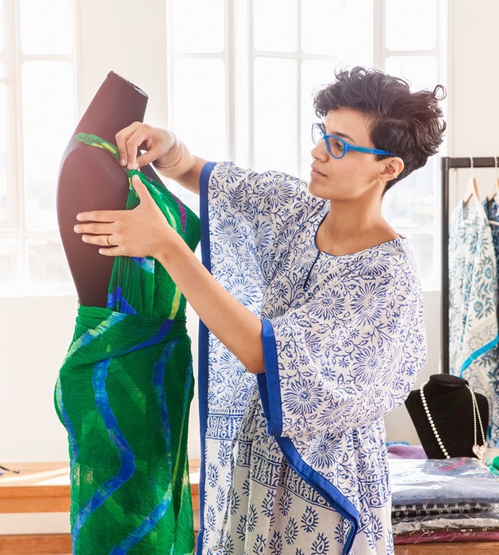
Custom Sponsorship Opportunities

Slide 10


Marketing and Promotion Plan
Pre-Event
During Event
Post-Event
7

Slide 11


Audience Reach and Influencer Engagement
Projected Reach
Demographics
Media Exposure

Slide 12
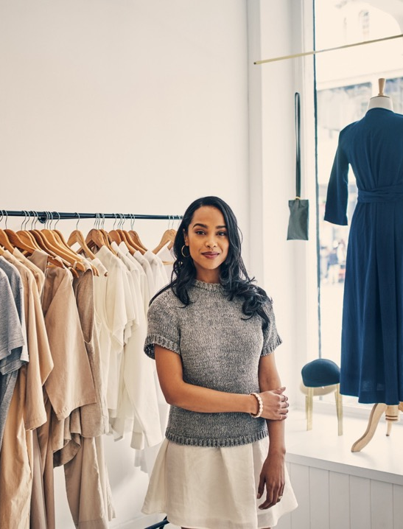
Fashion Show Attendee Engagement Opportunities

Slide 13
Previous Successes and Testimonials
In 20XX, Company Name…
attracted over
X,XXX
attendees
garnered over
XX,XXX
media impressions
Feedback from previous sponsors includes:
“Quote here.”

Slide 14
Contact Information
Sponsorship Coordinator
Name
Website
Email
company.com
sponsorships@company.com
Phone
Web & Social
(555) 987-6543
Follow us on Instagram, X, Facebook, and Threads for updates.

Slide 15
DISCLAIMER Any articles, templates, or information provided by Smartsheet on the website are for reference only. While we strive to keep the information up to date and correct, we make no representations or warranties of any kind, express or implied, about the completeness, accuracy, reliability, suitability, or availability with respect to the website or the information, articles, templates, or related graphics contained on the website. Any reliance you place on such information is therefore strictly at your own risk.

