Slide 1

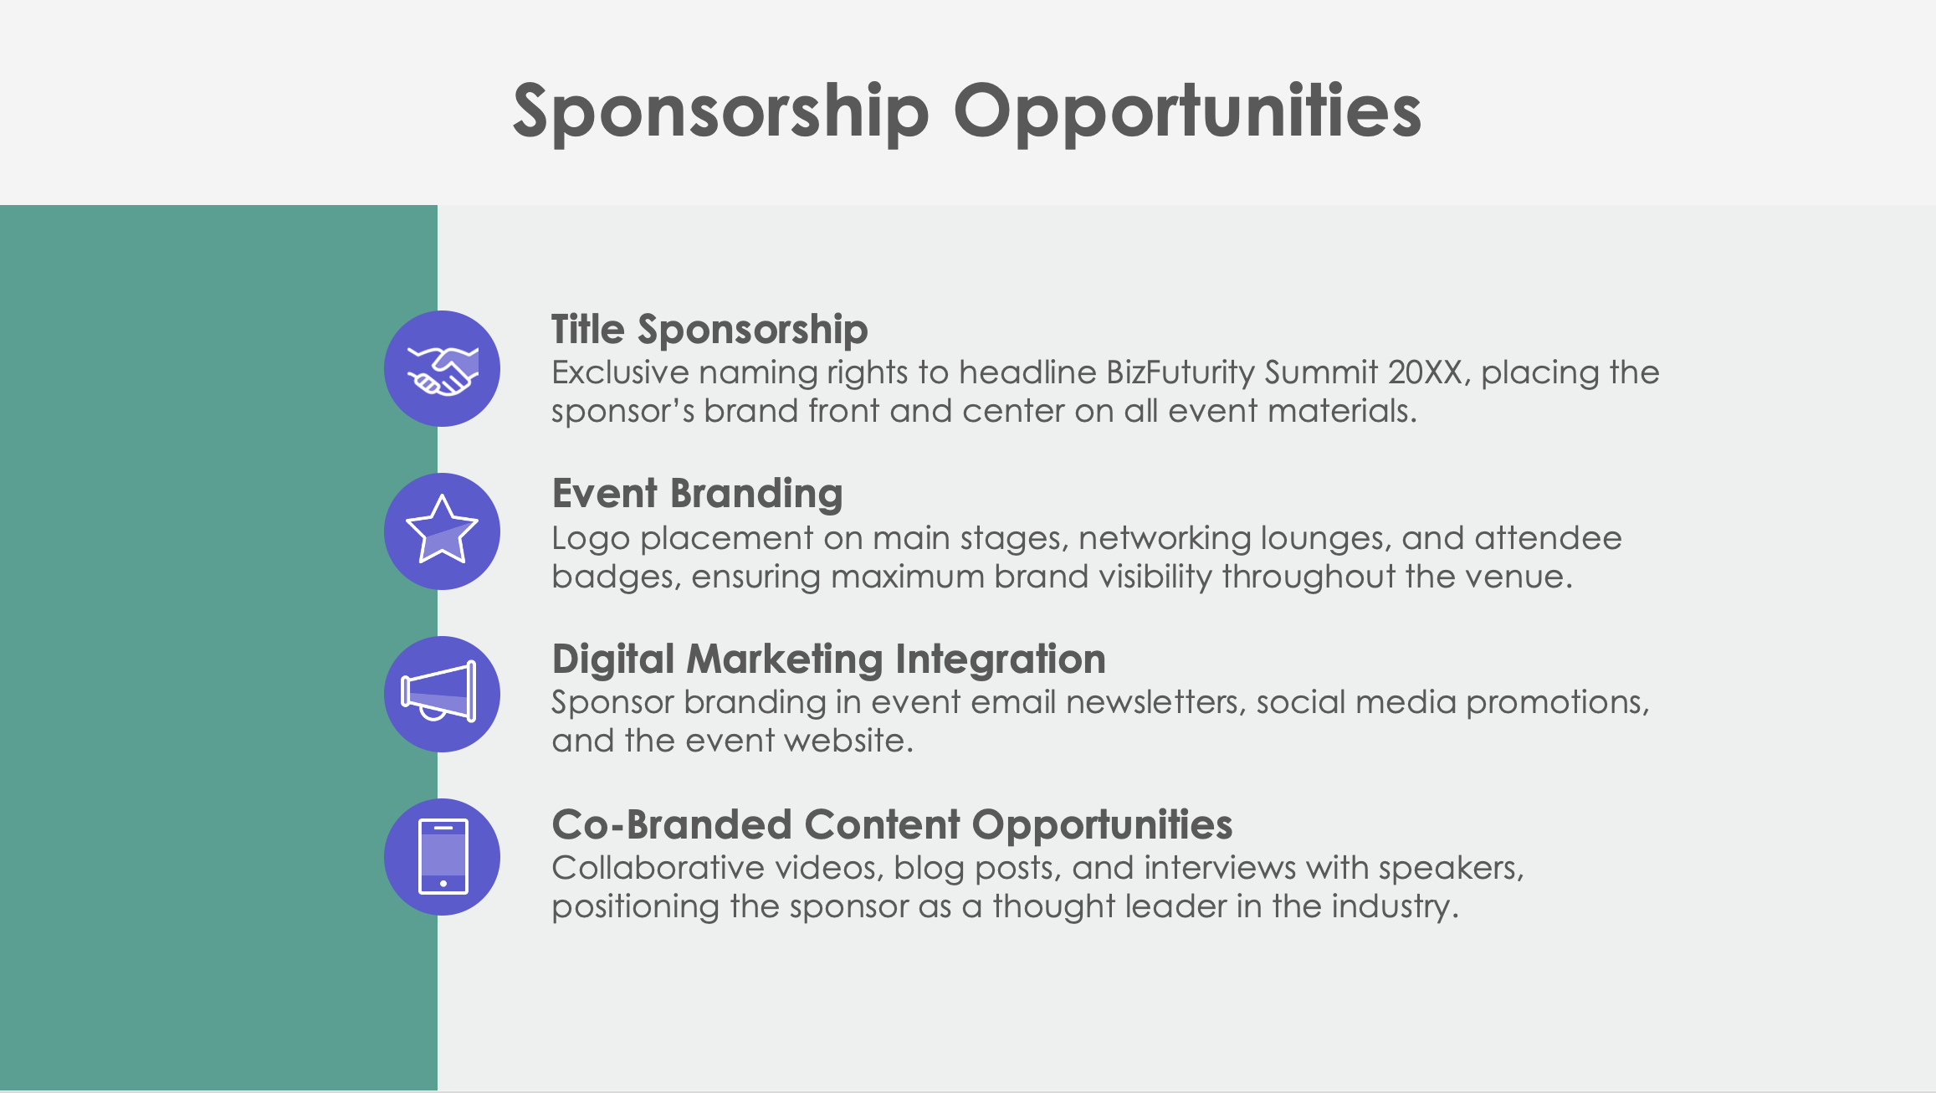

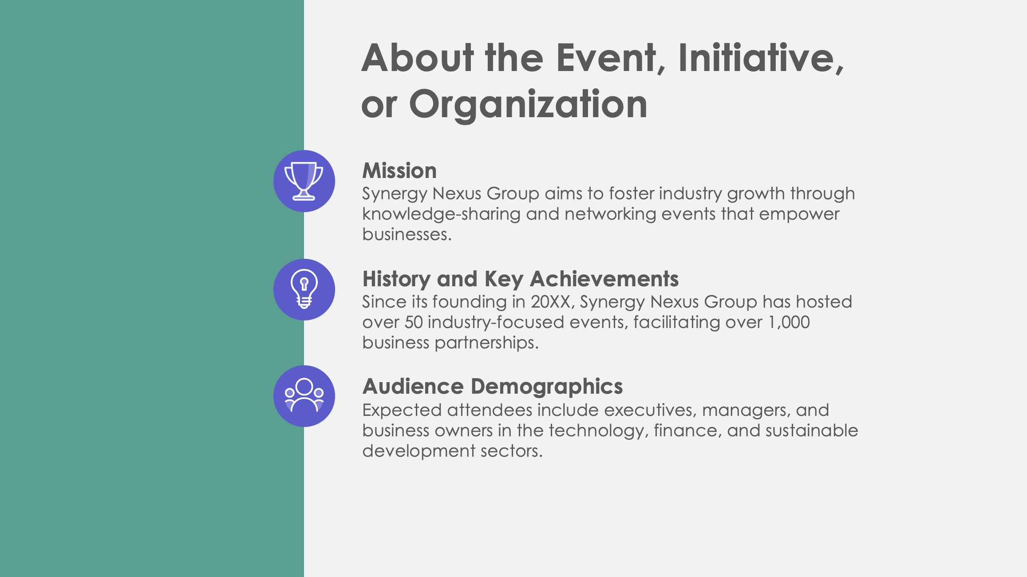

PowerPoint Corporate Sponsorship Proposal Template Example

Slide 2

BizFuturity Summit 20XX: Business Growth & Networking Summit Sponsorship Proposal
September 20XX, City Center Convention Hall
Synergy Nexus Group
Prepared by Devon Gomez
EXAMPLE: Corporate Sponsorship Proposal

Slide 3
Contents
1 | Event or Initiative Overview
2 | About the Event, Initiative, or Organization
3 | Sponsorship Opportunities
4 | Sponsorship Benefits
5 | Sponsorship Packages
6 | Custom Sponsorship Opportunities
7 | Marketing and Promotion Plan
8 | Corporate Social Responsibility (CSR) Alignment
9 | Business Partnership Opportunities
10 | Previous Successes and Testimonials
11 | Contact Information

Slide 4

Event or Initiative Overview
BizFuturity Summit 20XX brings together leaders from various industries, providing a platform for networking and partnership development. The event aims to drive innovation through collaboration, helping companies gain new insights and build strategic alliances. Sponsorship offers an unparalleled opportunity for brands to gain visibility, connect with industry influencers, and position themselves as leaders in the corporate space.

Slide 5



About the Event, Initiative, or Organization
Mission
Synergy Nexus Group aims to foster industry growth through knowledge-sharing and networking events that empower businesses.
History and Key Achievements
Since its founding in 20XX, Synergy Nexus Group has hosted over 50 industry-focused events, facilitating over 1,000 business partnerships.
Audience Demographics
Expected attendees include executives, managers, and business owners in the technology, finance, and sustainable development sectors.

Slide 6




Sponsorship Opportunities
Title Sponsorship
Exclusive naming rights to headline BizFuturity Summit 20XX, placing the sponsor’s brand front and center on all event materials.
Event Branding
Logo placement on main stages, networking lounges, and attendee badges, ensuring maximum brand visibility throughout the venue.
Digital Marketing Integration
Sponsor branding in event email newsletters, social media promotions, and the event website.
Co-Branded Content Opportunities
Collaborative videos, blog posts, and interviews with speakers, positioning the sponsor as a thought leader in the industry.

Slide 7

Sponsorship Benefits
Sponsors receive premier exposure to industry leaders through in-person and digital branding placements. The event provides valuable networking opportunities, including face-to-face connections with top professionals and business innovators. Sponsorship aligns your brand with sustainable industry growth, reinforcing your corporate social responsibility. Enhanced brand visibility will continue throughout the event and in digital post-event materials, maximizing exposure to both in-person and online audiences.
4

Slide 8
Sponsorship Packages
Platinum Package
This tier is title sponsorship with top-tier brand logo placement on all primary event materials, exclusive speaking slots, 40 VIP passes, and co-branded content across media channels.
Gold Package
This tier involves prominent brand logo placement on banners and digital materials, 25 VIP passes, and mentions in event communications, including newsletters and social media.
Silver Package
This tier involves the brand logo featured on the event website and selected printed materials, an exhibit booth, and 15 general admission passes.
Bronze Package
This tier includes logo placement in the event program, social media acknowledgment, and five general admission passes for sponsor representatives.
$X,XXX
$X,XXX
$X,XXX
$X,XXX

Slide 9

Custom Sponsorship Opportunities
BizFuturity Summit 20XX offers customized networking receptions, co-hosted workshops, or custom co-branded industry reports. These custom opportunities allow sponsors to connect directly with attendees through unique, high-impact interactions that align with their brand values and goals.

Slide 10
Marketing and Promotion Plan
Pre-Event
Sponsor features in email newsletters, social media posts, and digital ads, reaching thousands of business professionals before the event
During Event
Real-time updates on social media, livestreamed sessions featuring sponsor branding, and prominent sponsor banners in high-traffic areas of the venue
Post-Event
Sponsor acknowledgment in event recap videos, thank-you posts on social media, and a summary report shared with attendees that showcases sponsor impact and engagement
7

Slide 11

Corporate Social Responsibility (CSR) Alignment
Sponsorship of BizFuturity Summit 20XX provides an excellent opportunity to align with corporate social responsibility initiatives. By supporting this event, your brand is committed to sustainable business growth, community engagement, and industry advancement. This alignment strengthens your brand’s positive impact on the community and positions you as a socially responsible leader in the industry.

Slide 12


Business Partnership Opportunities
Synergy Nexus Group offers long-term partnership opportunities beyond BizFuturity Summit 20XX. Options include co-hosting future conferences, collaborating on research initiatives, and co-branded reports on industry trends. These partnerships provide ongoing brand visibility and influence, creating sustained value for sponsors beyond a single event.

Slide 13
Previous Successes and Testimonials
In 20XX, BizFuturity Summit…
attracted over
3,000
attendees
garnered
50,000+
media impressions
Feedback from previous sponsors includes:
"BizFuturity provided unmatched exposure and connected us with valuable partners in our industry.”
Metrics and positive feedback illustrate the event’s impact and the value it delivers to sponsors.

Slide 14
Contact Information
Sponsorship Coordinator
Everett Crosse
Website
Email
synergynexus.com
everett.crosse@synergynexus.com
Phone
Web & Social
(555) 234-5678
Follow us on LinkedIn, X, and Facebook for event updates.

Slide 15
DISCLAIMER Any articles, templates, or information provided by Smartsheet on the website are for reference only. While we strive to keep the information up to date and correct, we make no representations or warranties of any kind, express or implied, about the completeness, accuracy, reliability, suitability, or availability with respect to the website or the information, articles, templates, or related graphics contained on the website. Any reliance you place on such information is therefore strictly at your own risk.

