Slide 1

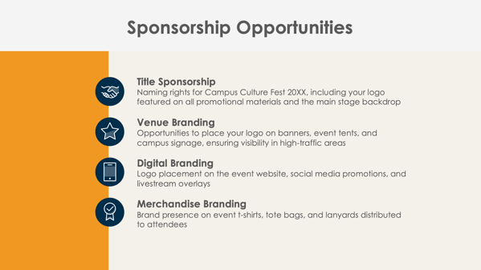
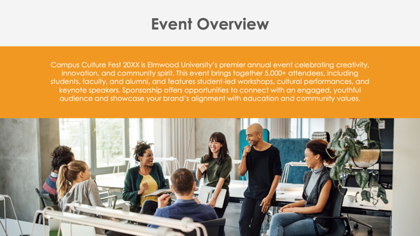
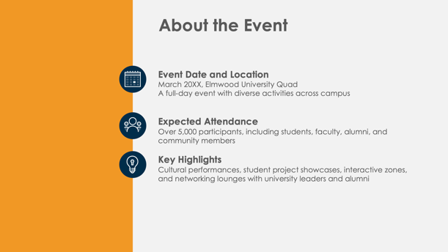
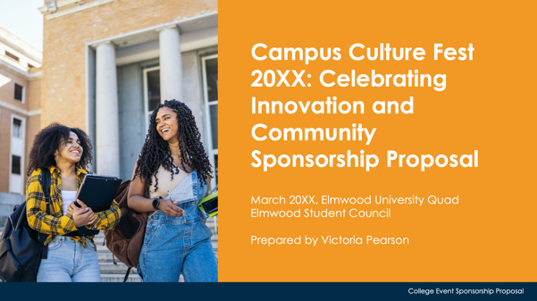
PowerPoint College Event Sponsorship Proposal Template Example

Slide 2

Campus Culture Fest 20XX: Celebrating Innovation and Community
Sponsorship Proposal
March 20XX, Elmwood University Quad
Elmwood Student Council
Prepared by Victoria Pearson
EXAMPLE: College Event Sponsorship Proposal

Slide 3
Contents
1 | Event Overview
2 | About the Event
3 | Sponsorship Opportunities
4 | Sponsorship Benefits
5 | Sponsorship Packages
6 | Custom Sponsorship Opportunities
7 | Marketing and Promotion Plan
8 | Campus Engagement and Student Interaction Opportunities
9 | Previous Successes and Testimonials
10 | Contact Information

Slide 4

Event Overview
Campus Culture Fest 20XX is Elmwood University’s premier annual event celebrating creativity, innovation, and community spirit. This event brings together 5,000+ attendees, including students, faculty, and alumni, and features student-led workshops, cultural performances, and keynote speakers. Sponsorship offers opportunities to connect with an engaged, youthful audience and showcase your brand’s alignment with education and community values.

Slide 5



About the Event
Event Date and Location
March 20XX, Elmwood University Quad
A full-day event with diverse activities across campus
Expected Attendance
Over 5,000 participants, including students, faculty, alumni, and community members
Key Highlights
Cultural performances, student project showcases, interactive zones, and networking lounges with university leaders and alumni

Slide 6




Sponsorship Opportunities
Title Sponsorship
Naming rights for Campus Culture Fest 20XX, including your logo featured on all promotional materials and the main stage backdrop
Venue Branding
Opportunities to place your logo on banners, event tents, and campus signage, ensuring visibility in high-traffic areas
Digital Branding
Logo placement on the event website, social media promotions, and livestream overlays
Merchandise Branding
Brand presence on event t-shirts, tote bags, and lanyards distributed to attendees

Slide 7

Sponsorship Benefits
Sponsors gain exclusive access to a vibrant college community, increasing brand awareness among a young, engaged audience. Align your brand with creativity, education, and community values, enhancing your positive brand image. Build meaningful connections with future leaders and decision-makers by fostering loyalty among students and alumni.
4

Slide 8
Sponsorship Packages
Platinum Package
Title sponsorship of the event, premium logo placement on all promotional materials, 20 VIP passes, and an exclusive speaking opportunity during the keynote session
Gold Package
Prominent logo placement on event signage and digital platforms, 10 VIP tickets, VIP lounge access, and co-sponsorship of the main stage
Silver Package
Logo featured on the event website, select printed materials, and student merchandise, along with five general admission tickets
Bronze Package
Logo placement in the event program, as well as social media acknowledgment and two general admission tickets
$X,XXX
$X,XXX
$X,XXX
$X,XXX

Slide 9
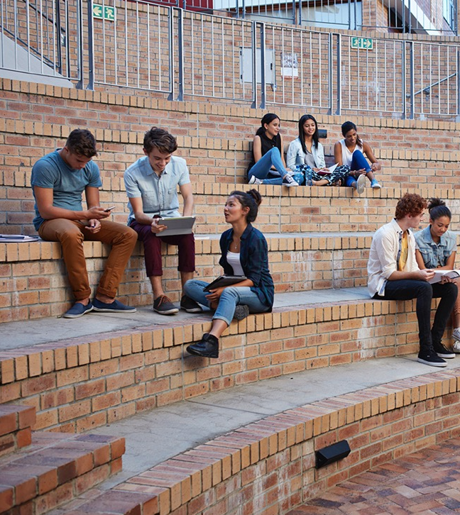
Custom Sponsorship Opportunities
Campus Culture Fest 20XX offers sponsors customizable engagement options, such as branded activity zones, sponsor-hosted workshops, and campus swag giveaways. These opportunities allow sponsors to connect directly with attendees in ways that align with their brand and audience engagement goals.

Slide 10


Marketing and Promotion Plan
Pre-Event
Sponsors will feature prominently in digital countdown campaigns, student email newsletters, and website promotions reaching the entire campus community.
During Event
Real-time updates, sponsor mentions during livestream coverage, and logos on event signage ensure constant visibility.
Post-Event
Sponsor logos will appear in recap videos, thank-you posts on social media, and attendee follow-up emails, maximizing post-event impact.
7

Slide 11
Campus Engagement and Student Interaction Opportunities
Branded Activity Zones
Sponsors can host interactive games or challenges, creating memorable student experiences.
Workshops and Panels
Sponsors can co-host educational sessions, reinforcing their commitment to learning and development.
Contests and Giveaways
Branded competitions engage students, with sponsor-provided prizes ensuring brand recall.
Networking Lounges
Sponsors receive branding rights in exclusive lounges where they can connect with students, faculty, and alumni.

Slide 12
Previous Successes and Testimonials
Last year’s Campus Culture Fest…
attracted over
4,500
attendees
oarnered over
30,000
social media impressions
Feedback from previous sponsors includes:
“Campus Culture Fest was an incredible platform to connect with students and build awareness for our brand within a forward-thinking community.”
Metrics and testimonials highlight the event’s success and sponsor value.

Slide 13
Contact Information
Sponsorship Coordinator
Alexandra Mattson
Website
Email
elmwood.edu/culturefest
sponsorships@elmwood.edu
Phone
Web & Social
(555) 345-6789
Follow us on Instagram, X, Facebook, and Threads for updates.

Slide 14
DISCLAIMER Any articles, templates, or information provided by Smartsheet on the website are for reference only. While we strive to keep the information up to date and correct, we make no representations or warranties of any kind, express or implied, about the completeness, accuracy, reliability, suitability, or availability with respect to the website or the information, articles, templates, or related graphics contained on the website. Any reliance you place on such information is therefore strictly at your own risk.

