Slide 1

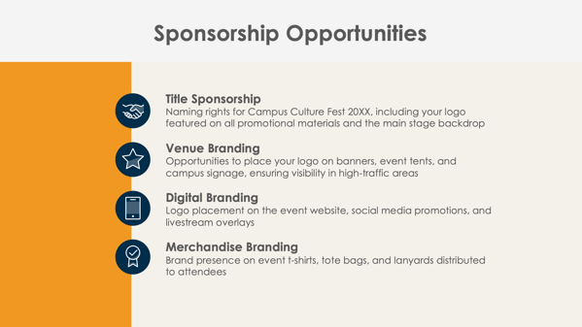

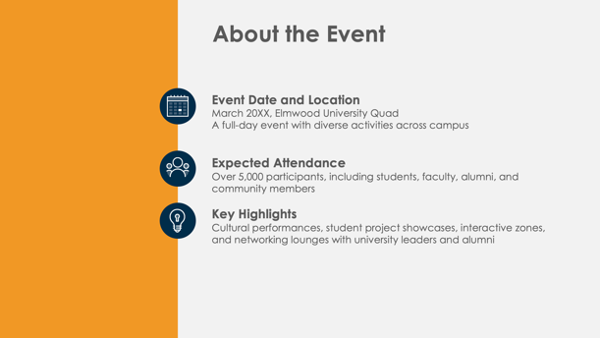

PowerPoint College Event
Sponsorship Proposal Template

Slide 2

Event Name
Sponsorship Proposal
Event Date and Location
Organization’s Name
Prepared by Name
College Event Sponsorship Proposal

Slide 3
Contents
1 | Event Overview
2 | About the Event
3 | Sponsorship Opportunities
4 | Sponsorship Benefits
5 | Sponsorship Packages
6 | Custom Sponsorship Opportunities
7 | Marketing and Promotion Plan
8 | Campus Engagement and Student Interaction Opportunities
9 | Previous Successes and Testimonials
10 | Contact Information

Slide 4

Event Overview

Slide 5



About the Event
Event Date and Location
Expected Attendance
Key Highlights

Slide 6




Sponsorship Opportunities
Title Sponsorship
Title sponsorship (overall event branding)
Venue Branding
Venue branding (main stage, event tents, banners)
Digital Branding
Digital branding (website, event app, social media)
Merchandise Branding
Merchandise branding (t-shirts, lanyards, event bags)

Slide 7

Sponsorship Benefits
4

Slide 8
Sponsorship Packages
Platinum Package
Gold Package
Silver Package
Bronze Package
$X,XXX
$X,XXX
$X,XXX
$X,XXX

Slide 9
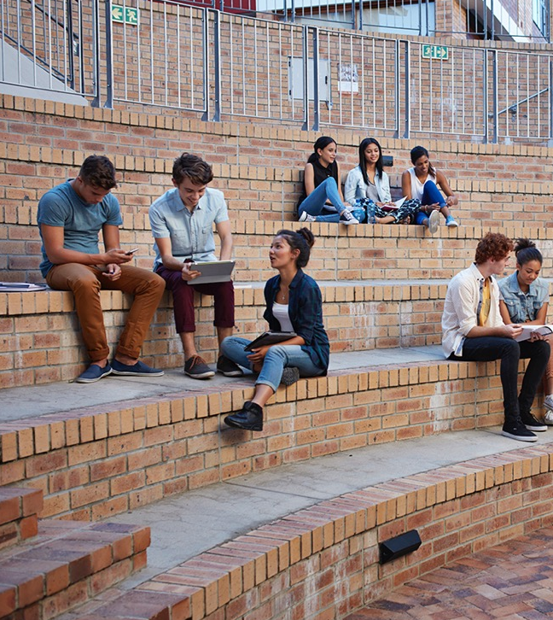
Custom Sponsorship Opportunities

Slide 10


Marketing and Promotion Plan
Pre-Event
During Event
Post-Event
7

Slide 11
Campus Engagement and Student Interaction Opportunities
Branded Activity Zones
Workshops and Panels
Contests and Giveaways
Networking Lounges

Slide 12
Previous Successes and Testimonials
Last year’s Event Name…
attracted over
X,XXX
attendees
garnered over
XX,XXX
social media impressions
Feedback from previous sponsors includes:
“Quote here.”

Slide 13
Contact Information
Sponsorship Coordinator
Name
Website
Email
college.edu/eventname
sponsorships@college.edu
Phone
Web & Social
(555) 345-6789
Follow us on Instagram, X, Facebook, and Threads for updates.

Slide 14
DISCLAIMER Any articles, templates, or information provided by Smartsheet on the website are for reference only. While we strive to keep the information up to date and correct, we make no representations or warranties of any kind, express or implied, about the completeness, accuracy, reliability, suitability, or availability with respect to the website or the information, articles, templates, or related graphics contained on the website. Any reliance you place on such information is therefore strictly at your own risk.

