Slide 1

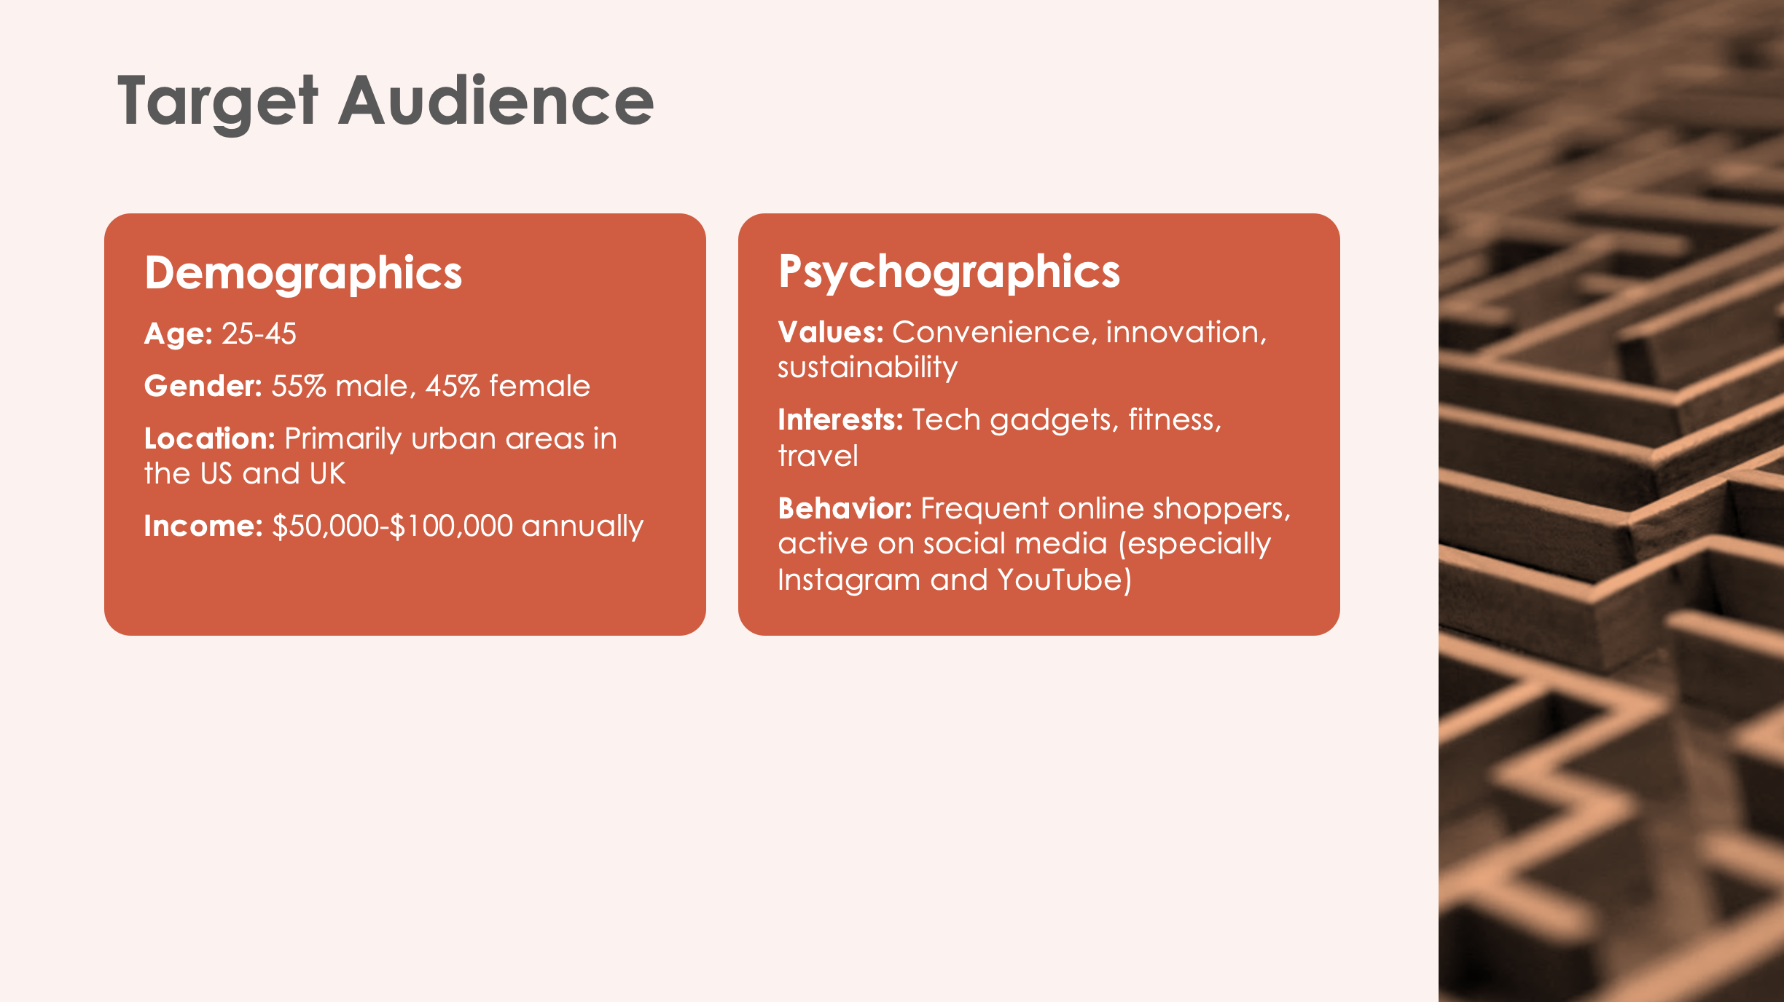
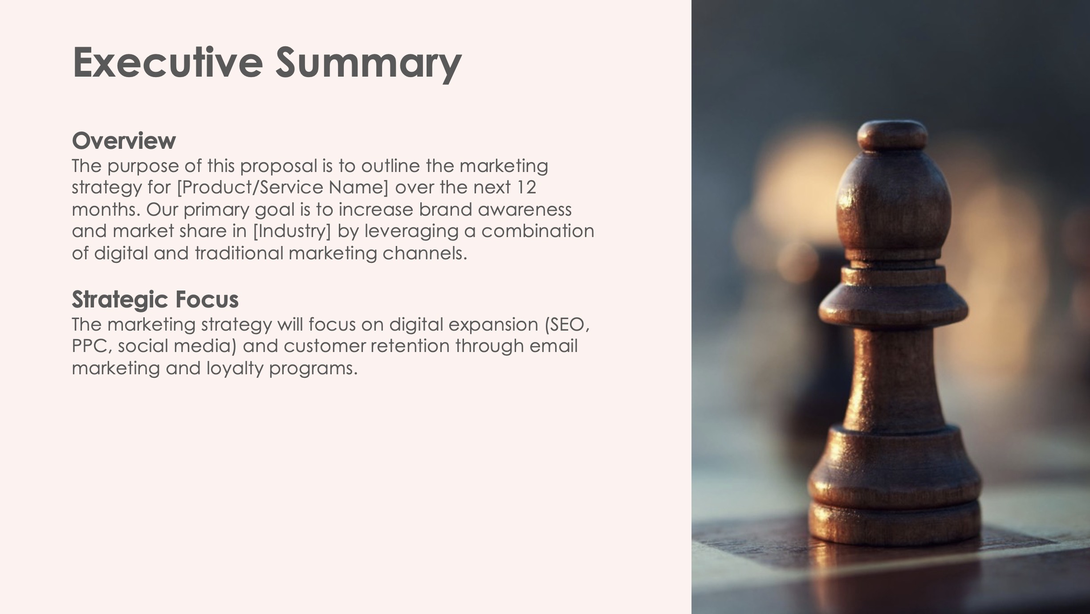
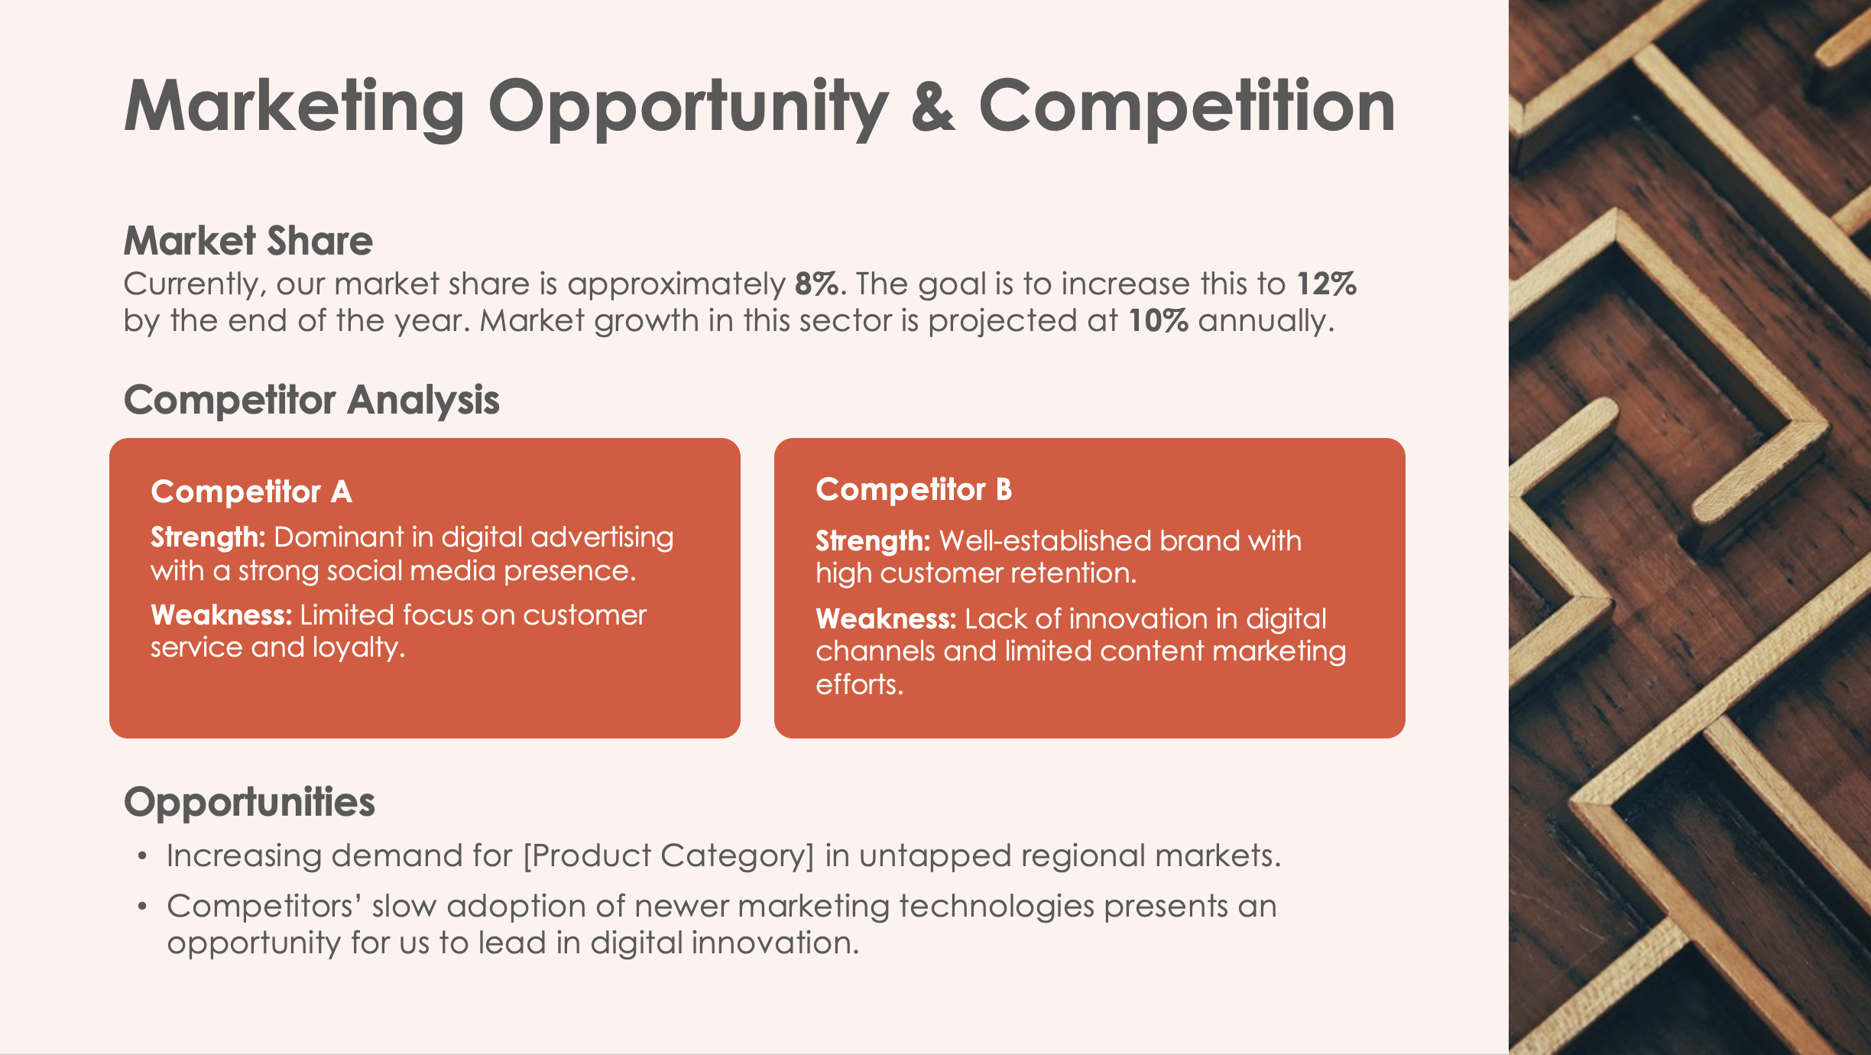
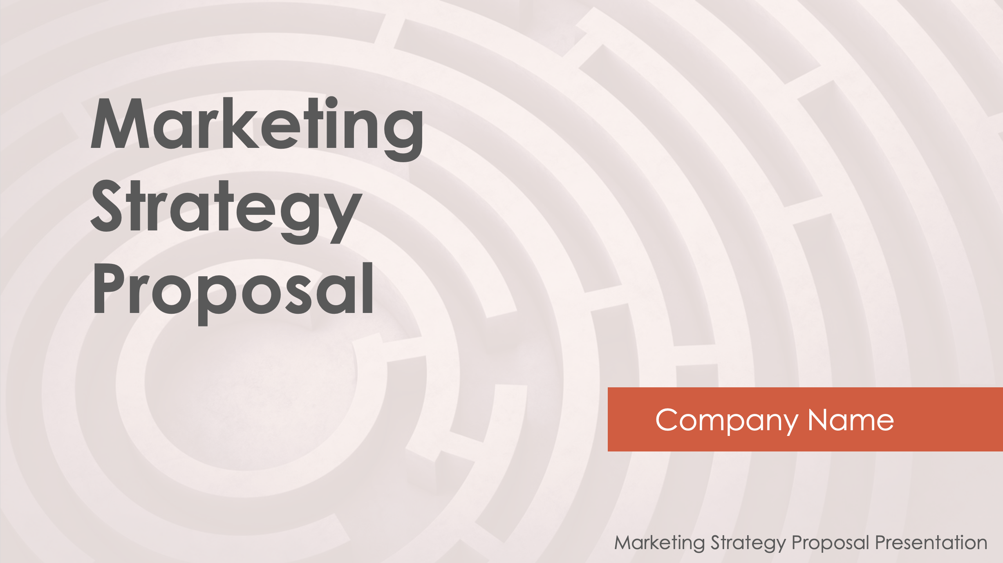
Example Marketing Strategy Proposal Presentation Template Example

Slide 2

Marketing Strategy Proposal
Company Name
EXAMPLE: Marketing Strategy Proposal Presentation

Slide 3

Executive Summary
Overview
The purpose of this proposal is to outline the marketing strategy for [Product/Service Name] over the next 12 months. Our primary goal is to increase brand awareness and market share in [Industry] by leveraging a combination of digital and traditional marketing channels.
Strategic Focus
The marketing strategy will focus on digital expansion (SEO, PPC, social media) and customer retention through email marketing and loyalty programs.

Slide 4

Marketing Opportunity & Competition
Market Share
Currently, our market share is approximately 8%. The goal is to increase this to 12% by the end of the year. Market growth in this sector is projected at 10% annually.
Competitor Analysis
Competitor A
Strength: Dominant in digital advertising with a strong social media presence.
Weakness: Limited focus on customer service and loyalty.
Competitor B
Strength: Well-established brand with high customer retention.
Weakness: Lack of innovation in digital channels and limited content marketing efforts.
Opportunities
Increasing demand for [Product Category] in untapped regional markets.
Competitors’ slow adoption of newer marketing technologies presents an opportunity for us to lead in digital innovation.

Slide 5

Target Audience
Demographics
Age: 25-45
Gender: 55% male, 45% female
Location: Primarily urban areas in the US and UK
Income: $50,000-$100,000 annually
Psychographics
Values: Convenience, innovation, sustainability
Interests: Tech gadgets, fitness, travel
Behavior: Frequent online shoppers, active on social media (especially Instagram and YouTube)

Slide 6
Objectives
Brand Awareness
Increase overall brand awareness by
25%
through content marketing and
influencer partnerships.
Customer Acquisition
Grow the customer base by
15%
via targeted digital advertising.
Engagement
Boost social media engagement
rates by
20%
(likes, comments, shares).
Revenue Growth
Increase overall revenue by
$500,000
by the end of the fiscal year.

Slide 7
Action Plan
Launch updated website with enhanced user experience.
Initiate SEO campaigns and content marketing (weekly blogs).
Kick off paid social media ads on Facebook and Instagram.
Begin influencer outreach for brand collaboration.
Launch email marketing campaigns targeting existing customers.
Implement a customer loyalty program.
Launch email marketing campaigns targeting new customers.
Expand paid ad campaigns to include LinkedIn and Google Ads.
Review performance, adjust campaigns as needed.
Launch end-of-year promotional campaigns for customer retention.
Quarter 1
Quarter 2
Quarter 3
Quarter 4

Slide 8
Milestones
Month 1
Complete website redesign and SEO audit.
Month 6
Achieve a 15% increase in website traffic and begin loyalty program.
Month 12
Reach target market share of 12% and review overall campaign performance.
Month 3
Launch of influencer partnerships with
[# of influencers].
Month 9
Expand advertising to international markets.

Slide 9





Performance Measures
Website Traffic
Track via Google Analytics for traffic increases.
Conversion Rates
Measure the percentage of website visitors that convert to leads.
Customer Acquisition Cost (CAC)
Monitor the cost of acquiring new customers through digital channels.
Social Media Engagement
Track likes, comments, shares, and follower growth on social platforms.
Return on Marketing Investment (ROMI)
Calculate revenue generated from each dollar spent on marketing.

Slide 10
Marketing Budget
Total Budget
$250,000
Allocation by Channel:
SEO and Content Marketing
$40,000
(16%)
PPC and Social
Media Ads
$80,000
(32%)
Email Marketing
$20,000
(8%)
Influencer Partnerships
$30,000
(12%)
Traditional Advertising
$50,000
(20%)
Miscellaneous
$30,000
(12%)

Slide 11

Conclusion
Key Takeaways
A clear opportunity exists to expand our market share from 8% to 12% through targeted marketing efforts.
The timeline outlines a phased approach over the next 12 months with specific milestones to ensure we stay on track.
With a $250,000 marketing budget, we will allocate resources across channels to maximize ROI.
Next Steps
Proposal Review: Teams will review the proposal and provide feedback by [specific date].
Approval and Kickoff: Upon approval, we will schedule the kickoff meeting to finalize details and assign key tasks.
Campaign Launch: Execution of the digital marketing strategy will begin in [Month].

Slide 12

Questions?

Slide 13
Marketing Strategy Proposal
Company Name
Marketing Strategy Proposal Presentation

Slide 14
Executive Summary
Overview
Description of overview.
Strategic Focus
Description of strategic focus.

Slide 15
Marketing Opportunity & Competition
Market Share
Currently, our market share is...
Competitor Analysis
Competitor A
Strength: Describe strengths.
Weakness: Describe weaknesses.
Competitor B
Strength: Describe strengths.
Weakness: Describe weaknesses.
Opportunities
List of opportunities

Slide 16
Target Audience
Demographics
Age: Age range
Gender: Male/female percentages
Location: Location
Income: Income range
Psychographics
Values: List values, list values
Interests: List interests, list interests
Behavior: List behaviors, list behaviors

Slide 17
Objectives
Brand Awareness
Increase overall brand awareness by
XX%
through content marketing and
influencer partnerships.
Customer Acquisition
Grow the customer base by
XX%
via targeted digital advertising.
Engagement
Boost social media engagement
rates by
XX%
(likes, comments, shares).
Revenue Growth
Increase overall revenue by
$XXX,XXX
by the end of the fiscal year.

Slide 18
Action Plan
Description
Description
Description
Description
Description
Description
Description
Description
Description
Description
Quarter 1
Quarter 2
Quarter 3
Quarter 4

Slide 19
Milestones
Month 1
Description
Month 6
Description
Month 12
Description
Month 3
Description
Month 9
Description

Slide 20
Performance Measures
Website Traffic
Track via Google Analytics for traffic increases.
Conversion Rates
Measure the percentage of website visitors that convert to leads.
Customer Acquisition Cost (CAC)
Monitor the cost of acquiring new customers through digital channels.
Social Media Engagement
Track likes, comments, shares, and follower growth on social platforms.
Return on Marketing Investment (ROMI)
Calculate revenue generated from each dollar spent on marketing.

Slide 21
Marketing Budget
Total Budget
$XXXXX
Allocation by Channel:
SEO and Content Marketing
$XX,XXX
(XX%)
PPC and Social
Media Ads
$XX,XXX
(XX%)
Email Marketing
$XX,XXX
(X%)
Influencer Partnerships
$XX,XXX
(XX%)
Traditional Advertising
$XX,XXX
(XX%)
Miscellaneous
$XX,XXX
(XX%)

Slide 22
Conclusion
Key Takeaways
List of key takeaways
Next Steps
Proposal Review: Description
Approval and Kickoff: Description
Campaign Launch: Execution of the digital marketing strategy will begin in [Month].

Slide 23
Questions?

Slide 24
DISCLAIMER Any articles, templates, or information provided by Smartsheet on the website are for reference only. While we strive to keep the information up to date and correct, we make no representations or warranties of any kind, express or implied, about the completeness, accuracy, reliability, suitability, or availability with respect to the website or the information, articles, templates, or related graphics contained on the website. Any reliance you place on such information is therefore strictly at your own risk.

