Slide 1

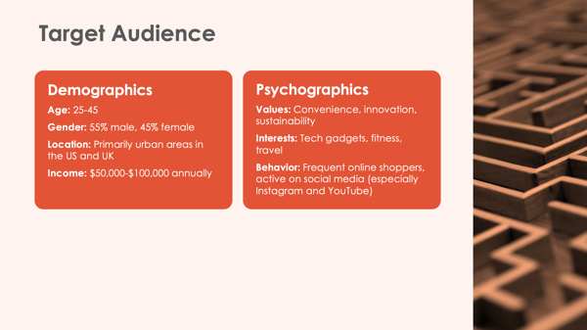
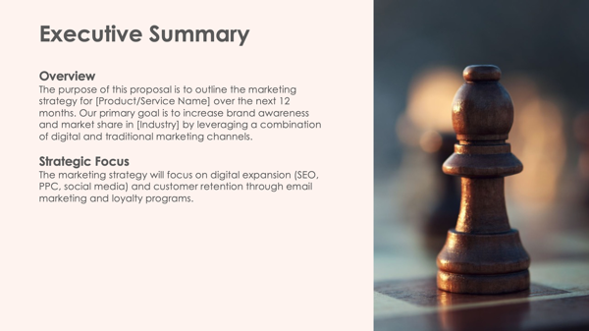
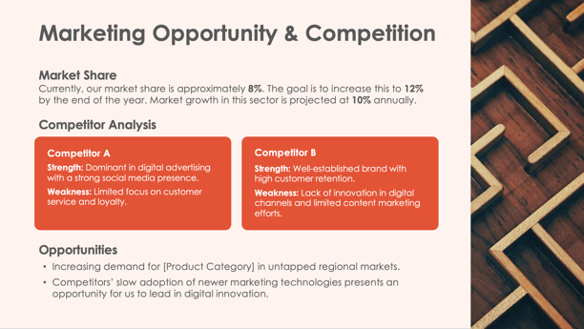

Digital Marketing Strategy
Proposal Presentation Template

Slide 2

Digital Marketing Strategy Proposal
Company Name
Digital Marketing Strategy Proposal Presentation

Slide 3

Executive Summary
Overview
Description of overview.
Strategic Focus
Description of strategic focus.

Slide 4

Marketing Opportunity & Competition
Market Share
Currently, our market share is...
Competitor Analysis
Competitor A
Strength: Describe strengths.
Weakness: Describe weaknesses.
Competitor B
Strength: Describe strengths.
Weakness: Describe weaknesses.
Opportunities
List of opportunities

Slide 5

Target Audience
Demographics
Age: Age range
Gender: Male/female percentages
Location: Location
Income: Income range
Psychographics
Values: List values, list values
Interests: List interests, list interests
Behavior: List behaviors, list behaviors

Slide 6
Objectives
Brand Awareness
Increase overall brand awareness by
XX%
through content marketing and
influencer partnerships.
Customer Acquisition
Grow the customer base by
XX%
via targeted digital advertising.
Engagement
Boost social media engagement
rates by
XX%
(likes, comments, shares).
Revenue Growth
Increase overall revenue by
$XXX,XXX
by the end of the fiscal year.

Slide 7
Action Plan
Description
Description
Description
Description
Description
Description
Description
Description
Description
Description
Quarter 1
Quarter 2
Quarter 3
Quarter 4

Slide 8
Milestones
Month 1
Description
Month 6
Description
Month 12
Description
Month 3
Description
Month 9
Description

Slide 9





Performance Measures
Website Traffic
Track via Google Analytics for traffic increases.
Conversion Rates
Measure the percentage of website visitors that convert to leads.
Customer Acquisition Cost (CAC)
Monitor the cost of acquiring new customers through digital channels.
Social Media Engagement
Track likes, comments, shares, and follower growth on social platforms.
Return on Marketing Investment (ROMI)
Calculate revenue generated from each dollar spent on marketing.

Slide 10
Marketing Budget
Total Budget
$XXXXX
Allocation by Channel:
SEO and Content Marketing
$XX,XXX
(XX%)
PPC and Social
Media Ads
$XX,XXX
(XX%)
Email Marketing
$XX,XXX
(X%)
Influencer Partnerships
$XX,XXX
(XX%)
Traditional Advertising
$XX,XXX
(XX%)
Miscellaneous
$XX,XXX
(XX%)

Slide 11

Conclusion
Key Takeaways
List of key takeaways
Next Steps
Proposal Review: Description
Approval and Kickoff: Description
Campaign Launch: Execution of the digital marketing strategy will begin in [Month].

Slide 12

Questions?

Slide 13
DISCLAIMER Any articles, templates, or information provided by Smartsheet on the website are for reference only. While we strive to keep the information up to date and correct, we make no representations or warranties of any kind, express or implied, about the completeness, accuracy, reliability, suitability, or availability with respect to the website or the information, articles, templates, or related graphics contained on the website. Any reliance you place on such information is therefore strictly at your own risk.

