Slide 1

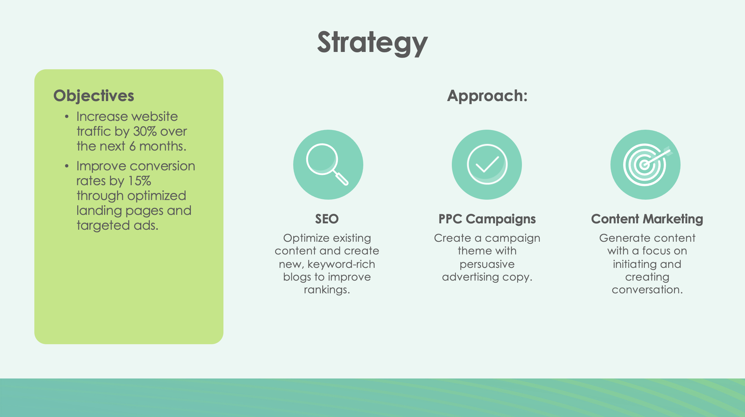
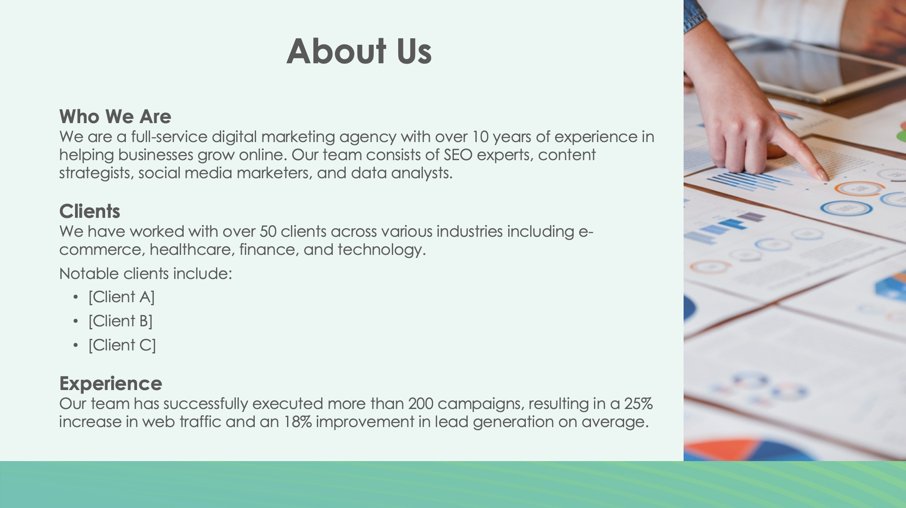
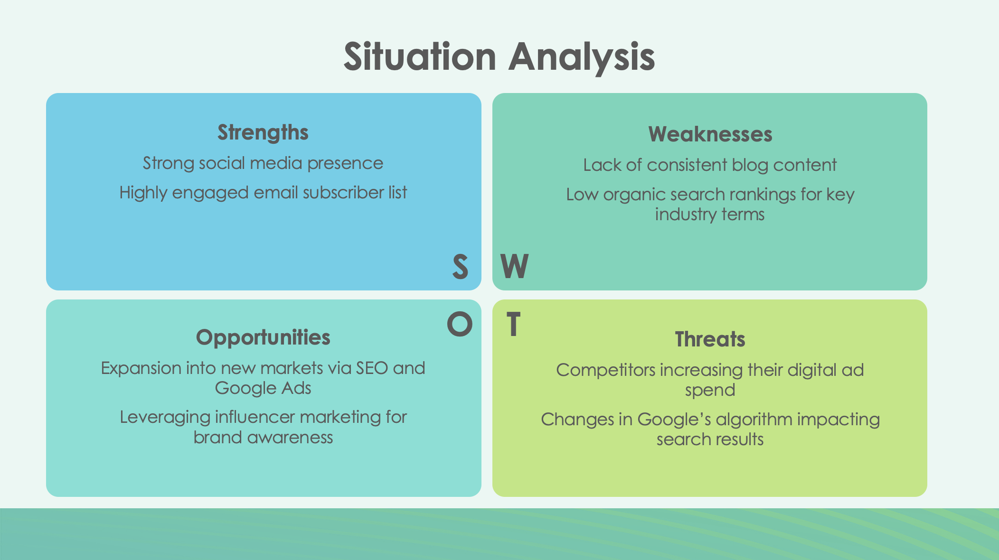
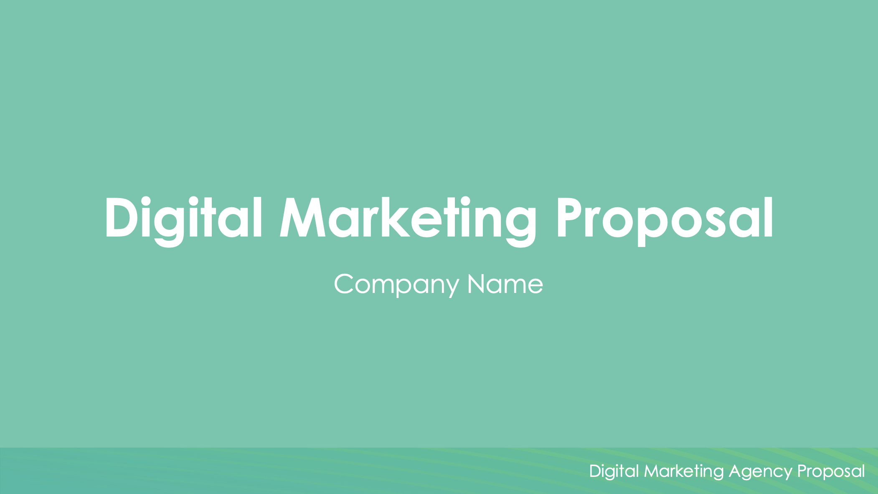
Digital Marketing Agency Proposal Template

Slide 2

Digital Marketing Proposal
Company Name
Digital Marketing Agency Proposal

Slide 3

About Us
Who We Are
Description of company.
Clients
Description.
Notable clients include:
[Client A]
[Client B]
[Client C]
Experience
Description of company’s experience.

Slide 4
Situation Analysis
Strengths
Strength 1
Strength 2
Weaknesses
Weakness 1
Weakness 2
S
W
O
T
Opportunities
Opportunity 1
Opportunity 2
Threats
Threat 1
Threat 2

Slide 5



Strategy
Objectives
List of objectives
Approach:
SEO
Optimize existing content and create new, keyword-rich blogs to improve rankings.
PPC Campaigns
Optimize existing content and create new, keyword-rich blogs to improve rankings.
Content Marketing
Optimize existing content and create new, keyword-rich blogs to improve rankings.

Slide 6
Target Audience
Demographics
Age:
Gender: XX% female, XX% male
Location:
Income Level: $XXK-$XXXK annually
Behavior
List of behaviors of target audience.

Slide 7
Buyer Personas
Persona 1: Digital David
Age:
Occupation:
Goals:
Challenges:
Persona 2: Savvy Sarah
Age:
Occupation:
Goals:
Challenges:

Slide 8
Digital Marketing Plan
Description
Description
Description
Description
Description
Description
Month 1
Month 2
Month 3
Month 4
Month 5
Month 6

Slide 9
KPIs
Website Traffic
Increase by
XX%
(measured via Google Analytics)
Conversion Rate
Improve by
XX%
Lead Generation
Generate
XXX
new leads per month
Email Open Rate
Achieve an open rate of
XX%
on email campaigns
Return on Ad Spend (ROAS)
Aim for a ratio of
3:1

Slide 10
Budget
PPC (Google Ads, Facebook Ads)
$XXXX
Per month
SEO and Content Marketing
$XXXX
Per month
Email Marketing
$XXXX
Per month
Social Media Management
$XXXX
Per month
Total Monthly Budget
$XXXX

Slide 11

Terms and Conditions
Payment Terms
Description of payment terms.
Contract Duration
Description of contract duration.
Termination
Description of termination policy.

Slide 12

Next Steps
Proposal Review
Please review the proposal and provide feedback or approval within 7 days.
Kickoff Meeting
Description of when a kickoff meeting is planned.
Start Date
The digital marketing plan will commence on [Date].

Slide 13
Digital Marketing Proposal
Company Name
EXAMPLE: Digital Marketing Agency Proposal

Slide 14
About Us
Who We Are
We are a full-service digital marketing agency with over 10 years of experience in helping businesses grow online. Our team consists of SEO experts, content strategists, social media marketers, and data analysts.
Clients
We have worked with over 50 clients across various industries including e-commerce, healthcare, finance, and technology.
Notable clients include:
[Client A]
[Client B]
[Client C]
Experience
Our team has successfully executed more than 200 campaigns, resulting in a 25% increase in web traffic and an 18% improvement in lead generation on average.

Slide 15
Situation Analysis
Strengths
Strong social media presence
Highly engaged email subscriber list
Weaknesses
Lack of consistent blog content
Low organic search rankings for key industry terms
S
W
O
T
Opportunities
Expansion into new markets via SEO and Google Ads
Leveraging influencer marketing for brand awareness
Threats
Competitors increasing their digital ad spend
Changes in Google’s algorithm impacting search results

Slide 16
Strategy
Objectives
Increase website traffic by 30% over the next 6 months.
Improve conversion rates by 15% through optimized landing pages and targeted ads.
Approach:
SEO
Optimize existing content and create new, keyword-rich blogs to improve rankings.
PPC Campaigns
Create a campaign theme with persuasive advertising copy.
Content Marketing
Generate content with a focus on initiating and creating conversation.

Slide 17
Target Audience
Demographics
Age: 25-45
Gender: 60% female, 40% male
Location: Primarily USA and UK
Income Level: $50K-$100K annually
Behavior
Frequent online shoppers
Engaging on social media platforms like Instagram and Facebook
Looking for premium quality products and personalized experiences

Slide 18
Buyer Personas
Persona 1: Digital David
Age: 35
Occupation: IT professional, tech-savvy
Goals: Finds solutions to streamline work and home life
Challenges: Limited time to research products
Persona 2: Savvy Sarah
Age: 28
Occupation: Marketing Manager
Goals: Looking for ways to improve work efficiency and life balance
Challenges: Overwhelmed by too many online options

Slide 19
Digital Marketing Plan
Set up Google Ads and Facebook Ads campaigns
Conduct a full SEO audit and begin on-page optimization
Launch content marketing initiatives with 3 blog posts per week
A/B testing on landing pages for conversion rate optimization
Scale up PPC campaigns and optimize based on performance
Implement email marketing drip campaigns to nurture lead
Month 1
Month 2
Month 3
Month 4
Month 5
Month 6

Slide 20
KPIs
Website Traffic
Increase by
30%
(measured via Google Analytics)
Conversion Rate
Improve by
15%
Lead Generation
Generate
200
new leads per month
Email Open Rate
Achieve an open rate of
18%
on email campaigns
Return on Ad Spend (ROAS)
Aim for a ratio of
3:1

Slide 21
Budget
PPC (Google Ads, Facebook Ads)
$10,000
Per month
SEO and Content Marketing
$5,000
Per month
Email Marketing
$2,000
Per month
Social Media Management
$3,000
Per month
Total Monthly Budget
$20,000

Slide 22
Terms and Conditions
Payment Terms
Payments are due at the beginning of each month.
Late payments will incur a 5% fee after 15 days.
Contract Duration
This agreement covers a 6-month period with the option to renew.
Termination
Either party may terminate the agreement with 30 days’ notice.

Slide 23
Next Steps
Proposal Review
Please review the proposal and provide feedback or approval within 7 days.
Kickoff Meeting
Once approved, we will schedule a kickoff meeting to finalize the campaign details.
Start Date
The digital marketing plan will commence on [Date].

Slide 24
DISCLAIMER Any articles, templates, or information provided by Smartsheet on the website are for reference only. While we strive to keep the information up to date and correct, we make no representations or warranties of any kind, express or implied, about the completeness, accuracy, reliability, suitability, or availability with respect to the website or the information, articles, templates, or related graphics contained on the website. Any reliance you place on such information is therefore strictly at your own risk.

