Slide 1

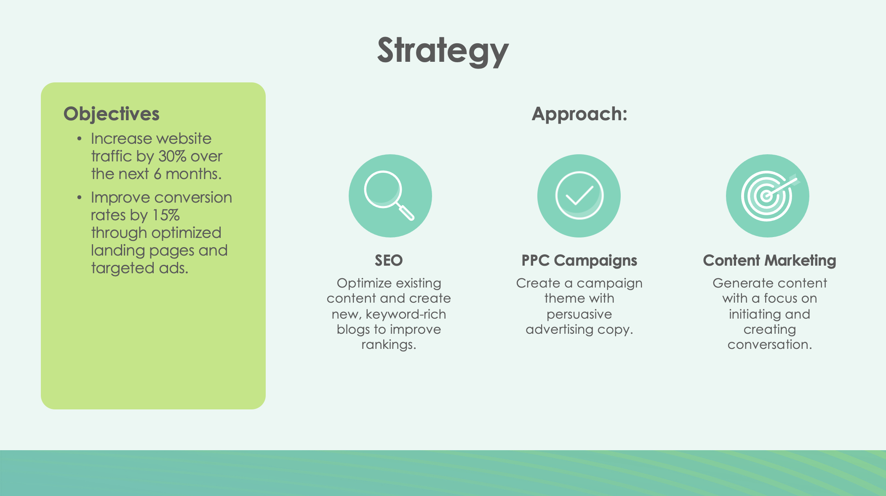
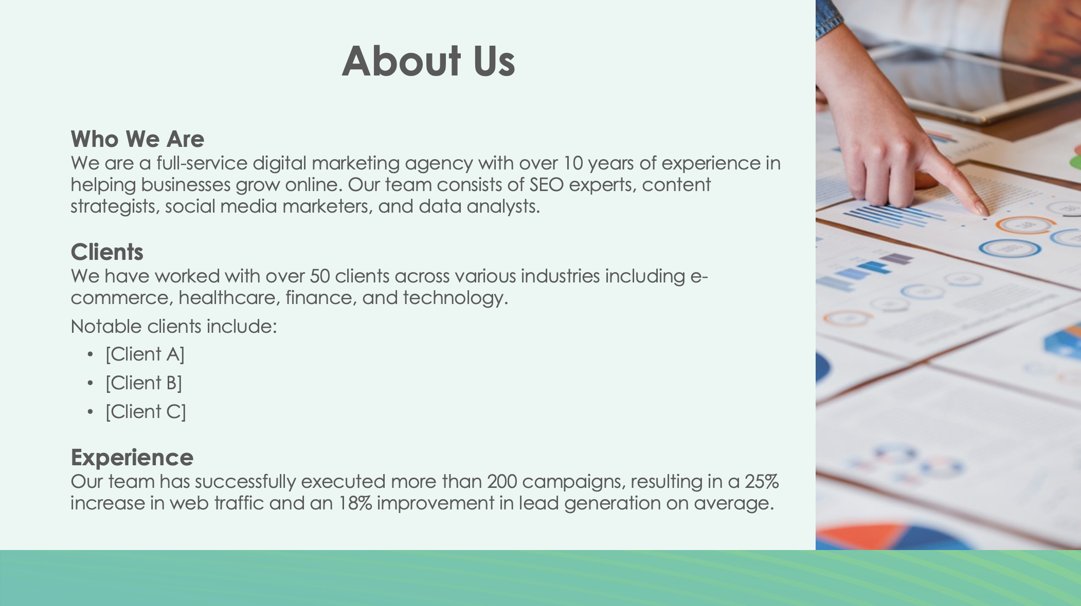
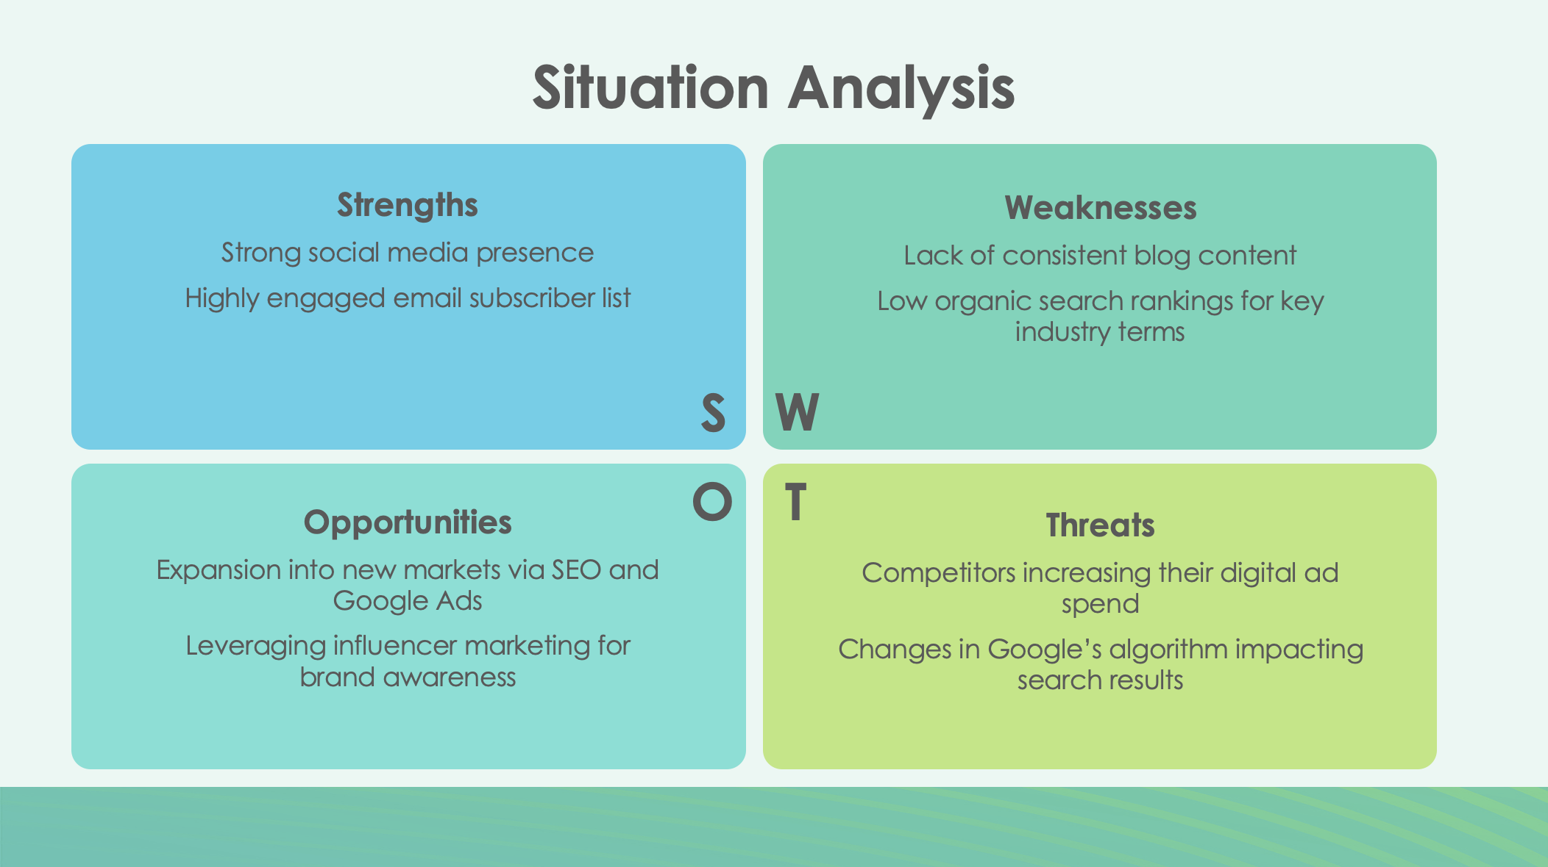
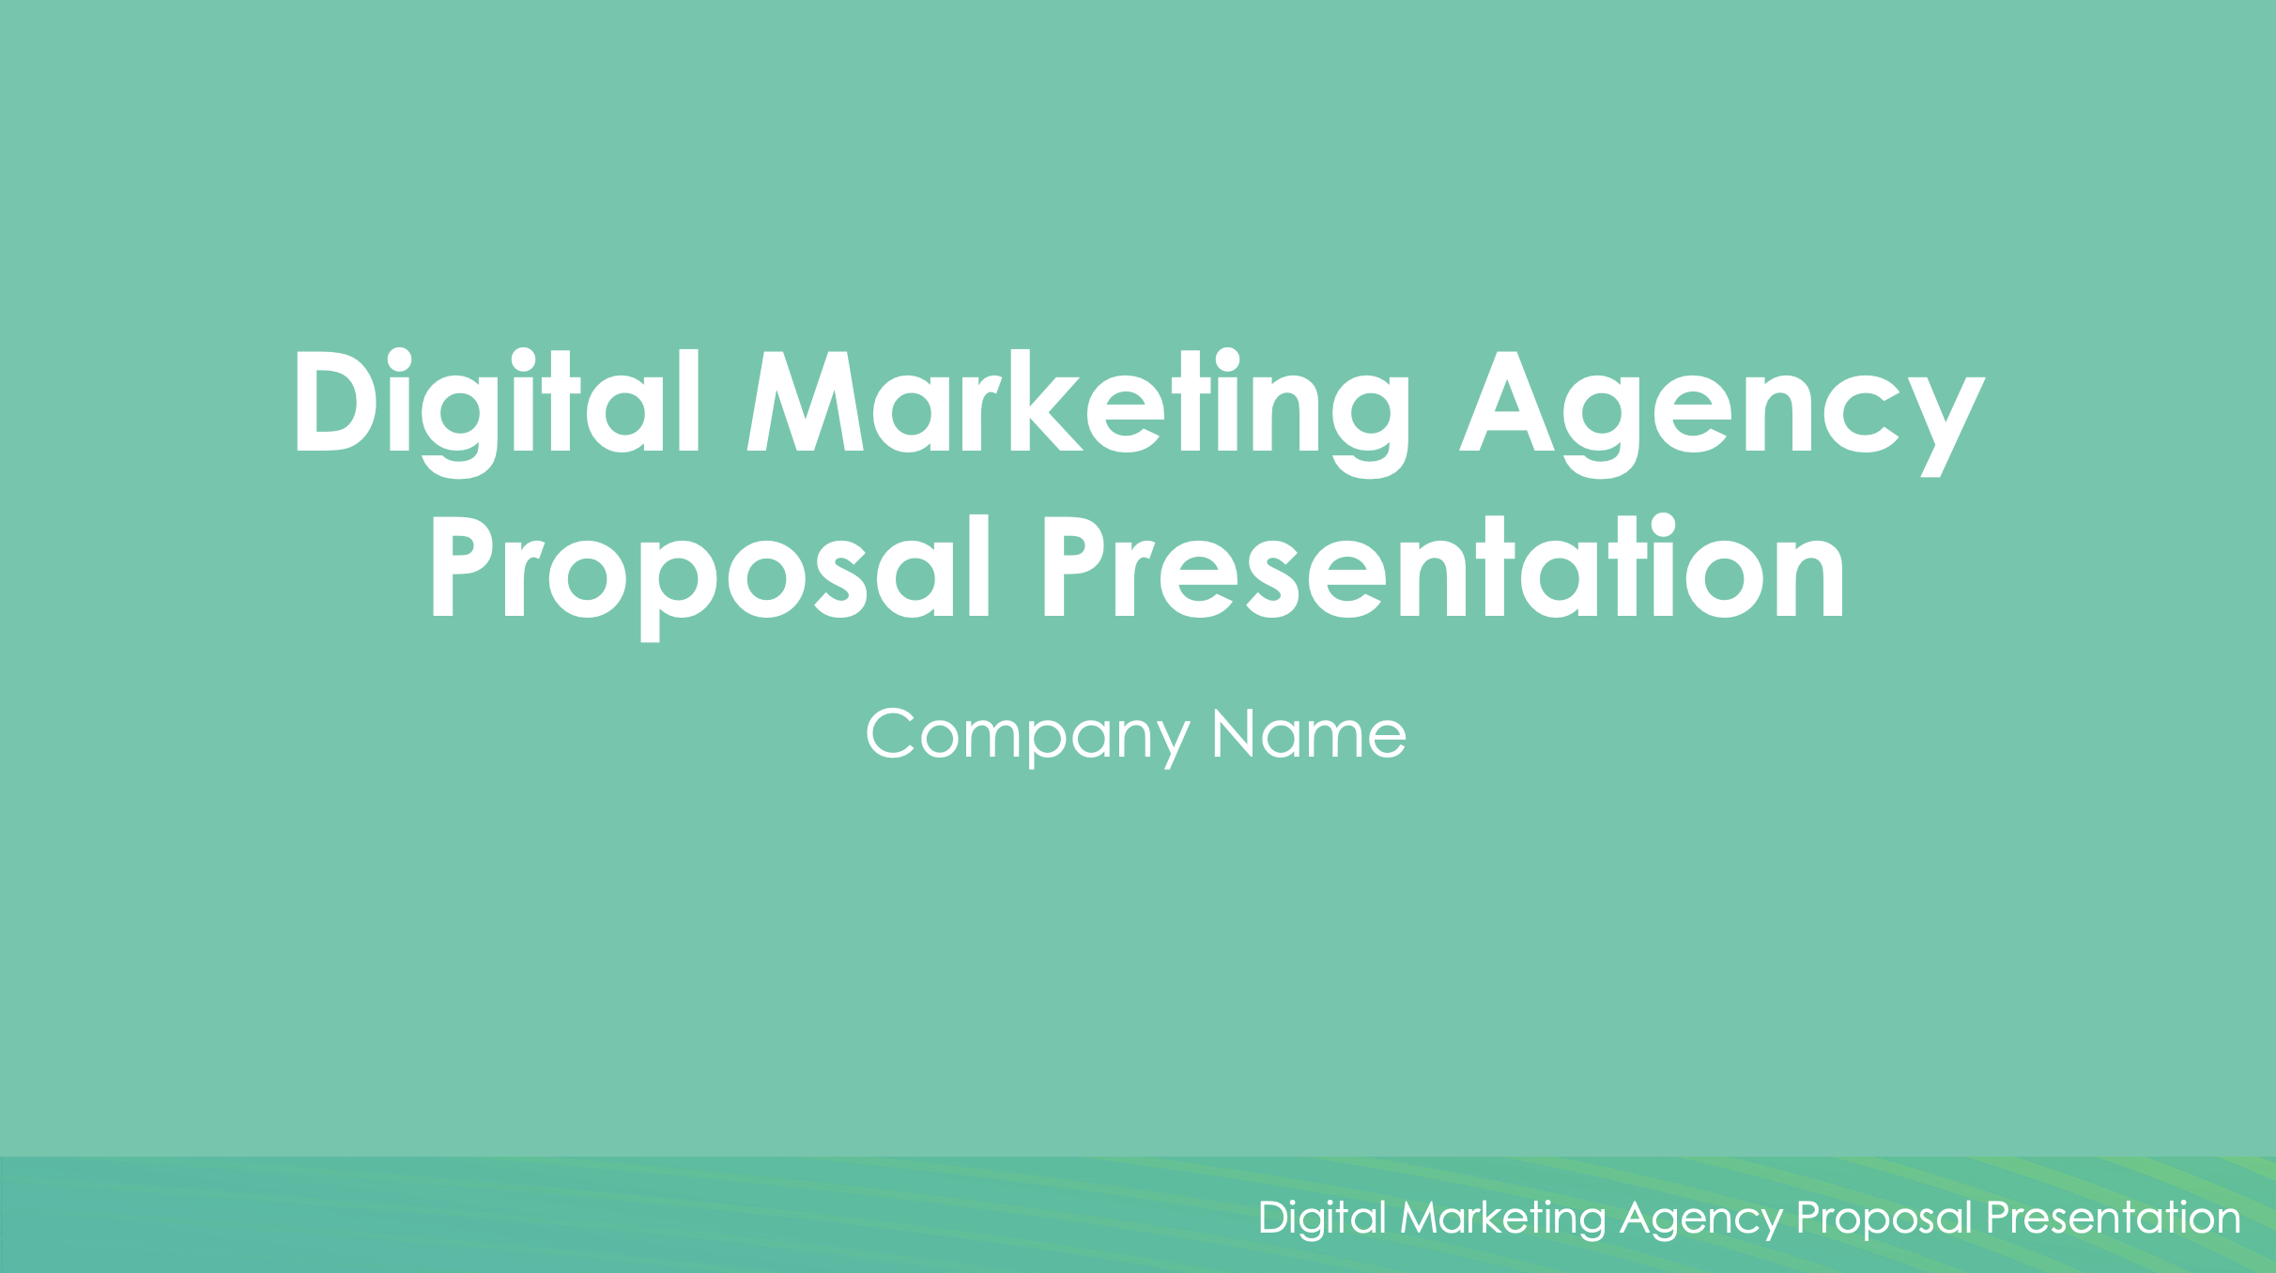
Digital Marketing Agency Proposal Presentation Template

Slide 2

Digital Marketing Agency Proposal Presentation
Company Name
Digital Marketing Agency Proposal Presentation

Slide 3

About Us
Who We Are
Description of company.
Clients
Description.
Notable clients include:
[Client A]
[Client B]
[Client C]
Experience
Description of company’s experience.

Slide 4
Situation Analysis
Strengths
Strength 1
Strength 2
Weaknesses
Weakness 1
Weakness 2
S
W
O
T
Opportunities
Opportunity 1
Opportunity 2
Threats
Threat 1
Threat 2

Slide 5



Strategy
Objectives
List of objectives
Approach:
SEO
Optimize existing content and create new, keyword-rich blogs to improve rankings.
PPC Campaigns
Optimize existing content and create new, keyword-rich blogs to improve rankings.
Content Marketing
Optimize existing content and create new, keyword-rich blogs to improve rankings.

Slide 6
Target Audience
Demographics
Age:
Gender: XX% female, XX% male
Location:
Income Level: $XXK-$XXXK annually
Behavior
List of behaviors of target audience.

Slide 7
Buyer Personas
Persona 1: Digital David
Age:
Occupation:
Goals:
Challenges:
Persona 2: Savvy Sarah
Age:
Occupation:
Goals:
Challenges:

Slide 8
Digital Marketing Plan
Description
Description
Description
Description
Description
Description
Month 1
Month 2
Month 3
Month 4
Month 5
Month 6

Slide 9
KPIs
Website Traffic
Increase by
XX%
(measured via Google Analytics)
Conversion Rate
Improve by
XX%
Lead Generation
Generate
XXX
new leads per month
Email Open Rate
Achieve an open rate of
XX%
on email campaigns
Return on Ad Spend (ROAS)
Aim for a ratio of
3:1

Slide 10
Budget
PPC (Google Ads, Facebook Ads)
$XXXX
Per month
SEO and Content Marketing
$XXXX
Per month
Email Marketing
$XXXX
Per month
Social Media Management
$XXXX
Per month
Total Monthly Budget
$XXXX

Slide 11

Terms and Conditions
Payment Terms
Description of payment terms.
Contract Duration
Description of contract duration.
Termination
Description of termination policy.

Slide 12

Next Steps
Proposal Review
Please review the proposal and provide feedback or approval within 7 days.
Kickoff Meeting
Description of when a kickoff meeting is planned.
Start Date
The digital marketing plan will commence on [Date].

Slide 13
DISCLAIMER Any articles, templates, or information provided by Smartsheet on the website are for reference only. While we strive to keep the information up to date and correct, we make no representations or warranties of any kind, express or implied, about the completeness, accuracy, reliability, suitability, or availability with respect to the website or the information, articles, templates, or related graphics contained on the website. Any reliance you place on such information is therefore strictly at your own risk.

