Slide 1


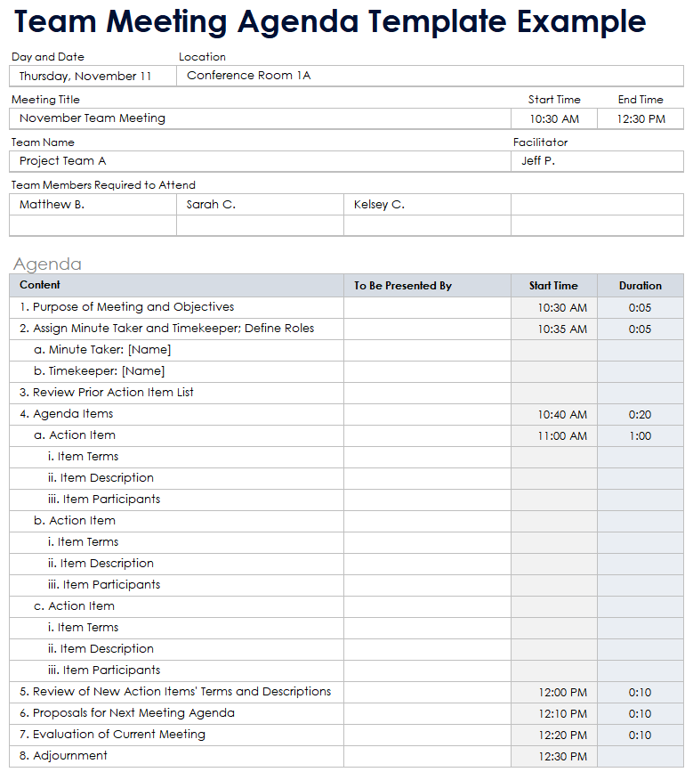
Team Meeting Agenda Template Example

Slide 2
Meeting Details
Example
Day and Date | Location
Thursday, November 11 | Conference Room 1A
Meeting Title |  |  | Start Time | End Time
November Team Meeting |  |  | 10:30 AM | 12:30 PM
Team Name |  |  | Facilitator
Project Team A |  |  | Jeff P.
Team Members Required to Attend
Matthew B. | Sarah C. | Kelsey C.

Slide 3
Agenda
Content | To Be Presented By | Start Time | Duration
1. Purpose of Meeting and Objectives |  | 10:30 AM | 0:05
2. Assign Minute Taker and Timekeeper; Define Roles |  | 10:35 AM | 0:05
a. Minute Taker: [Name]
b. Timekeeper: [Name]
3. Review Prior Action Item List
4. Agenda Items |  | 10:40 AM | 0:20
a. Action Item |  | 11:00 AM | 1:00
i. Item Terms
ii. Item Description
iii. Item Participants
b. Action Item
i. Item Terms
ii. Item Description
iii. Item Participants
c. Action Item
i. Item Terms
ii. Item Description
iii. Item Participants
5. Review of New Action Items' Terms and Descriptions |  | 12:00 PM | 0:10
6. Proposals for Next Meeting Agenda |  | 12:10 PM | 0:10
7. Evaluation of Current Meeting |  | 12:20 PM | 0:10
8. Adjournment |  | 12:30 PM
Example

Slide 4
Meeting Details
Day and Date | Location
Meeting Title |  |  | Start Time | End Time
Team Name |  |  | Facilitator
Team Members Required to Attend

Slide 5
Agenda
Content | To Be Presented By | Start Time | Duration

Slide 6
DISCLAIMER Any articles, templates, or information provided by Smartsheet on the website are for reference only. While we strive to keep the information up to date and correct, we make no representations or warranties of any kind, express or implied, about the completeness, accuracy, reliability, suitability, or availability with respect to the website or the information, articles, templates, or related graphics contained on the website. Any reliance you place on such information is therefore strictly at your own risk.

