Slide 1

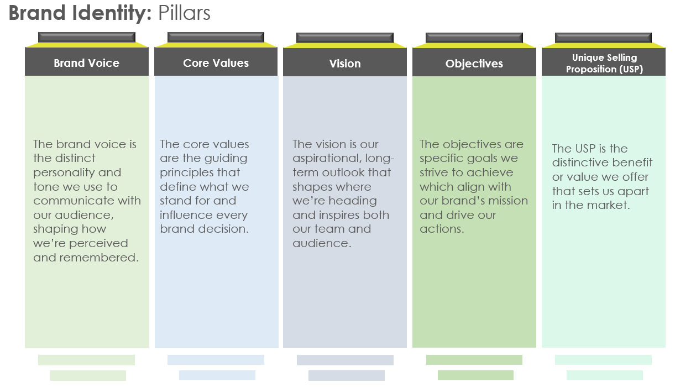
Brand Identity Pillars Template

Slide 2
Brand Identity: Pillars
Brand Voice
Core Values
Vision
Objectives
Unique Selling Proposition (USP)
Objectives
The brand voice is the distinct personality and tone we use to communicate with our audience, shaping how we’re perceived and remembered.
The core values are the guiding principles that define what we stand for and influence every brand decision.
The vision is our aspirational, long-term outlook that shapes where we’re heading and inspires both our team and audience.
The objectives are specific goals we strive to achieve which align with our brand’s mission and drive our actions.
The USP is the distinctive benefit or value we offer that sets us apart in the market.

Slide 3
Brand Identity: Details
Brand Voice
Core Values
Vision
Objectives
Unique Selling Proposition (USP)
Objectives
How should our brand sound in different settings (formal, friendly, professional)?
What tone will resonate most with our target audience?
How can we ensure consistency in our voice across all communication channels?
What language style and personality traits reflect our brand best?
What principles define who we are and what we stand for?
How do our values influence the way we interact with customers and partners?
Which values will help us create a meaningful impact in our industry?
How do we demonstrate these values in our daily actions and decisions?
Where do we want our brand to be in the next five to ten years?
How does our vision inspire both our team and our audience?
What impact do we aim to make on our industry or community?
How does our vision align with our customers’ needs and aspirations?
What specific goals are we working toward in the short and long term?
How do these objectives support our brand’s mission and vision?
Which objectives will have the most significant impact on our growth and reputation?
How do we measure success in reaching these objectives?
What makes our brand stand out in a crowded market?
How does our USP solve a problem or meet a need for our customers?
What benefits do we offer that competitors can’t match?
How can we communicate our USP clearly and consistently?

Slide 4

Brand Identity: Logo, Colors, and Fonts
Logo
Brand Colors
Objectives
Horizontal Layout
Vertical Layout
Your Logo
Your Logo
Electric Blue
Bright Green
Steel Gray
Solar Yellow
Hex: #007BFF
Primary color for positive charge, symbolizing energy and innovation. Used in main branding elements, such as the logo, primary headers, and CTA buttons.
Hex: #28A745
Represents eco-friendliness and sustainability, ideal for accent features in marketing materials, environmental messaging, and product highlights.
Hex: #5A5A5A
Neutral, dependable, and professional; used for body text, backgrounds, and sections that require a balanced, grounded appearance.
Hex: #FFD700
A vibrant yellow to signify optimism and positivity, used sparingly as a highlight in icons, infographics, or key points in presentations and ads.
Logomark (icon)
Wordmark
The logotype sans logomark is to be used exclusively within the app.
Your Logo
Font
Aa
Primary Font: Century Gothic – Clean and modern, Montserrat is used for main titles, headers, and the brand name to convey professionalism and trustworthiness.
Font Style: Bold – for key headers and logo.
Font Style: Regular – for subheads or important content blocks.
Secondary Font: Georgia – A readable font for body text, instructional content, and smaller print.
Font Style: Regular – For general text.
Font Style: Italic – For emphasizing important points or quotes within content.

Slide 5
DISCLAIMER Any articles, templates, or information provided by Smartsheet on the website are for reference only. While we strive to keep the information up to date and correct, we make no representations or warranties of any kind, express or implied, about the completeness, accuracy, reliability, suitability, or availability with respect to the website or the information, articles, templates, or related graphics contained on the website. Any reliance you place on such information is therefore strictly at your own risk.

