Slide 1

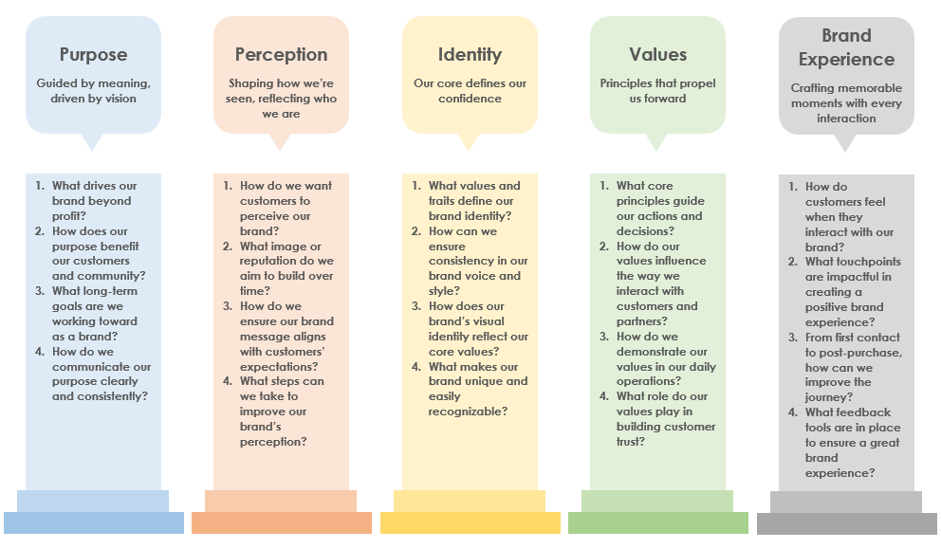
Basic Brand Pillars Template

Slide 2
Basic Brand Pillars
Building connections through purpose, perception, identity, values, and experience
Creating a lasting impact by aligning purpose, perception, and experience
Perception
Shaping how we’re seen, reflecting who we are
Brand Experience
Crafting memorable moments with every interaction
Purpose
Guided by meaning, driven by vision
Identity
Our core defines our confidence
Values
Principles that propel us forward
What drives our brand beyond profit?
How does our purpose benefit our customers and community?
What long-term goals are we working toward as a brand?
How do we communicate our purpose clearly and consistently?
How do we want customers to perceive our brand?
What image or reputation do we aim to build over time?
How do we ensure our brand message aligns with customers’ expectations?
What steps can we take to improve our brand’s perception?
What values and traits define our brand identity?
How can we ensure consistency in our brand voice and style?
How does our brand’s visual identity reflect our core values?
What makes our brand unique and easily recognizable?
What core principles guide our actions and decisions?
How do our values influence the way we interact with customers and partners?
How do we demonstrate our values in our daily operations?
What role do our values play in building customer trust?
How do customers feel when they interact with our brand?
What touchpoints are impactful in creating a positive brand experience?
From first contact to post-purchase, how can we improve the journey?
What feedback tools are in place to ensure a great brand experience?

Slide 3
DISCLAIMER Any articles, templates, or information provided by Smartsheet on the website are for reference only. While we strive to keep the information up to date and correct, we make no representations or warranties of any kind, express or implied, about the completeness, accuracy, reliability, suitability, or availability with respect to the website or the information, articles, templates, or related graphics contained on the website. Any reliance you place on such information is therefore strictly at your own risk.

