Slide 1


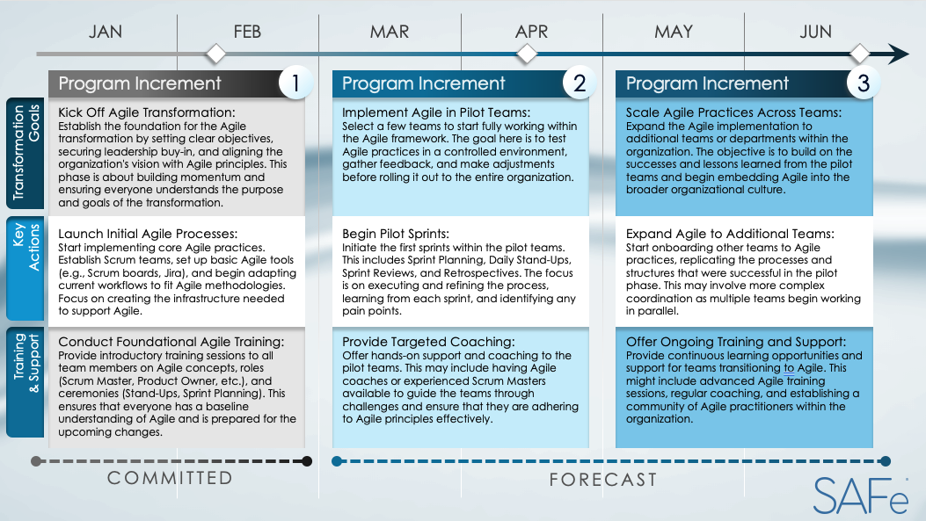
SAFe Agile Transformation Roadmap

Slide 2

JAN
FEB
MAR
APR
MAY
JUN
1
2
3
Program Increment
Program Increment
Program Increment
Kick Off Agile Transformation:
Establish the foundation for the Agile transformation by setting clear objectives, securing leadership buy-in, and aligning the organization's vision with Agile principles. This phase is about building momentum and ensuring everyone understands the purpose and goals of the transformation.
Implement Agile in Pilot Teams:
Select a few teams to start fully working within the Agile framework. The goal here is to test Agile practices in a controlled environment, gather feedback, and make adjustments before rolling it out to the entire organization.
Scale Agile Practices Across Teams: Expand the Agile implementation to additional teams or departments within the organization. The objective is to build on the successes and lessons learned from the pilot teams and begin embedding Agile into the broader organizational culture.
Transformation Goals
Launch Initial Agile Processes:
Start implementing core Agile practices. Establish Scrum teams, set up basic Agile tools (e.g., Scrum boards, Jira), and begin adapting current workflows to fit Agile methodologies. Focus on creating the infrastructure needed to support Agile.
Begin Pilot Sprints:
Initiate the first sprints within the pilot teams. This includes Sprint Planning, Daily Stand-Ups, Sprint Reviews, and Retrospectives. The focus is on executing and refining the process, learning from each sprint, and identifying any pain points.
Expand Agile to Additional Teams:
Start onboarding other teams to Agile practices, replicating the processes and structures that were successful in the pilot phase. This may involve more complex coordination as multiple teams begin working in parallel.
Key
Actions
Conduct Foundational Agile Training:
Provide introductory training sessions to all team members on Agile concepts, roles (Scrum Master, Product Owner, etc.), and ceremonies (Stand-Ups, Sprint Planning). This ensures that everyone has a baseline understanding of Agile and is prepared for the upcoming changes.
Provide Targeted Coaching:
Offer hands-on support and coaching to the pilot teams. This may include having Agile coaches or experienced Scrum Masters available to guide the teams through challenges and ensure that they are adhering to Agile principles effectively.
Offer Ongoing Training and Support:
Provide continuous learning opportunities and support for teams transitioning to Agile. This might include advanced Agile training sessions, regular coaching, and establishing a community of Agile practitioners within the organization.
Training
& Support
COMMITTED
FORECAST

Slide 3
DISCLAIMER Any articles, templates, or information provided by Smartsheet on the website are for reference only. While we strive to keep the information up to date and correct, we make no representations or warranties of any kind, express or implied, about the completeness, accuracy, reliability, suitability, or availability with respect to the website or the information, articles, templates, or related graphics contained on the website. Any reliance you place on such information is therefore strictly at your own risk.

