Slide 1


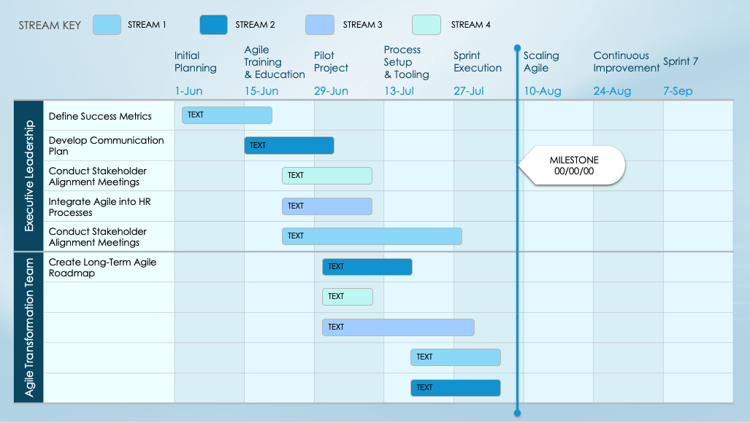
Agile Transformation Roadmap Template

Slide 2
TO USE THIS TEMPLATE:
Adjust number of Sprints to meet your plan.
Enter Sprint Start Dates.
Apply Streams to the Stream Key.
Duplicate the initial slide with Dates and Teams to represent each Phase / Category.
Enter Tasks and Milestones.

Slide 3
STREAM KEY
STREAM 1
STREAM 2
STREAM 3
STREAM 4
 |  | Initial Planning | Agile Training & Education | Pilot Project | Process Setup & Tooling | Sprint Execution | Scaling Agile | Continuous Improvement | Sprint 7
 |  | 1-Jun | 15-Jun | 29-Jun | 13-Jul | 27-Jul | 10-Aug | 24-Aug | 7-Sep
Executive Leadership | Define Success Metrics
 | Develop Communication Plan
 | Conduct Stakeholder Alignment Meetings
 | Integrate Agile into HR Processes
 | Conduct Stakeholder Alignment Meetings
Agile Transformation Team | Create Long-Term Agile Roadmap
TEXT
TEXT
MILESTONE
00/00/00
TEXT
TEXT
TEXT
TEXT
TEXT
TEXT
TEXT
TEXT

Slide 4
STREAM KEY
STREAM 1
STREAM 2
STREAM 3
STREAM 4
 |  | Initial Planning | Agile Training & Education | Pilot Project | Process Setup & Tooling | Sprint Execution | Scaling Agile | Continuous Improvement | Sprint 7
 |  | 1-Jun | 15-Jun | 29-Jun | 13-Jul | 27-Jul | 10-Aug | 24-Aug | 7-Sep
Product Mgmt. Team | Create Agile training materials
Development Team | Complete Sprint 1 planning
TEXT
TEXT
MILESTONE
00/00/00
TEXT
TEXT
TEXT
TEXT
TEXT
TEXT
TEXT
TEXT

Slide 5
STREAM KEY
STREAM 1
STREAM 2
STREAM 3
STREAM 4
 |  | Initial Planning | Agile Training & Education | Pilot Project | Process Setup & Tooling | Sprint Execution | Scaling Agile | Continuous Improvement | Sprint 7
 |  | 1-Jun | 15-Jun | 29-Jun | 13-Jul | 27-Jul | 10-Aug | 24-Aug | 7-Sep
User Experience (UX) Team
Quality Assurance
TEXT
TEXT
MILESTONE
00/00/00
TEXT
TEXT
TEXT
TEXT
TEXT
TEXT
TEXT
TEXT

Slide 6
Notes
Text

Slide 7
DISCLAIMER Any articles, templates, or information provided by Smartsheet on the website are for reference only. While we strive to keep the information up to date and correct, we make no representations or warranties of any kind, express or implied, about the completeness, accuracy, reliability, suitability, or availability with respect to the website or the information, articles, templates, or related graphics contained on the website. Any reliance you place on such information is therefore strictly at your own risk.

