Slide 1


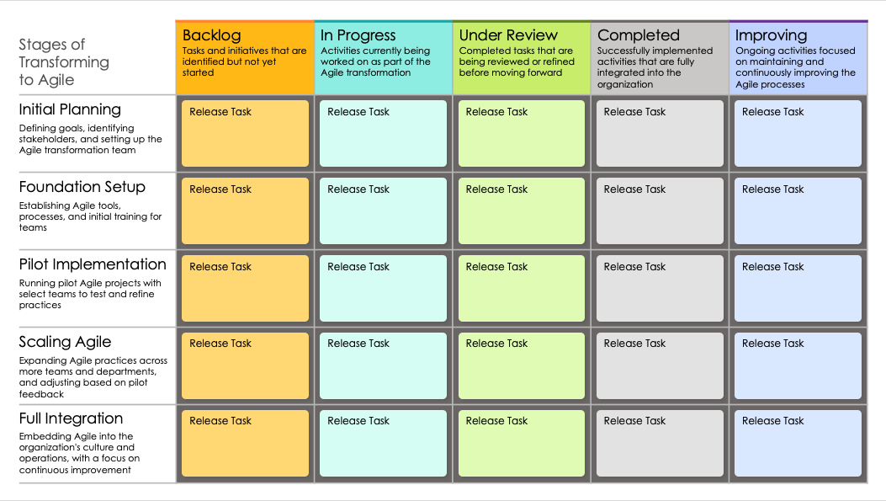
Agile Roadmap Transformation Presentation Template

Slide 2
Stages of Transforming to Agile | Backlog | In Progress | Under Review | Completed | Improving
 | Tasks and initiatives that are identified but not yet started | Activities currently being worked on as part of the Agile transformation | Completed tasks that are being reviewed or refined before moving forward | Successfully implemented activities that are fully integrated into the organization | Ongoing activities focused on maintaining and continuously improving the Agile processes
Initial Planning
Defining goals, identifying stakeholders, and setting up the Agile transformation team
Foundation Setup
Establishing Agile tools, processes, and initial training for teams
Pilot Implementation
Running pilot Agile projects with select teams to test and refine practices
Scaling Agile
Expanding Agile practices across more teams and departments, and adjusting based on pilot feedback
Full Integration
Embedding Agile into the organization's culture and operations, with a focus on continuous improvement
Release Task
Release Task
Release Task
Release Task
Release Task
Release Task
Release Task
Release Task
Release Task
Release Task
Release Task
Release Task
Release Task
Release Task
Release Task
Release Task
Release Task
Release Task
Release Task
Release Task
Release Task
Release Task
Release Task
Release Task
Release Task

Slide 3
DISCLAIMER Any articles, templates, or information provided by Smartsheet on the website are for reference only. While we strive to keep the information up to date and correct, we make no representations or warranties of any kind, express or implied, about the completeness, accuracy, reliability, suitability, or availability with respect to the website or the information, articles, templates, or related graphics contained on the website. Any reliance you place on such information is therefore strictly at your own risk.

