Slide 1


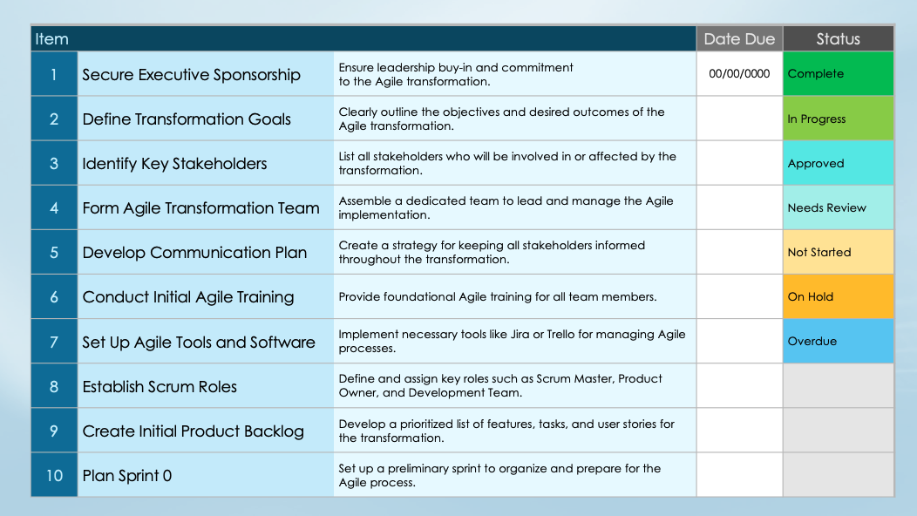
Agile Roadmap Transformation Checklist

Slide 2
Item |  |  | Date Due | Status
1 | Secure Executive Sponsorship | Ensure leadership buy-in and commitment to the Agile transformation. | 00/00/0000 | Complete
2 | Define Transformation Goals | Clearly outline the objectives and desired outcomes of the Agile transformation. |  | In Progress
3 | Identify Key Stakeholders | List all stakeholders who will be involved in or affected by the transformation. |  | Approved
4 | Form Agile Transformation Team | Assemble a dedicated team to lead and manage the Agile implementation. |  | Needs Review
5 | Develop Communication Plan | Create a strategy for keeping all stakeholders informed throughout the transformation. |  | Not Started
6 | Conduct Initial Agile Training | Provide foundational Agile training for all team members. |  | On Hold
7 | Set Up Agile Tools and Software | Implement necessary tools like Jira or Trello for managing Agile processes. |  | Overdue
8 | Establish Scrum Roles | Define and assign key roles such as Scrum Master, Product Owner, and Development Team.
9 | Create Initial Product Backlog | Develop a prioritized list of features, tasks, and user stories for the transformation.
10 | Plan Sprint 0 | Set up a preliminary sprint to organize and prepare for the Agile process.

Slide 3
Item |  |  | Date Due | Status
11 | Launch Pilot Agile Teams | Identify select Agile teams to test and refine practices.
12 | Conduct Sprint Planning Sessions | Organize sessions to plan the work for each sprint within the pilot teams.
13 | Implement Daily Standups | Begin daily Scrum meetings to review progress and address issues.
14 | Run Retrospectives | Review the process after each sprint and make improvements.
15 | Measure Initial Success | Track progress and measure outcomes against the initial goals.
16 | Adjust Agile Processes | Make necessary adjustments based on feedback from the pilot teams.
17 | Scale Agile Practices | Expand Agile to additional teams and departments based on pilot results.
18 | Continue Agile Training | Provide ongoing, advanced training and support as Agile scales.
19 | Integrate Agile with Existing Processes | Align Agile with other methodologies or practices in the organization.
20 | Monitor Team Velocity | Track the pace of work completed during sprints to measure productivity.

Slide 4
Item |  |  | Date Due | Status
21 | Foster Culture of Continuous Improvement | Encourage regular feedback and iterative improvements within teams.
22 | Update Stakeholders Regularly | Keep stakeholders informed of progress, including challenges and successes.
23 | Ensure Compliance and Governance | Align Agile practices with organizational policies and governance standards.
24 | Establish Community | Create forums or groups for sharing Agile knowledge and experiences within the organization.
25 | Review and Update Product Backlog | Regularly refine and reprioritize the backlog as the transformation progresses.
26 | Implement Cross-Functional Collaboration | Encourage collaboration across different teams and departments.
27 | Monitor and Adjust Success Metrics | Continually review and adapt the metrics used to measure success.
28 | Plan for Long-Term Agile Sustainability | Develop strategies for maintaining Agile practices over time.
29 | Conduct Final Review of Transformation | Assess the overall success of the transformation and identify areas for future improvement.
30 | Celebrate Success | Acknowledge the efforts and successes of the teams involved in the Agile transformation.

Slide 5
Notes
Text

Slide 6
DISCLAIMER Any articles, templates, or information provided by Smartsheet on the website are for reference only. While we strive to keep the information up to date and correct, we make no representations or warranties of any kind, express or implied, about the completeness, accuracy, reliability, suitability, or availability with respect to the website or the information, articles, templates, or related graphics contained on the website. Any reliance you place on such information is therefore strictly at your own risk.

