Slide 1



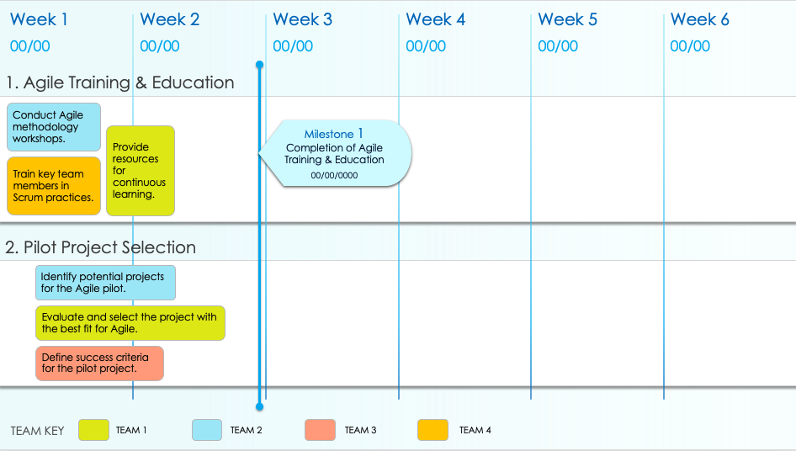
Agile Pilot Implementation Roadmap Template

Slide 2

Week 1
Week 2
Week 3
Week 4
Week 5
Week 6
00/00
00/00
00/00
00/00
00/00
00/00
1. Agile Training & Education
Conduct Agile methodology workshops.
Provide resources for continuous learning.
Milestone 1
Completion of Agile Training & Education
00/00/0000
Train key team members in Scrum practices.
2. Pilot Project Selection
Identify potential projects for the Agile pilot.
Evaluate and select the project with the best fit for Agile.
Define success criteria for the pilot project.
TEAM KEY
TEAM 1
TEAM 2
TEAM 3
TEAM 4

Slide 3
Week 1
Week 2
Week 3
Week 4
Week 5
Week 6
00/00
00/00
00/00
00/00
00/00
00/00
3. Agile Process Setup
Set up Agile tools (e.g., Jira, Trello).
Define roles and responsibilities within the Agile team.
Establish communication channels and Scrum boards.
4. Sprint Execution
Plan and execute Sprint 1.
Conduct Sprint 1 Retrospective and adjust plans.
Milestone 2
Successful Execution of Sprint 1
00/00/0000
Plan and execute Sprint 2.
TEAM KEY
TEAM 1
TEAM 2
TEAM 3
TEAM 4

Slide 4
Week 1
Week 2
Week 3
Week 4
Week 5
Week 6
00/00
00/00
00/00
00/00
00/00
00/00
5. Review & Adaptation
Gather feedback from the pilot team.
Adjust Agile processes based on lessons learned.
Analyze performance against success criteria.
Milestone 3
Final Review & Prep
of Adaptation Plan
00/00/0000
6. Scaling & Integration
Develop a plan to scale Agile practices to other teams.
Integrate Agile with existing processes in the organization.
Prepare for a full-scale Agile implementation.
TEAM KEY
TEAM 1
TEAM 2
TEAM 3
TEAM 4

Slide 5
DISCLAIMER Any articles, templates, or information provided by Smartsheet on the website are for reference only. While we strive to keep the information up to date and correct, we make no representations or warranties of any kind, express or implied, about the completeness, accuracy, reliability, suitability, or availability with respect to the website or the information, articles, templates, or related graphics contained on the website. Any reliance you place on such information is therefore strictly at your own risk.

