Slide 1


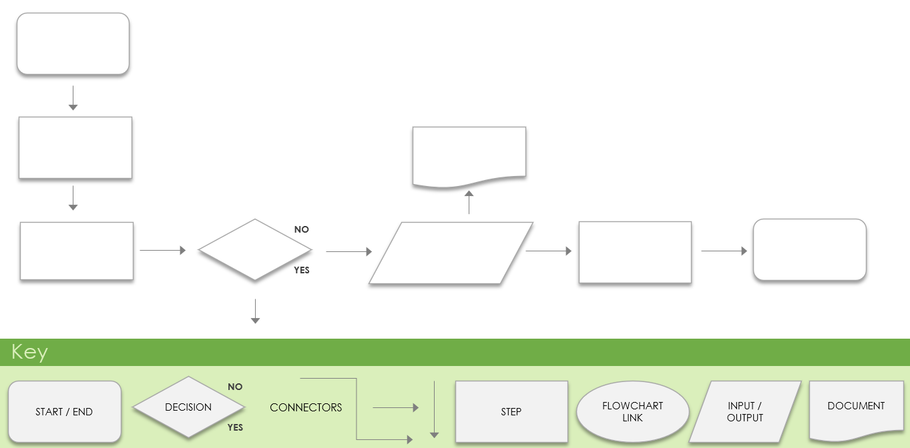
Flowchart Template for Visualizing Current and Future Business Processes
PROCESS NAME | ANALYSIS COMPLETED BY | DEPARTMENT(S) | DATE COMPLETED

Slide 2
Current Process
Lay out your current business process using this flowchart. Use the blank space to brainstorm and visualize how and where this process needs to change. Then use the following flowchart to lay out your ideal future process.
NO
YES
Key
DECISION
START / END
NO
STEP
FLOWCHART LINK
INPUT / OUTPUT
DOCUMENT
CONNECTORS
YES

Slide 3
Future Process
NO
YES
Key
DECISION
START / END
NO
STEP
FLOWCHART LINK
INPUT / OUTPUT
DOCUMENT
CONNECTORS
YES

Slide 4
COPY AND PASTE BLANK ICONS
NO
YES

Slide 5
DISCLAIMER Any articles, templates, or information provided by Smartsheet on the website are for reference only. While we strive to keep the information up to date and correct, we make no representations or warranties of any kind, express or implied, about the completeness, accuracy, reliability, suitability, or availability with respect to the website or the information, articles, templates, or related graphics contained on the website. Any reliance you place on such information is therefore strictly at your own risk.

