Slide 1


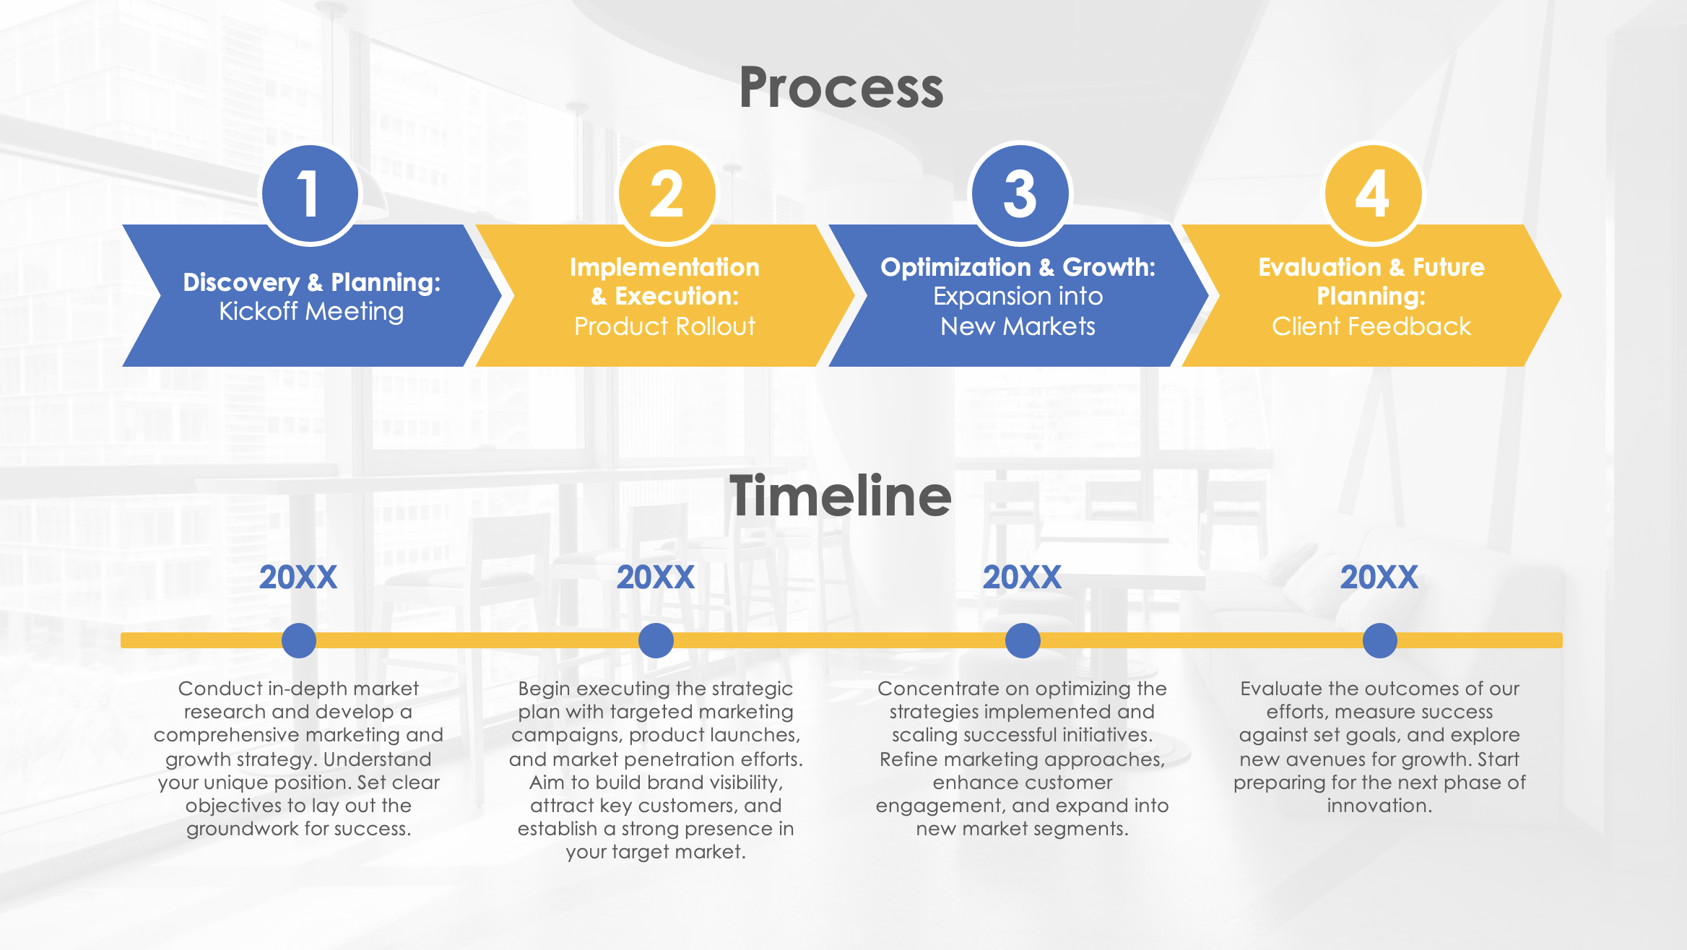
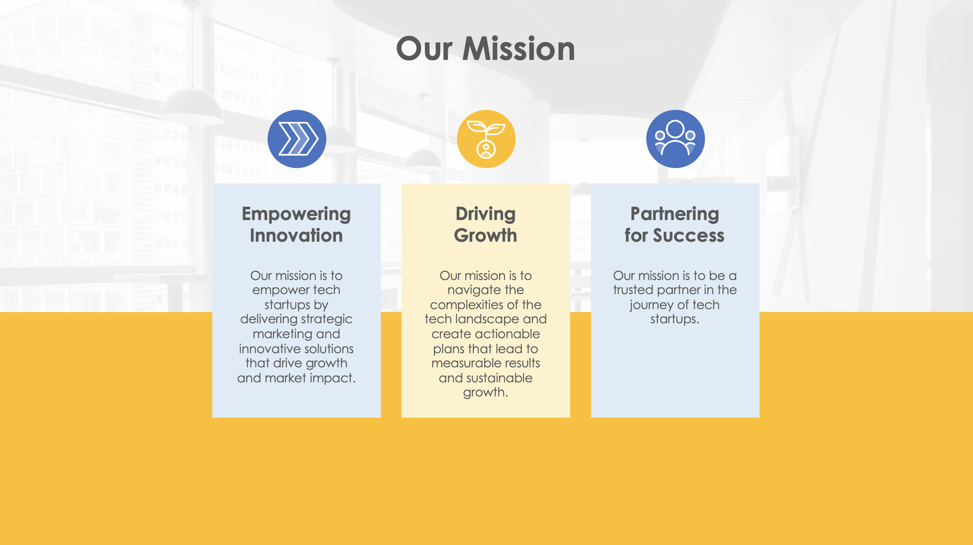

PowerPoint Sample Consulting Proposal Template

Slide 2

Consulting Proposal Template Title
TechSage Consulting
XX.XX.XXXX

Slide 3


What We Heard From You
Project Context
Mid-sized tech startup/s specializing in cybersecurity solutions
Challenges:
  Limited online presence
  Limited engagement with the target audience
Project Objectives
Develop a comprehensive content marketing plan to enhance brand visibility
Create high-quality, SEO-optimized content that addresses industry trends and challenges
Generate a content calendar with blog posts focused on cybersecurity best practices, emerging threats, and case studies

Slide 4
Our Offerings
Content Strategy Development
Craft a tailored content marketing strategy to elevate the brand’s visibility and engagement
Identify key industry topics, set clear content goals, and outline a strategic approach to address audience needs and industry trends
SEO-Optimized Content Creation
Produce high-quality, SEO-optimized content that aligns with current cybersecurity trends and challenges
Craft content to improve search engine rankings, attract target audiences, and establish the client as a thought leader in the cybersecurity space
Content Calendar Management
Develop a comprehensive content calendar featuring blog posts, articles, and case studies on cybersecurity best practices, emerging threats, and real-world case studies
Performance Tracking
Implement tracking mechanisms to measure the effectiveness of the content marketing efforts
Analyze performance data and audience engagement metrics
Provide actionable insights and recommendations

Slide 5





Content Marketing and Support
Content Marketing
Create engaging articles, infographics, and case studies that resonate with IT professionals and decision-makers
White
Papers
Develop white papers that explore critical cybersecurity challenges and solutions
Technical Blogging
Publish regular blog posts focused on the latest cybersecurity threats, trends, and technologies
Keyword Research
Conduct in-depth keyword research to pinpoint the terms and phrases that your target audience uses when searching for cybersecurity solutions
Social Media Marketing
Craft targeted posts and analyze engagement metrics to boost your visibility and build relationships with potential clients and industry influencers

Slide 6
Project Cost Breakdown
No. | Description of Work | Anticipated Cost
01 | Create a comprehensive content marketing plan, including topic ideation and distribution channels | $2,500
02 | Research, write, and design a detailed white paper on a key cybersecurity topic | $3,000
03 | Write and publish four blog posts per month on cybersecurity trends and best practices | $1,200
04 | Conduct keyword research and optimize existing content for better search engine rankings | $1,000
05 | Develop and manage social media content, including posts and interactions, across key platforms | $1,500
06 | Track and analyze performance metrics for content marketing, blogging, and social media efforts | $1,000
TOTAL COST |  | $10,200

Slide 7









Typical Collaboration Areas
Sample text
Sample text
Sample text
Sample text
Sample text
Sample text
Sample text
Sample text
Sample text

Slide 8



A Proven Record of Success
TechSage Consulting transformed our tech startup's approach to market entry. Their strategic insights and tailored marketing strategies helped us gain significant traction in a competitive industry. We couldn’t have achieved this level of success without their expertise.
Brent Williams
CEO of InnovateTech
TechSage's guidance was instrumental in refining our brand strategy and boosting our market presence. Their professional approach and actionable recommendations delivered results beyond our expectations.
Hilda Wilson
CMO of QuantumLeap
From strategy development to execution, TechSage delivered exceptional results. Their team’s commitment to understanding our unique challenges and opportunities helped us navigate the complexities of scaling our startup effectively.
Kirk Caskey
Co-Founder of ByteShift

Slide 9
Market Potential
XX%
XX%
XX%
Market Penetration
Sample text
User Engagement
Sample text
Product Adoption
Sample text

Slide 10



TechSage Consulting elevates tech startups with tailored marketing and strategic solutions. We leverage market insights and innovative strategies to boost market share, enhance brand visibility, and drive growth. By focusing on emerging trends and untapped segments, we craft actionable plans that deliver measurable results. TechSage is your trusted partner in navigating the tech landscape and achieving sustainable success.
Our Team
Carmen Robertson
Senior Marketing Strategist
Carmen excels in identifying market opportunities and crafting targeted campaigns that resonate with tech startup audiences.
Romy Bailey
Tech Solutions Architect
Romy's expertise lies in integrating innovative technologies to optimize business operations and solve complex challenges.
Sarah Goodwin
Client Success Manager
Sarah excels in understanding client needs, managing project deliverables, and ensuring successful outcomes.

Slide 11



Our Mission
Empowering Innovation
Our mission is to empower tech startups by delivering strategic marketing and innovative solutions that drive growth and market impact.
Driving Growth
Our mission is to navigate the complexities of the tech landscape and create actionable plans that lead to measurable results and sustainable growth.
Partnering
for Success
Our mission is to be a trusted partner in the journey of tech startups.

Slide 12

Location
Location
Location
Location

Slide 13
Process
1
2
3
4
Discovery & Planning:
Kickoff Meeting
Implementation
& Execution:
Product Rollout
Optimization & Growth:
Expansion into
New Markets
Evaluation & Future Planning:
Client Feedback
Timeline
20XX
20XX
20XX
20XX
Conduct in-depth market research and develop a comprehensive marketing and growth strategy. Understand your unique position. Set clear objectives to lay out the groundwork for success.
Begin executing the strategic plan with targeted marketing campaigns, product launches, and market penetration efforts. Aim to build brand visibility, attract key customers, and establish a strong presence in your target market.
Concentrate on optimizing the strategies implemented and scaling successful initiatives. Refine marketing approaches, enhance customer engagement, and expand into new market segments.
Evaluate the outcomes of our efforts, measure success against set goals, and explore new avenues for growth. Start preparing for the next phase of innovation.

Slide 14
Chart Title
XX
XX
XX
XX
XX
XX
Category 1
Category 2
Category 3

Slide 15

Mockup Title

Slide 16

Thank You

Slide 17
Consulting Proposal Template Title
Company Name
XX.XX.XXXX

Slide 18
What We Heard From You
Project Context
Sample text
Sample text
Sample text
Sample text
Sample text
Sample text
Project Objectives
Sample text
Sample text
Sample text
Sample text
Sample text
Sample text

Slide 19
Our Offerings
Content Strategy Development
Sample text
Sample text
Sample text
SEO-Optimized Content Creation
Sample text
Sample text
Sample text
Content Calendar Management
Sample text
Sample text
Sample text
Performance Tracking
Sample text
Sample text
Sample text

Slide 20
Content Marketing and Support
Content Marketing
Sample text
White
Papers
Sample text
Technical Blogging
Sample text
Keyword Research
Sample text
Social Media Marketing
Sample text

Slide 21
Project Cost Breakdown
No. | Description of Work | Anticipated Cost
01 | Sample text | $X,XXX
02 | Sample text | $X,XXX
03 | Sample text | $X,XXX
04 | Sample text | $X,XXX
05 | Sample text | $X,XXX
06 | Sample text | $X,XXX
TOTAL COST |  | $XX,XXX

Slide 22
Typical Collaboration Areas
Sample text
Sample text
Sample text
Sample text
Sample text
Sample text
Sample text
Sample text
Sample text

Slide 23
A Proven Record of Success
Sample quote text.
Name
Company
Sample quote text.
Name
Company
Sample quote text.
Name
Company

Slide 24
Market Potential
XX%
XX%
XX%
Market Penetration
Sample text
User Engagement
Sample text
Product Adoption
Sample text

Slide 25
Sample company bio text.
Our Team
Name
Position Title
Sample background text.
Name
Position Title
Sample background text
Name
Position Title
Sample background text

Slide 26
Our Mission
Empowering Innovation
Sample text
Driving Growth
Sample text
Partnering
for Success
Sample text

Slide 27
Location
Location
Location
Location

Slide 28
Process
1
2
3
4
Sample Step:
Sample text
Sample Step:
Sample text
Sample Step:
Sample text
Sample Step:
Sample text
Timeline
20XX
20XX
20XX
20XX
Sample text
Sample text
Sample text
Sample text

Slide 29
Chart Title
XX
XX
XX
XX
XX
XX
Category 1
Category 2
Category 3

Slide 30
Mockup Title

Slide 31
Thank You

Slide 32
DISCLAIMER Any articles, templates, or information provided by Smartsheet on the website are for reference only. While we strive to keep the information up to date and correct, we make no representations or warranties of any kind, express or implied, about the completeness, accuracy, reliability, suitability, or availability with respect to the website or the information, articles, templates, or related graphics contained on the website. Any reliance you place on such information is therefore strictly at your own risk.

