Slide 1
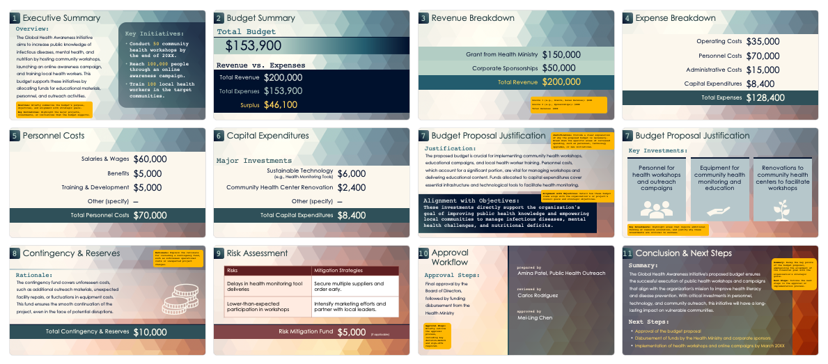
Budget Proposal Presentation Template
Example

Slide 2
Budget Proposal
for Global Health Awareness Initiative
Fiscal Year 20XX
date prepared
prepared by
February 15, 20XX
Aviv Perez, Public Health Outreach

Slide 3
1
Executive Summary
7
Budget Proposal Justification
2
Budget Summary
8
Contingency & Reserves
3
Revenue Breakdown
9
Risk Assessment
4
Expense Breakdown
10
Approval Workflow
5
Personnel Costs
11
Conclusion & Next Steps
6
Capital Expenditures

Slide 4
1
Executive Summary
Overview:
Key Initiatives:
The Global Health Awareness Initiative aims to increase public knowledge of infectious diseases, mental health, and nutrition by hosting community workshops, launching an online awareness campaign, and training local health workers. This budget supports these initiatives by allocating funds for educational materials, personnel, and outreach activities.
Conduct 50 community health workshops by the end of 20XX.
Reach 100,000 people through an online awareness campaign.
Train 100 local health workers in the target communities.
Overview: Briefly summarize the budget’s purpose, objectives, and alignment with strategic goals.
Key Initiatives: Highlight the major projects, investments, or initiatives the budget supports.

Slide 5
2
Budget Summary
Total Budget:
$153,900
Revenue vs. Expenses
Total Revenue | $200,000
Total Expenses | $153,900
Surplus | $46,100

Slide 6
3
Revenue Breakdown
Grant from Health Ministry | $150,000
Corporate Sponsorships | $50,000
Total Revenue | $200,000
Source 1 (e.g., Grants, Sales Revenue): $XXX
Source 2 (e.g., Sponsorships): $XXX
Total Revenue: $XXX

Slide 7
4
Expense Breakdown
Operating Costs | $35,000
Personnel Costs | $70,000
Administrative Costs | $15,000
Capital Expenditures | $8,400
Total Expenses | $128,400

Slide 8
5
Personnel Costs
Salaries & Wages | $60,000
Benefits | $5,000
Training & Development | $5,000
Other (specify) | –
Total Personnel Costs | $70,000

Slide 9
6
Capital Expenditures
Major Investments:
Sustainable Technology (e.g., Health Monitoring Tools) | $6,000
Community Health Center Renovation | $2,400
Other (specify) | –
Total Capital Expenditures | $8,400

Slide 10
7
Budget Proposal Justification
Justification: Provide a clear explanation of why the proposed budget is necessary. Break down the specific areas of increased spending, such as personnel, technology upgrades, or new initiatives.
Justification:
The proposed budget is crucial for implementing community health workshops, educational campaigns, and local health worker training. Personnel costs, which account for a significant portion, are vital for managing workshops and delivering educational content. Funds allocated to capital expenditures cover essential infrastructure and technological tools to facilitate health monitoring.
Alignment with Objectives: Detail how these budget items align with the organization's or project's overall goals and strategic objectives.
Alignment with Objectives:
These investments directly support the organization's goal of improving public health knowledge and empowering local communities to manage infectious diseases, mental health challenges, and nutritional deficits.

Slide 11
7
Budget Proposal Justification
Key Investments:
Personnel for
health workshops and outreach campaigns
Equipment for community health monitoring and education
Renovations to community health centers to facilitate workshops
Key Investments: Highlight areas that require additional funding or resource allocation and justify why these investments are critical to success.

Slide 12
8
Contingency & Reserves
Rationale: Explain the rationale for including a contingency fund, such as unforeseen operational costs or unexpected project changes.
Rationale:
The contingency fund covers unforeseen costs, such as additional outreach materials, unexpected facility repairs, or fluctuations in equipment costs. This fund ensures the smooth continuation of the project, even in the face of potential disruptions.
Total Contingency & Reserves | $10,000

Slide 13
9
Risk Assessment
Risks | Mitigation Strategies
Delays in health monitoring tool deliveries | Secure multiple suppliers and order early
Lower-than-expected participation in workshops | Intensify marketing efforts and partner with local leaders
Risk Mitigation Fund | $5,000 (if applicable)

Slide 14
10
Approval Workflow
prepared by
Approval Steps:
Aviv Perez, Public Health Outreach
Final approval by the Board of Directors, followed by funding disbursement from the Health Ministry
reviewed by
Devon Gomez
approved by
Marta Hicks
Approval Steps: Briefly outline the approval process, including key decision-makers and sign-offs required.

Slide 15
11
Conclusion & Next Steps
Summary: Recap the key points of the budget proposal, emphasizing the alignment of the financial plan with the organization's strategic goals.
Next Steps: Outline the next steps in the approval or implementation process.
Summary:
The Global Health Awareness Initiative's proposed budget ensures the successful execution of public health workshops and campaigns that align with the organization's mission to improve health literacy and disease prevention. With critical investments in personnel, technology, and community outreach, this initiative will have a long-lasting impact on vulnerable communities.
Next Steps:
Approval of the budget proposal
Disbursement of funds by the Health Ministry and corporate sponsors
Implementation of health workshops and online campaigns by March 20XX

Slide 16
DISCLAIMER Any articles, templates, or information provided by Smartsheet on the website are for reference only. While we strive to keep the information up to date and correct, we make no representations or warranties of any kind, express or implied, about the completeness, accuracy, reliability, suitability, or availability with respect to the website or the information, articles, templates, or related graphics contained on the website. Any reliance you place on such information is therefore strictly at your own risk.

