Slide 1


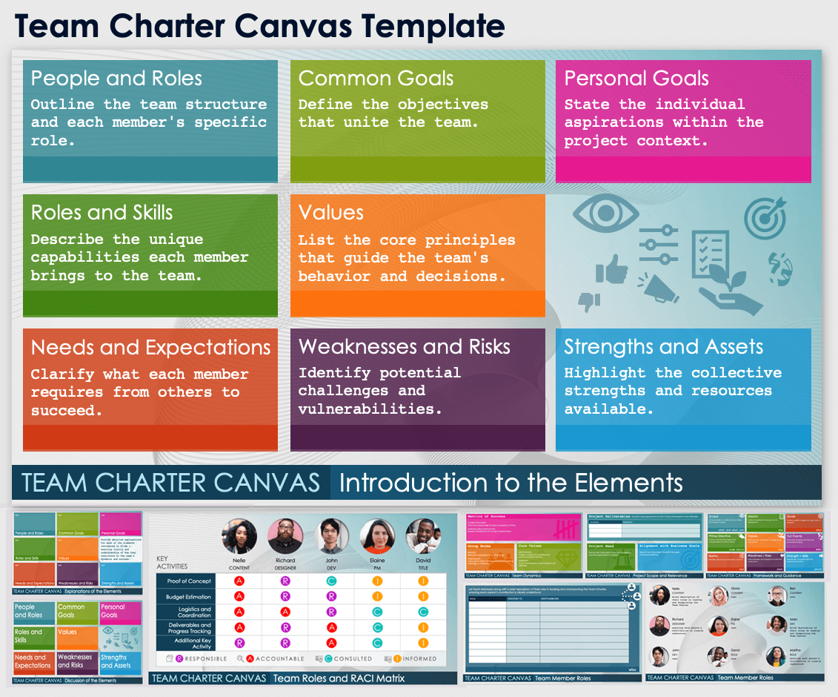
Team Charter Canvas Template
When to Use This Template:
Use this template to collaboratively define and visualize team roles, objectives, and operational strategies in a single, comprehensive view. This template is ideal for team workshops and strategic planning sessions.
Notable Template Features:
Featuring an intuitive canvas layout, this template enables teams to map out purpose, roles, key stakeholders, measures for success, and risk management, fostering engagement and ensuring all team members have a clear, shared understanding of the project’s goals and processes.

Slide 2








People and Roles
Common Goals
Personal Goals
Outline the team structure and each member's specific role.
Define the objectives that unite the team.
State the individual aspirations within the project context.
Roles and Skills
Values
Describe the unique capabilities each member brings to the team.
List the core principles that guide the team's behavior and decisions.
Needs and Expectations
Weaknesses and Risks
Strengths and Assets
Clarify what each member requires from others to succeed.
Identify potential challenges and vulnerabilities.
Highlight the collective strengths and resources available.
TEAM CHARTER CANVAS
Introduction to the Elements

Slide 3
text
text
text
People and Roles
Common Goals
Personal Goals
text
text
Provide detailed explanations for each of the elements introduced in Slide 1, ensuring clarity and understanding of how they contribute to the team's dynamics and success.
Roles and Skills
Values
text
text
text
Needs and Expectations
Weaknesses and Risks
Strengths and Assets
TEAM CHARTER CANVAS
Explanations of the Elements

Slide 4
People and Roles
Common Goals
Personal Goals
Roles and Skills
Values
Needs and Expectations
Weaknesses and Risks
Strengths and Assets
TEAM CHARTER CANVAS
Discussion of the Elements

Slide 5

















KEY
ACTIVITIES
Nelle Porter
CONTENT
Richard Fish
TITLE
John Cage
TITLE
Elaine Vassal
TITLE
David Kelley
TITLE
Proof of Concept
Budget Estimation
Logistics and Coordination
Deliverables and Progress Tracking
Additional Key Activity
RESPONSIBLE
ACCOUNTABLE
CONSULTED
INFORMED
TEAM CHARTER CANVAS
Team Roles and RACI Matrix

Slide 6



Metrics of Success
COMPLETION RATE:
Track the percentage of tasks completed on time.
STAKEHOLDER SATISFACTION:
Measure feedback from project stakeholders.
Group Norms
Core Values
RESPECT:
Maintain a respectful tone at all times.
PUNCTUALITY:
Value each other’s time by starting and ending meetings on schedule.
INNOVATION:
Foster a culture of creativity and continuous improvement.
INTEGRITY:
Ensure transparency and honesty in all dealings.
TEAM CHARTER CANVAS
Team Dynamics

Slide 7


Project Deliverables
List specific outputs expected from the team. Provide a brief description of each deliverable.
DELIVERABLE | DESCRIPTION
Project Need
Alignment with Business Goals
Discuss why this project is crucial, its urgency, and the implications of inaction.
Explain how the project fits within broader company initiatives.
TEAM CHARTER CANVAS
Project Scope and Relevance

Slide 8








Scope
Mission
Goals
Set boundaries to clarify what is outside the project’s scope.
Define the project's purpose and its significance.
Outline specific targets the team aims to achieve.
what and what not
why
what
Prime Directive
Values
Fun Events
Create a motivating slogan that encapsulates the team's ethos.
Reinforce the values that underpin team interactions.
Plan team-building activities that enhance bonding.
team motto
how
WOW!
Norms
Weakness / Risks
Strength + Skills
Establish rules that govern team conduct.
Acknowledge and prepare for potential weak spots.
Identify key competencies that empower the team.
how
what
which
TEAM CHARTER CANVAS
Framework and Guidance

Slide 9
List Team Members along with a brief description of their roles in leading and championing the Team Charter, ensuring each person’s contribution is clearly understood.
ROLE | ASSIGNED TO | RESPONSIBILITIES
who
TEAM CHARTER CANVAS
Team Member Roles

Slide 10




Nelle
Gloria
Ben
CONTENT
ROLE
ROLE
brief description of their role
text
text
Richard
Elaine
Marc
ROLE
ROLE
ROLE
text
text
text
John
David
Martha
ROLE
ROLE
ROLE
text
text
text
TEAM CHARTER CANVAS
Team Member Roles

Slide 11
DISCLAIMER Any articles, templates, or information provided by Smartsheet on the website are for reference only. While we strive to keep the information up to date and correct, we make no representations or warranties of any kind, express or implied, about the completeness, accuracy, reliability, suitability, or availability with respect to the website or the information, articles, templates, or related graphics contained on the website. Any reliance you place on such information is therefore strictly at your own risk.

