Slide 1
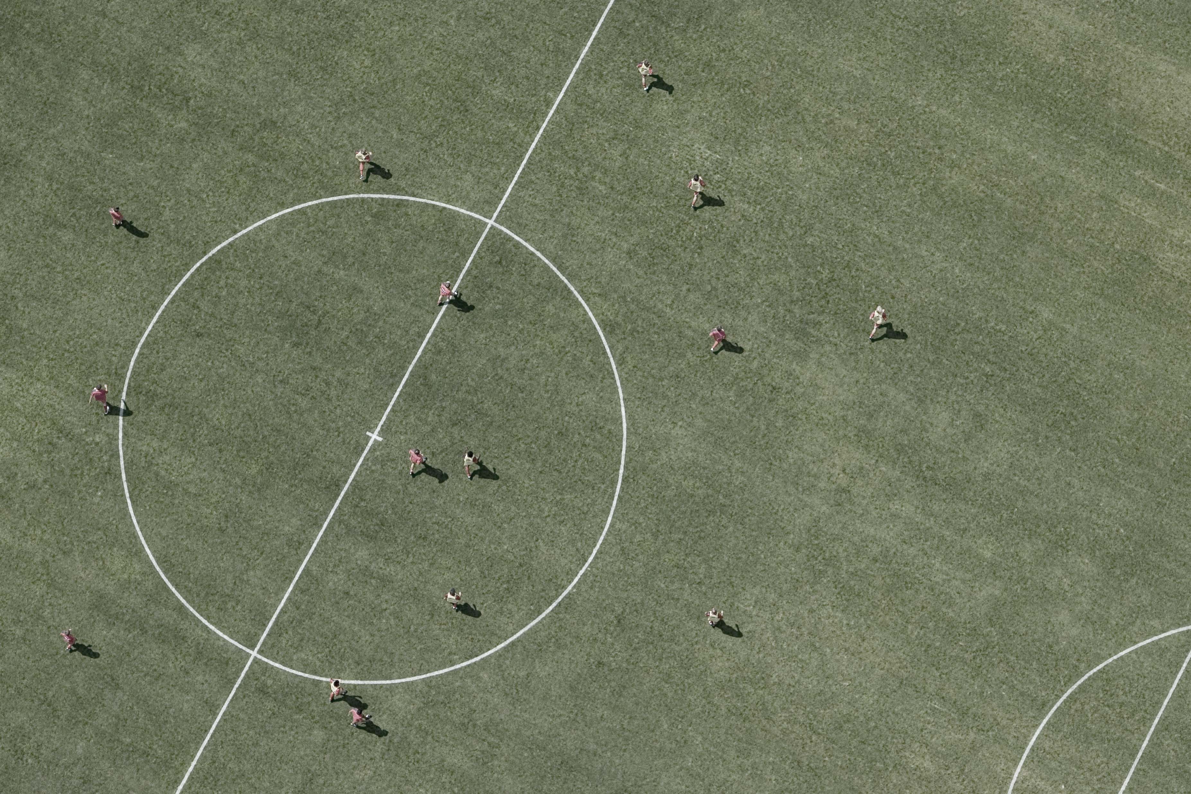


Sports Event Proposal Presentation Template Example
Soccer Academy Event Proposal
Youth Soccer Skills Camp
Event Date: July 15-20, 20XX
Event Location: Greenfield Sports Complex
Organization: Greenfield Soccer Academy
GREENFIELD SOCCER ACADEMY
Replace with image related to your event.

Slide 2

CONTENTS
1
EVENT OVERVIEW
5
SPONSORSHIP OPPORTUNITIES (Optional depending on audience)
2
EVENT DETAILS
6
LOGISTICS AND PLANNING
7
BUDGET AND FINANCIALS
3
EVENT HIGHLIGHTS
4
MARKETING AND PROMOTION
8
RISK MANAGEMENT
9
CONCLUSION AND CALL TO ACTION

Slide 3


1. EVENT OVERVIEW
Event Name: Greenfield Soccer Academy Youth Skills Camp
Purpose: To develop soccer skills and promote physical fitness among youth participants.
Objectives:
Enhance soccer techniques and game understanding
Promote teamwork and sportsmanship
Provide a fun and engaging environment for young athletes
Tagline: "Kick, Learn, Grow"

Slide 4
2. EVENT DETAILS
Date and Time: July 15-20, 20XX | 9:00 AM - 4:00 PM
Venue: Greenfield Sports Complex, 123 Soccer Lane, Greenfield
Participants: Boys and girls aged 8-16
Event Schedule:
Day 1: Registration, Orientation, Basic Drills
Day 2: Passing and Dribbling Skills
Day 3: Shooting Techniques and Defense Strategies
Day 4: Teamwork Exercises and Mini-Games
Day 5: Advanced Skills and Strategy Sessions
Day 6: Final Tournament and Award Ceremony

Slide 5

3. EVENT HIGHLIGHTS
Key Attractions:
Special guest appearances by professional soccer players
Personalized coaching from certified trainers
Fun activities including skill challenges and friendly matches
Unique Selling Points:
Comprehensive training program tailored to different skill levels
Focus on both physical and mental aspects of soccer
Opportunity to be scouted for local youth leagues
Past Successes: Last year's camp saw a 95% satisfaction rate from participants and parents.

Slide 6

4. MARKETING AND PROMOTION
MARKETING PLAN | ● Social media campaigns on Facebook, Instagram, and Twitter ● Email newsletters to local schools and soccer clubs ● Flyers and posters distributed in community centers
CHANNELS | ● Social Media: Facebook, Instagram, Twitter ● Email: Weekly newsletters and updates ● Print Media: Local newspapers and community bulletin boards
PARTNERSHIPS | Collaboration with local sports stores and community organizations
PROMOTIONAL ACTIVITIES | ● Early bird discounts ● Referral programs ● Free merchandise for the first 50 registrants

Slide 7
5. SPONSORSHIP OPPORTUNITIES (Optional depending on audience)
SPONSORSHIP TIERS | Gold Sponsor: $5,000 (Logo on all promotional materials, banner at the event, VIP passes) Silver Sponsor: $2,500 (Logo on promotional materials, booth at the event) Bronze Sponsor: $1,000 (Logo on event program, mention in thank-you email)
BENEFITS | ● Increased brand visibility ● Community engagement ● Positive association with youth sports and healthy lifestyles
EXPOSURE | ● Logos on jerseys, banners, and promotional materials ● Mentions in social media posts and press releases
CONTACT INFORMATION | Contact Lori Garcia for sponsorship inquiries at 123-456-7890.

Slide 8

6. LOGISTICS AND PLANNING
EVENT TEAM | ● Event Manager: Jane B. ● Head Coach: Mike J. ● Logistics Coordinator: Sarah L. ● Marketing Lead: Emily D.
LOGISTICS PLAN | Transportation: Shuttle services from key locations Accommodations: Partnership with local hotels for discounted rates Security: Professional security personnel on-site
PERMITS AND LICENSES | All necessary permits for the venue and activities have been secured.
SAFETY MEASURES | First aid stations, hydration points, and emergency protocols in place.

Slide 9

7. BUDGET AND FINANCIALS
BUDGET OVERVIEW | Total Budget: $30,000
INCOME SOURCES | ● Registration Fees: $15,000 ● Sponsorships: $10,000 ● Merchandise Sales: $5,000
EXPENSES | ● Venue Rental: $5,000 ● Equipment and Supplies: $7,000 ● Marketing and Promotion: $3,000 ● Staff Salaries: $10,000 ● Miscellaneous: $5,000
FINANCIAL PROJECTIONS | ● Projected profit: $5,000 after all expenses.

Slide 10

8. RISK MANAGEMENT
RISK ASSESSMENT | MITIGATION STRATEGIES | CONTINGENCY PLANS
Weather-related disruptions Injuries or medical emergencies Low participant turnout | Backup indoor venues On-site medical staff Extensive marketing to boost registrations | Rain dates for outdoor activities Insurance coverage for accidents Flexible refund policies

Slide 11
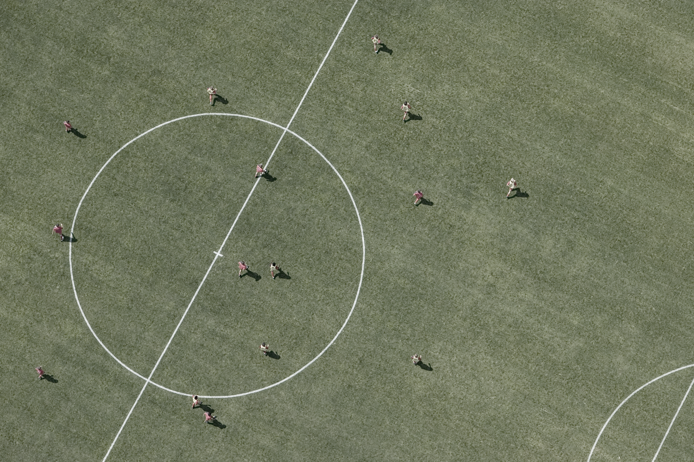

9. CONCLUSION AND CALL TO ACTION
Summary: The Greenfield Soccer Academy Youth Skills Camp is an excellent opportunity for young athletes to develop their skills, make new friends, and enjoy the sport of soccer in a supportive environment.
Call to Action: Join us in making this event a success! Register your child today or become a sponsor and support our community's youth.
GREENFIELD SOCCER ACADEMY
SOCCER ACADEMY EVENT PROPOSAL
Youth Soccer Skills Camp

Slide 12
DISCLAIMER Any articles, templates, or information provided by Smartsheet on the website are for reference only. While we strive to keep the information up to date and correct, we make no representations or warranties of any kind, express or implied, about the completeness, accuracy, reliability, suitability, or availability with respect to the website or the information, articles, templates, or related graphics contained on the website. Any reliance you place on such information is therefore strictly at your own risk.

